Slide 1


Slide 2
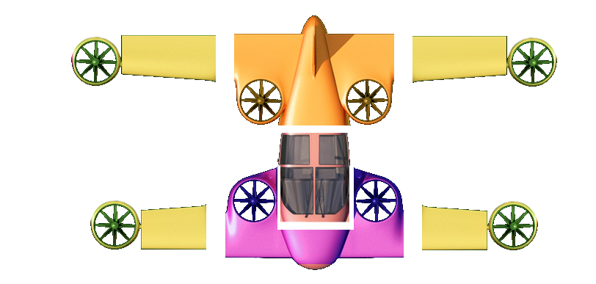
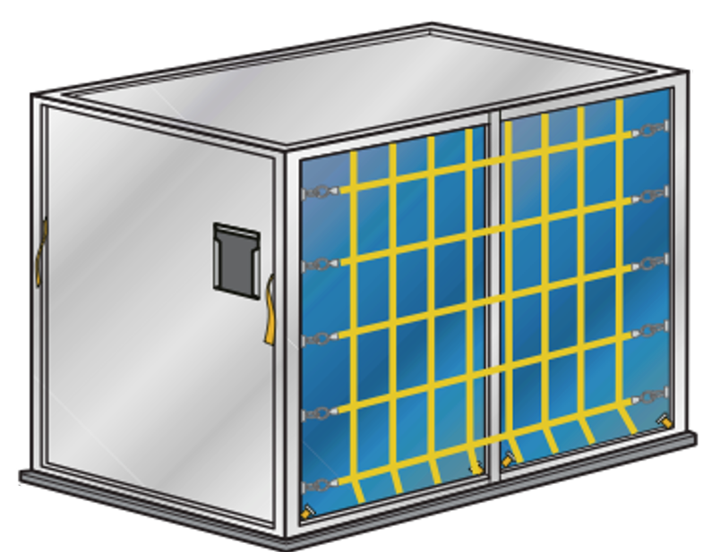
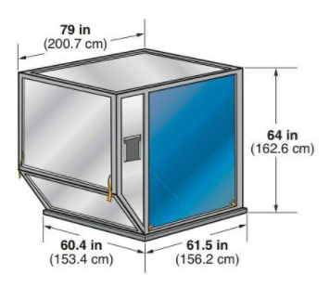
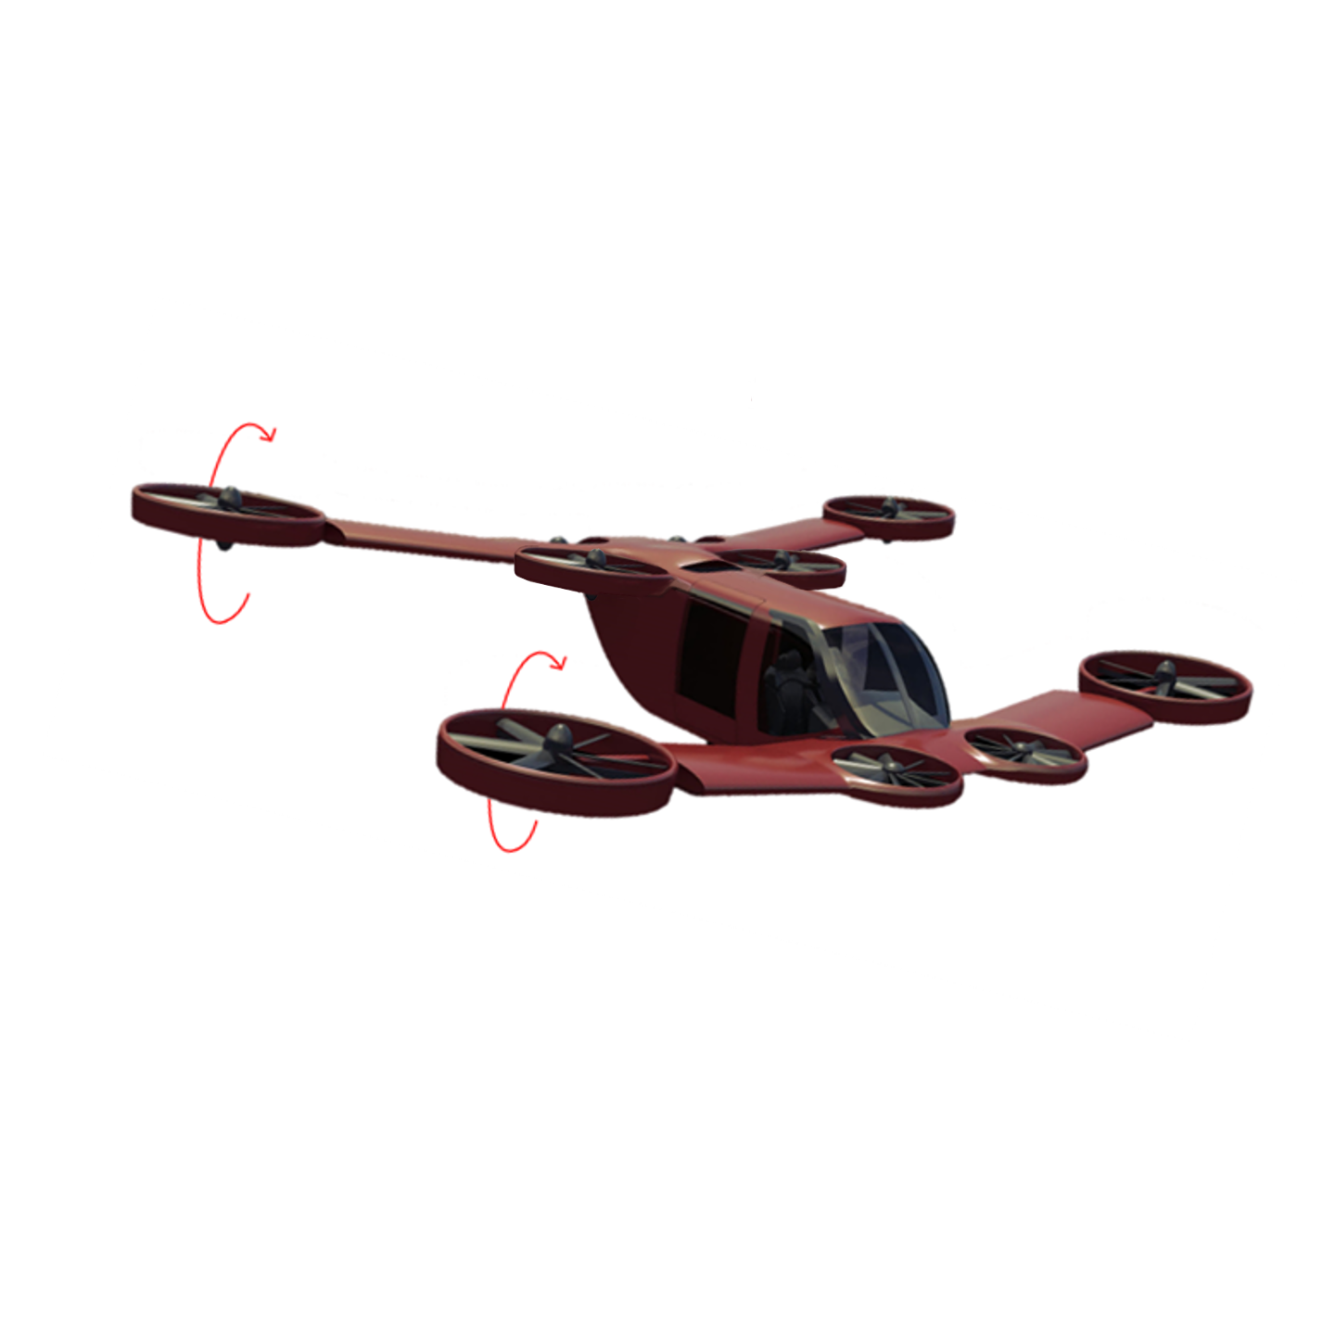
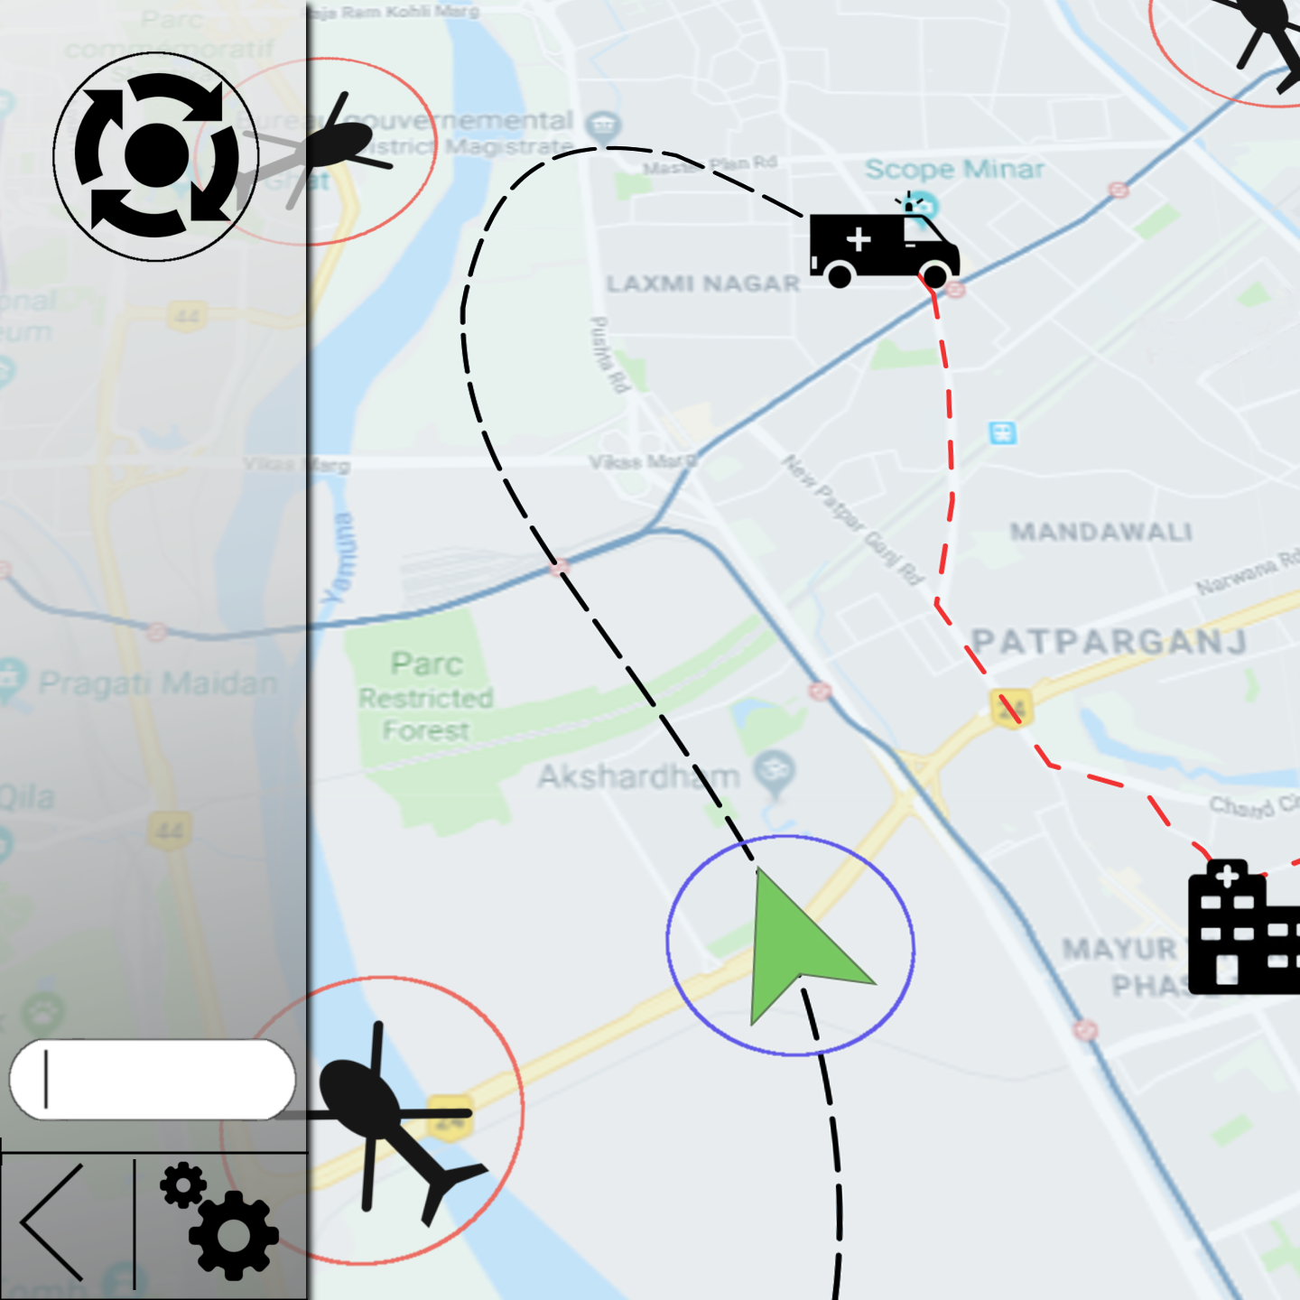
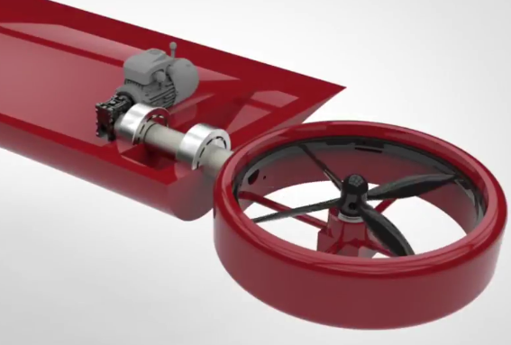
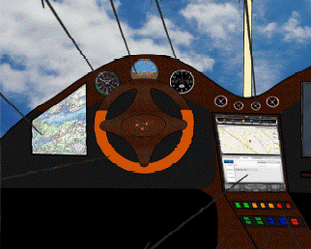
Product : Mini-Bee Hybrid VTOL
Hybrid power security
Modular & ULD conception
Specifications
Capacity: 2 crew
1 patient
MTOW 1200Kg
Payload: 350kg
Range: 500km
Cruise speed: 250km/h
Max. speed: 300km/h
Low cost structure
Flight Path Management
Driving experience
Drive your aircraft !
VTOL Aircraft
(6 rotors + 4 tilt rotors)
Short Wings
for longer range

Slide 3
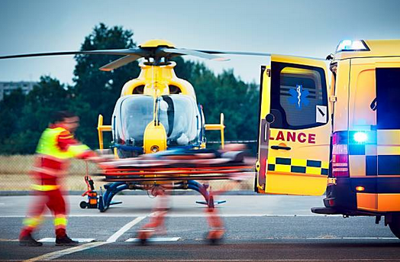
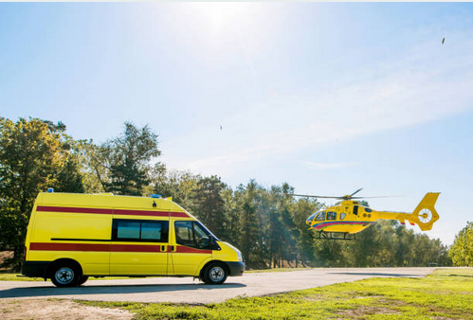
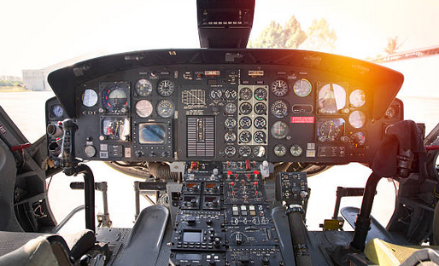
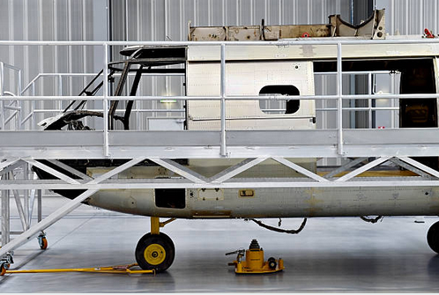

Market : HEMS
Helicopter Emergency Medical Services
Key strenghts of HEMS
Gives a medical response to crisis and medical emergencies
Provides territorial grid for medical interventions
Primary Missions
Bring a medical support as close and quick as possible to the patient
Transport a stabilized patient to the nearest specialized hospital
Secondary Missions
Urgent transfert of a patient from a hospital to another
Limits and pain points
Operations Management
Pilot & Doctor’s Training
Operational Disponibility
Operational and purchasing Costs

Slide 4
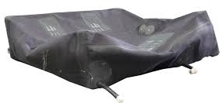
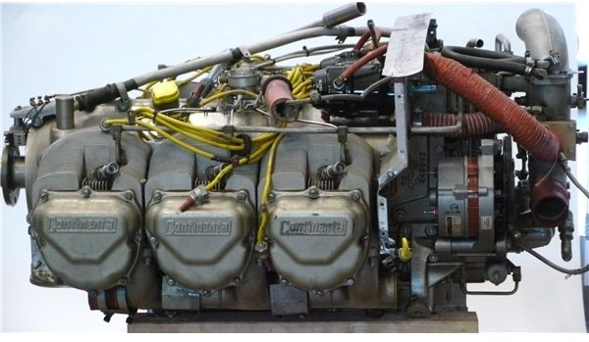
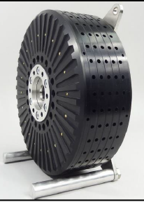
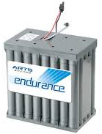
Hybrid Powered solution
Basic flight path
Cruise speed : 260km/h
Range : 450 km
Duration : 1h45
MTOW : 1200kg
Climbing angle: 10°
Altitude: 1500m
Max power 250 kW
Cruise flight : 90% of energy
Fuel consumption : 150kg
Single Piston engine with battery back-up
10 three-phase
electric engines (40Kw)
Fuel tank
Piston Engine
Theree-phase Alternator
Battery back-up
200L
Continental 550 series
Lycoming O-540 series
Including 4 external tiltable engines

Slide 5
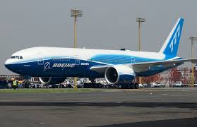
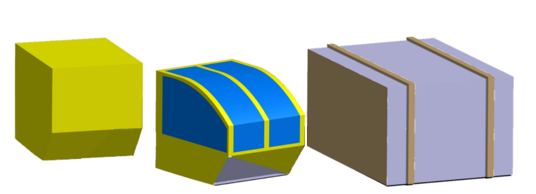
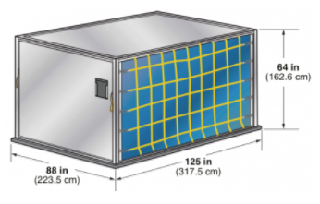
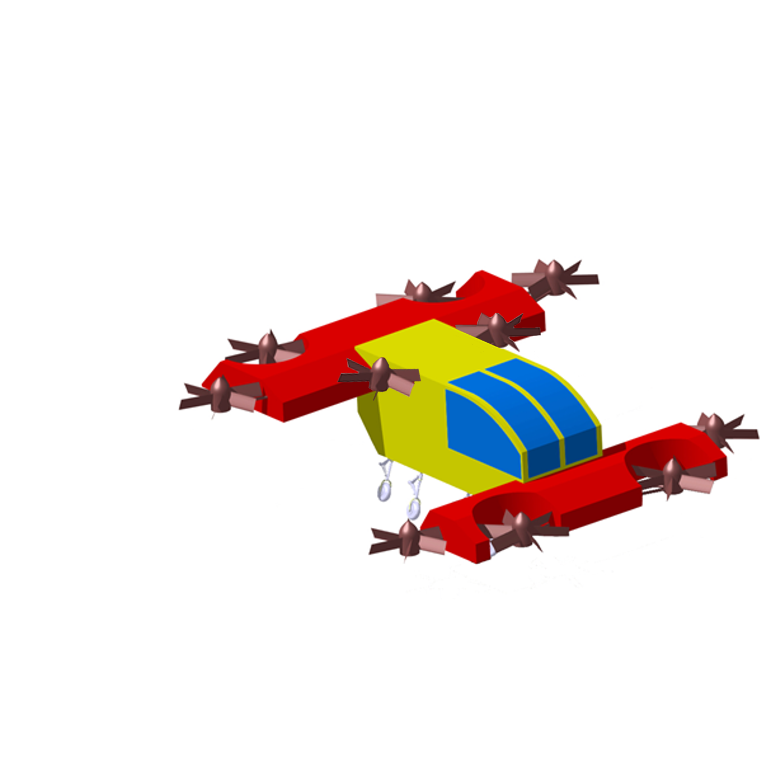
Product : Mini-Bee Hybrid VTOL
Mini-Bee modular deployment
Mini-Bee can be loaded onto civilian aircrafts cargo soute
LD9: Wings/Rotors transportation
LD3: Cockpit/Generator
Mini-Bee can be easily mounted on tarmac
First air vehicule to be loaded into a civilian aircraft cargo soute without rotor assembly
5

Slide 6
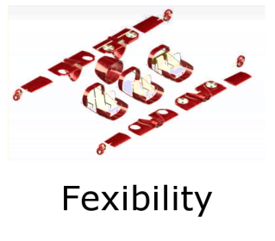
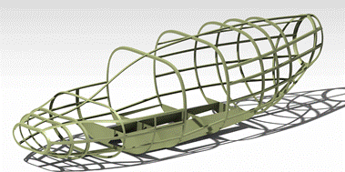

Product : Mini-Bee Hybrid VTOL
Limits and pain points
Operations Management
Pilot & Doctor’s Training
Operational Disponibility
Operational and purchasing Costs
Decision making and navigation support through flight path management solutions
Intuitive use through redesigned IHM and driving experience
MRO does not restrain the Mini-Bee to the ground thanks to evolutive and modular design
Low-Cost and light structure reduce the acquisition and operational costs
Reduced preparation time.
Find the flight path to waypoints and consider actual air traffic
Increase flexibility on the mission through new touchdown areas or rendezvous points
Intuitive control
User friendly interfaces to shorten initial formation and increase medical time
Modules can easily be supplied by ULD or container to maintain disponibility
Each module can be monitored seperatly from the aircraft
Low-Cost modules
High autonomy to decrease the training costs and operational costs

Slide 7
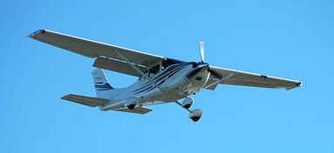
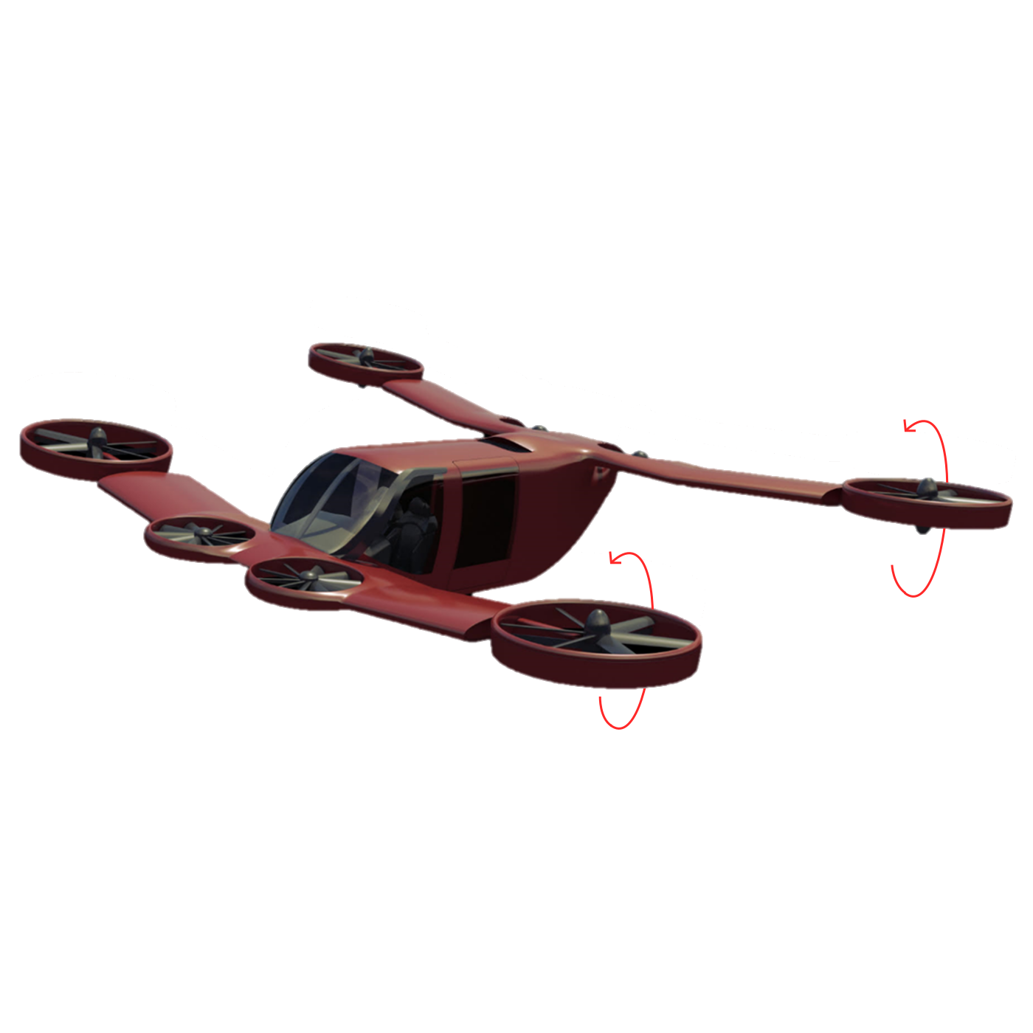
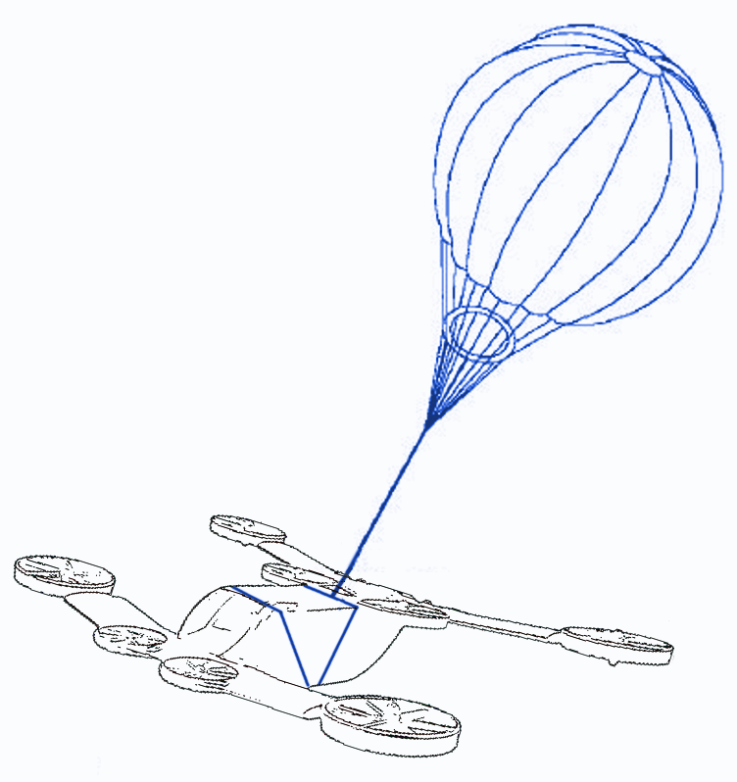
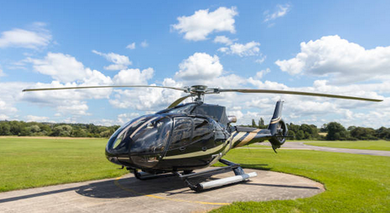
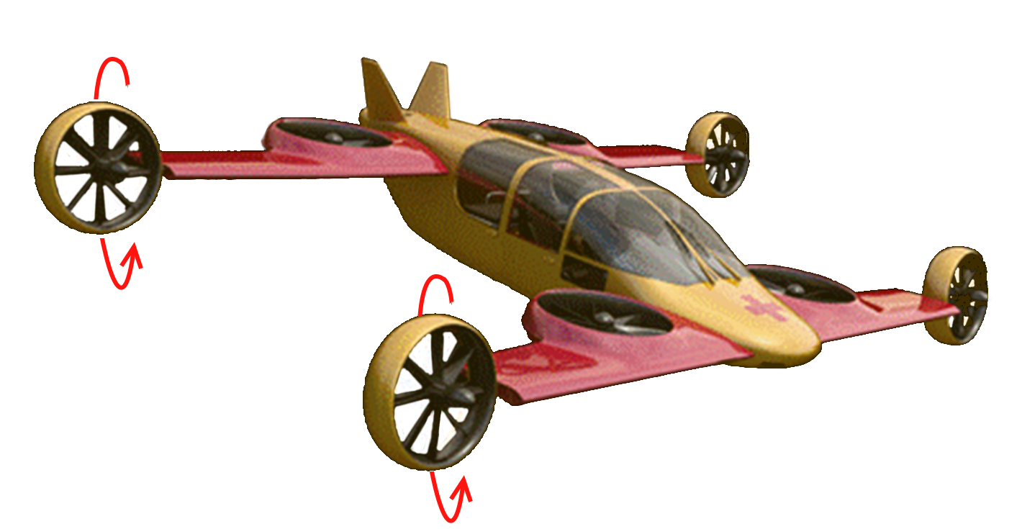
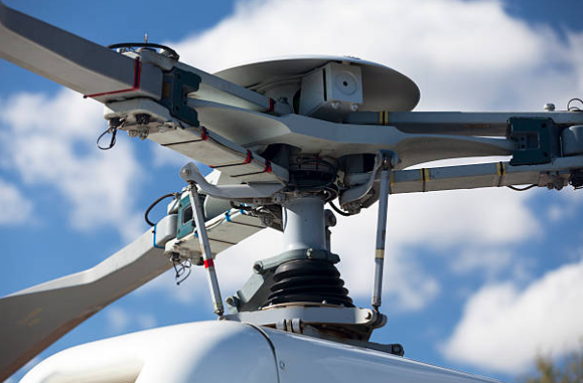
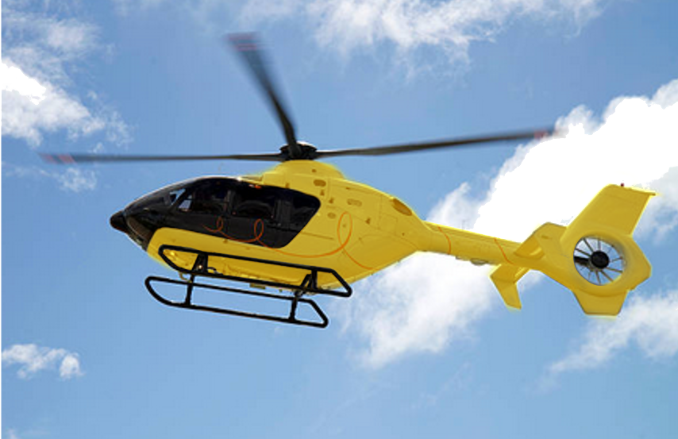
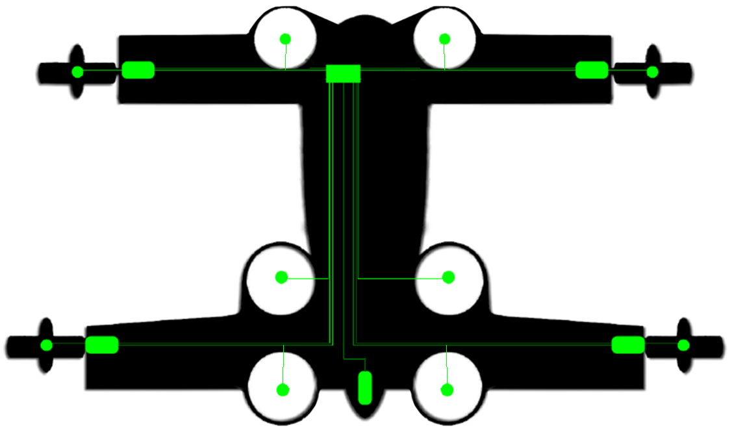
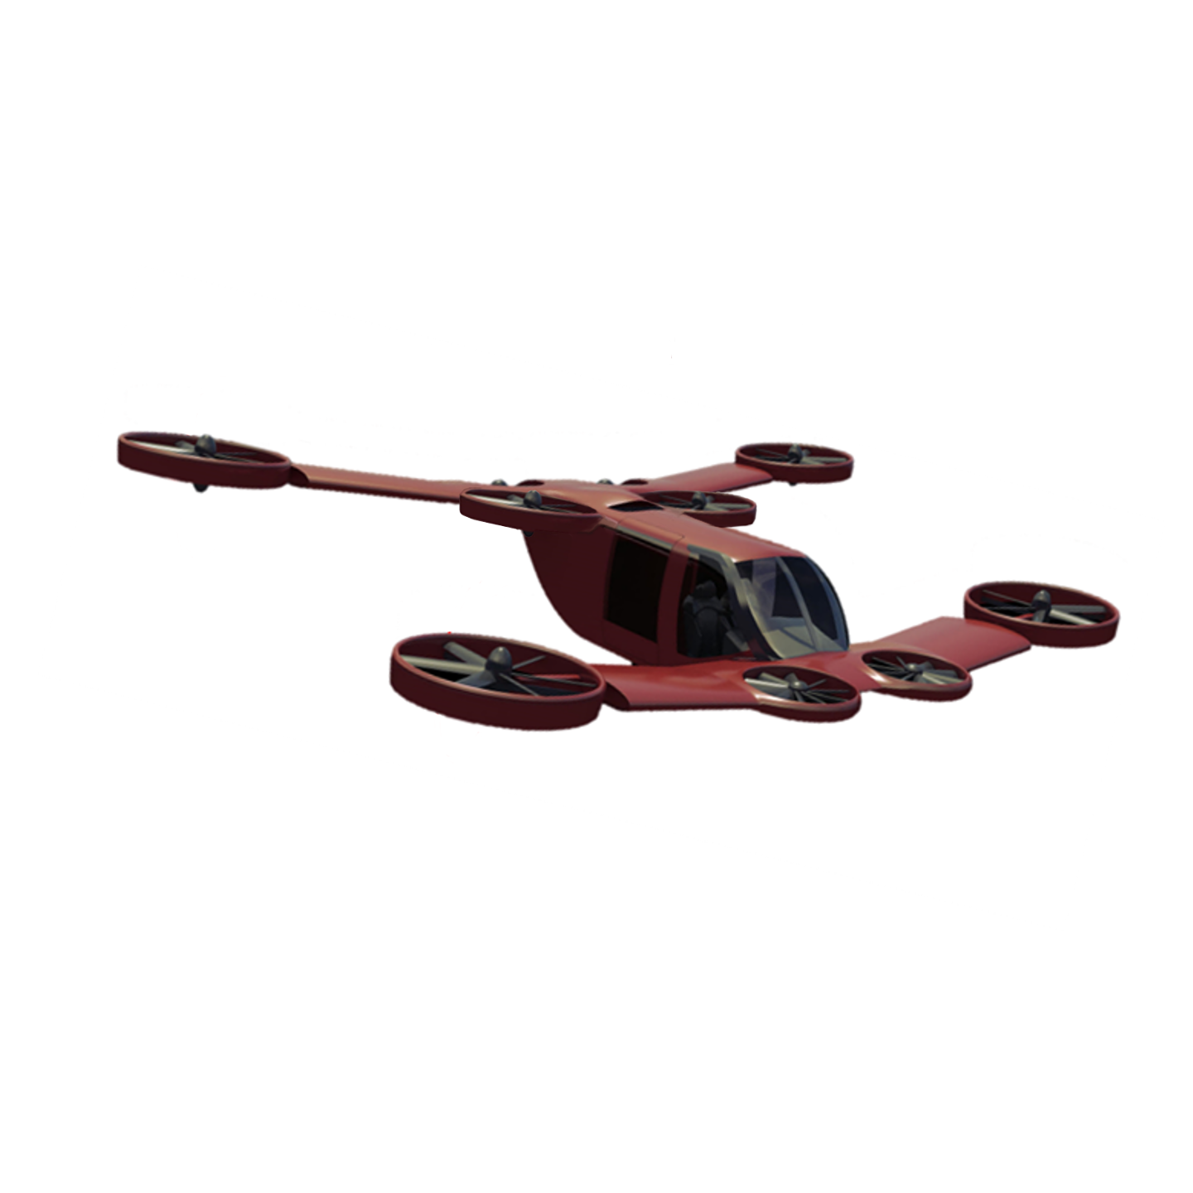
Benchmark
Exisiting solutions and competitors
Mini-Bee solutions
Range > 500km
TakeOff/Landing distances: 530m/425m
Total Variable cost/h: 175$
Purchase cost: 525k$
VTOL
& Wings
Cessna 206
Single-Engine
Cruise speed: 240km/h
Autorotation in case of emergency landing
Purchase cost: 3,1m$
Total Variable cost/h: $646
Security
EC130
Parachute & Battery back-up
Cruise speed: 261km/h
Purchase cost: 3,6m$
Total Variable cost/h: $847
Twin-Engine
Cost
EC135
Purchase Cost: ~450k$
Cruise speed: 250km/h
Range: 500km
Total Variable cost/h: ~$300
Hybrid double source power with a single engine

Slide 8
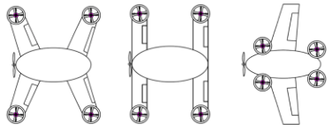
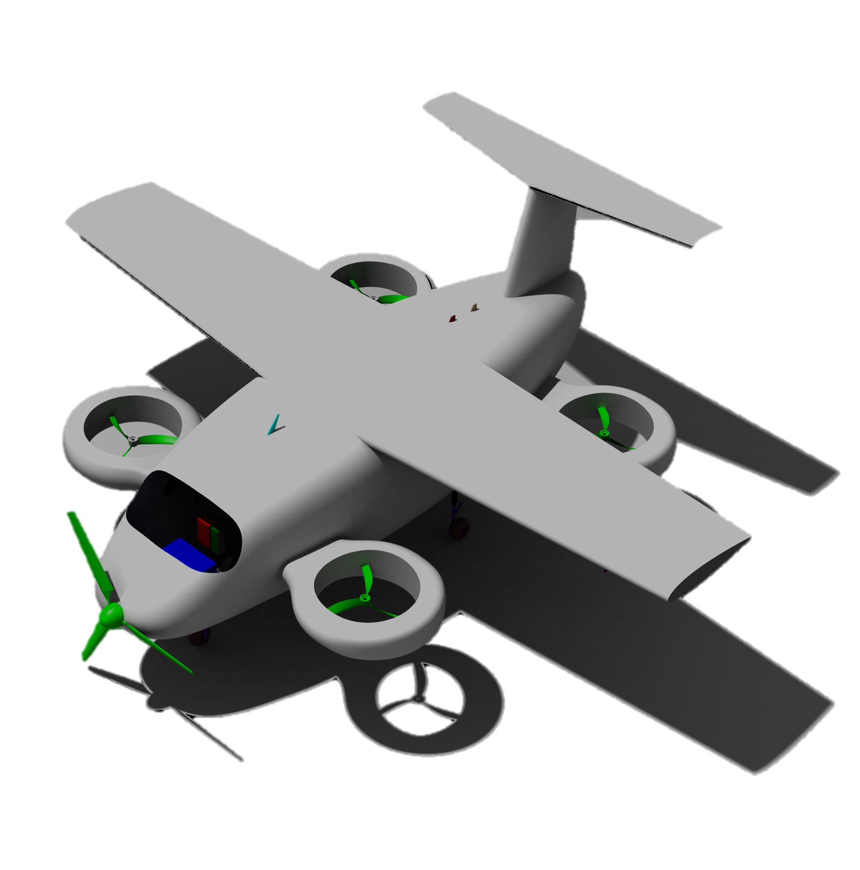
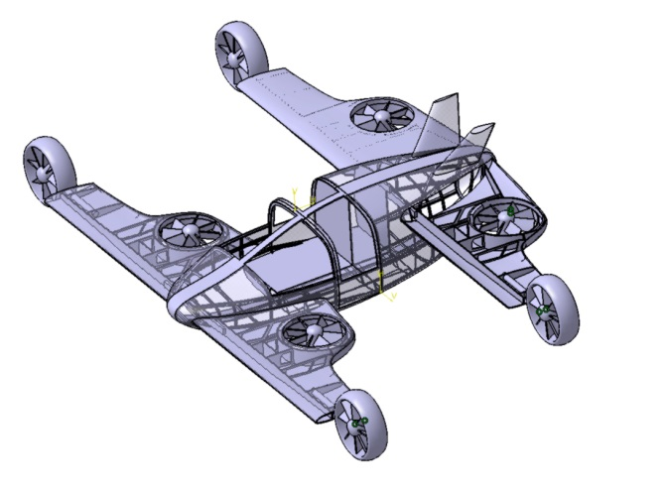
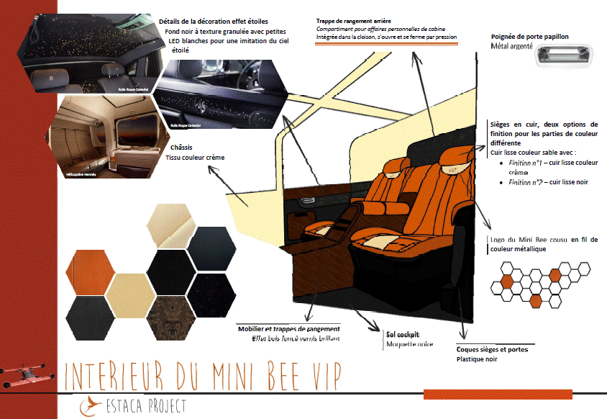
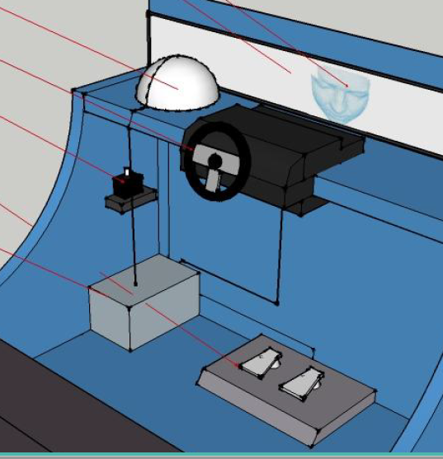
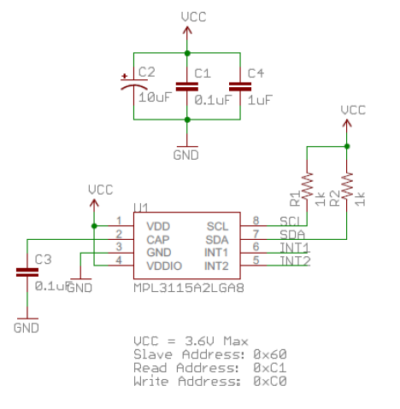
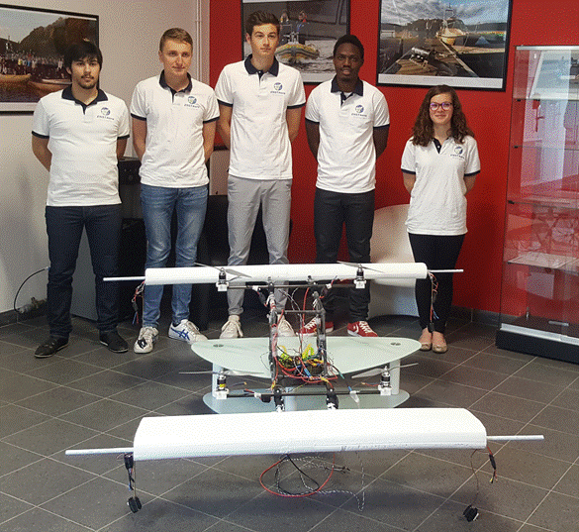
Mini-Bee – Projet development steps
2015
Basic mock-up
2016
Detailed Concept
Structure
Usages and HMI
Electronics and sensors integration
First Flight
Today
2019
Tiltable Demonstrator
2018
VTOL Demonstrator
2017
Scale Model
Dynamics of flight
2020
Prototype
Test Flights
Final Developments
Qualification
2025
Commissioning and sales

Slide 9
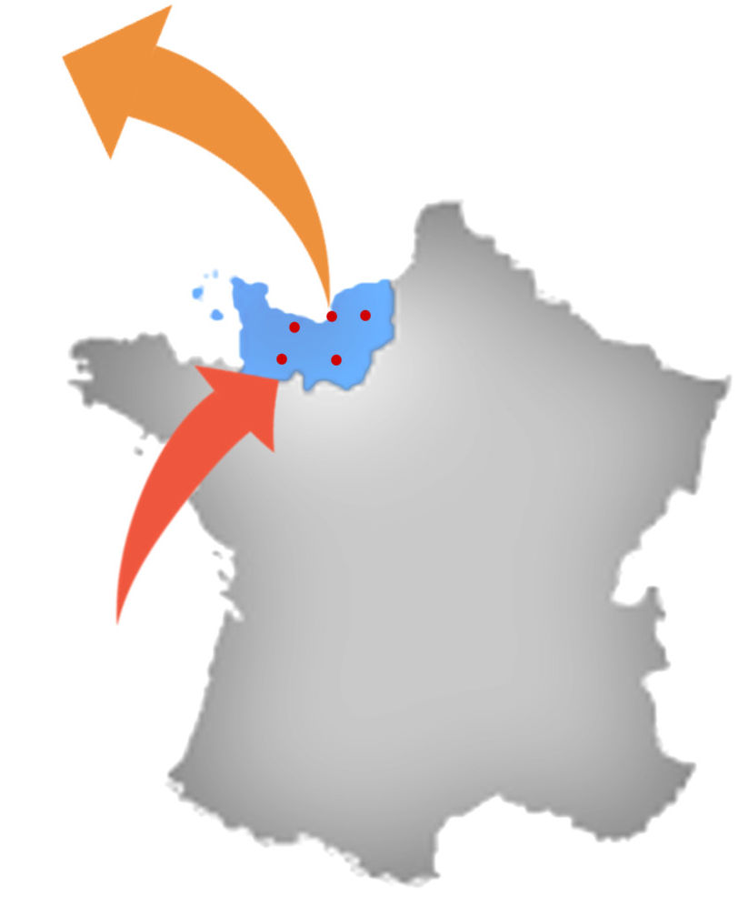






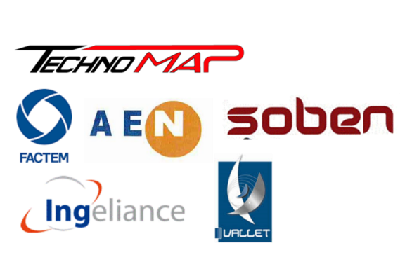

























Mini-Bee : Our Partners
Industrials
Coordinator
International access from Le Havre airport and sea port with a low cost and worldwide efficient supply chain
LOI
Industrials engaged in structure manufacturing
Design & Com
Suppliers
Industrials intentions to join the development of the Mini-Bee.
Academics
Long term relationship with highly qualified multi-field academics and industrial

Slide 10
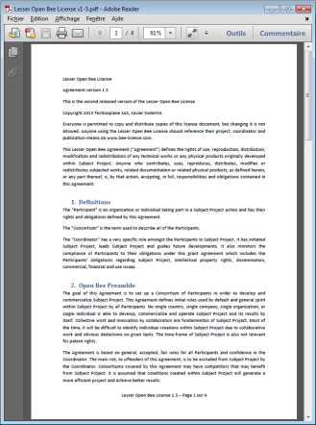
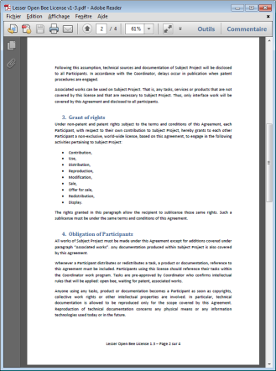
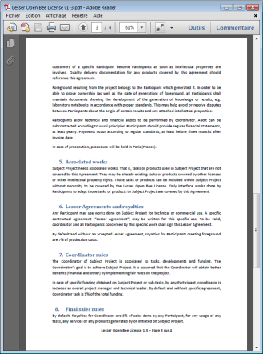
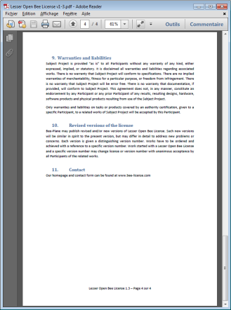
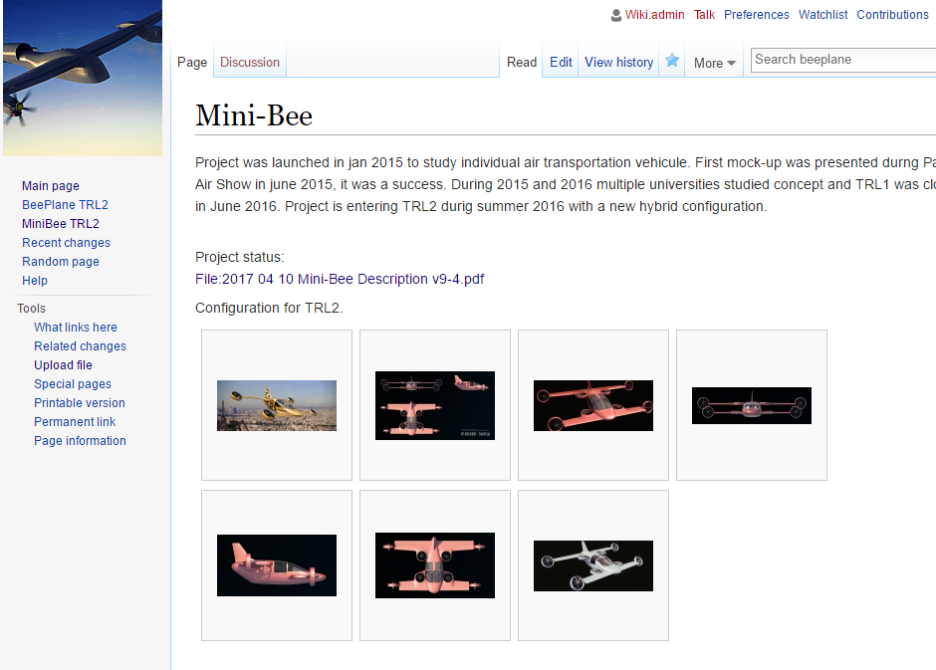
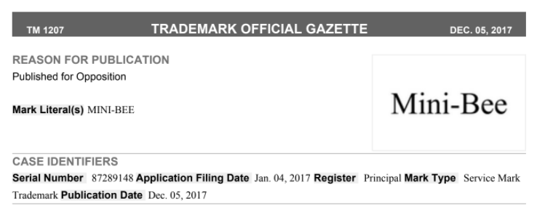
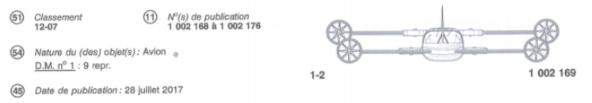

Industrial Property
www.bee-license.com
Lesser Open Bee License 1.3
Mini-Bee project is achieved under dedicated lesser open source license
It allows multiple actors (academic, industrial, individuals) to collaborate in an open-innovation workflow. Project works are mainly shared on a public wiki.
Tasks are achieved with coordinator management
Private Tasks (without public disclosure) or product covered by other licenses or other intellectual property rights can be included within the project. Only interface works will be covered by the open source paragraph of the Lesser Open Source License
Any Participant may use works done on the Project for technical or commercial use. By default, standard royalties percent are defined
www.collaborativebee.com

Slide 11
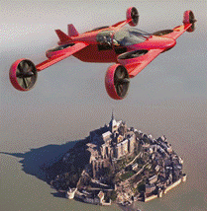


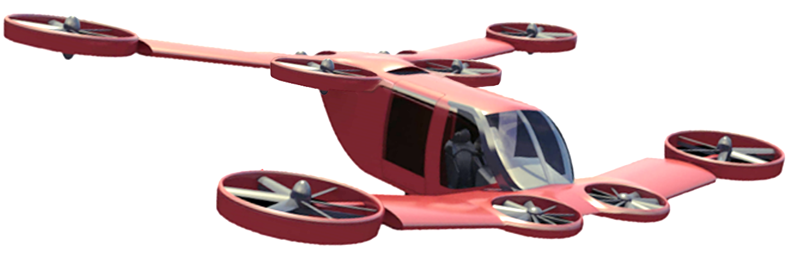
Other Markets accessible
Today
Ambulance
& Utilities
VIP
Taxi
Sport
3 PAX
Volum
VTOL mission
1 PAX Power/weight ratio
2 PAX (pilot included)
Weight and Confort
4 PAX
Number of seats
All electric propulsion
Can be loaded into VIP or Corporate large civilian aircrafts cargo soute

