Slide 1
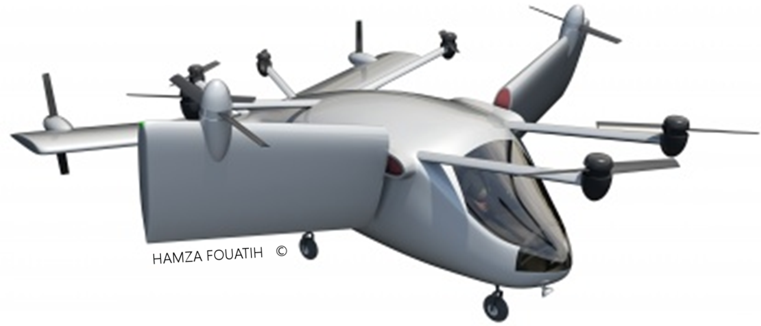
Design
to be updated
TRL 3
Sujet : Mécanique de vol des VTOL hybrides

Slide 2
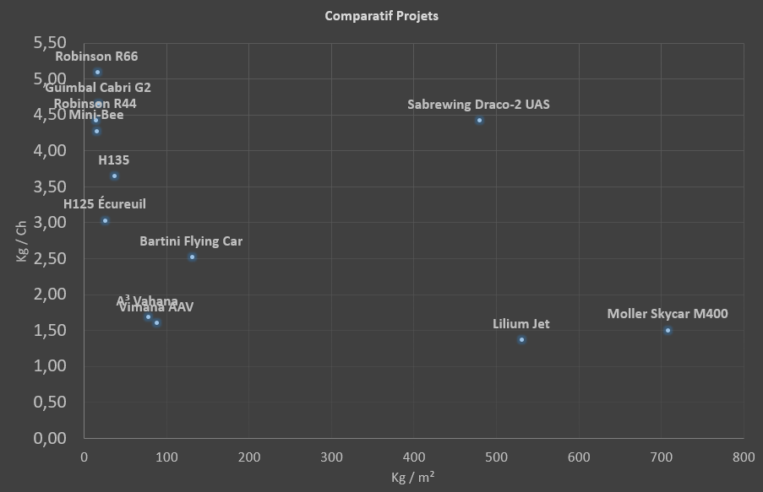
Technical state of the art

Slide 3
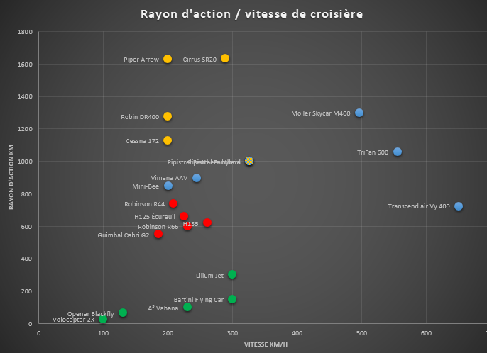
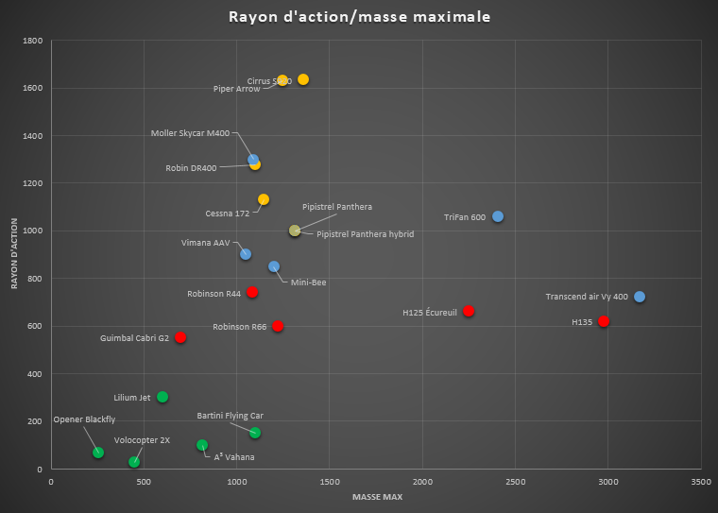
Main market drivers
Electric VTOL
Helicopters
Hybrid VTOL
General aviation
VTOL, MTOW 1200kg, 200km/h, 850km
Electric Multi-rotors
Mini-Bee R2H10P4 is between Helicopter R44 and Aircraft C172

Slide 4
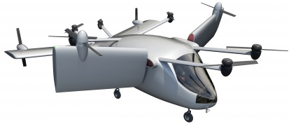
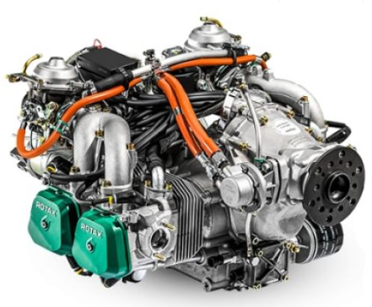
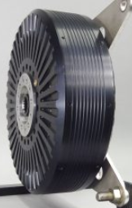
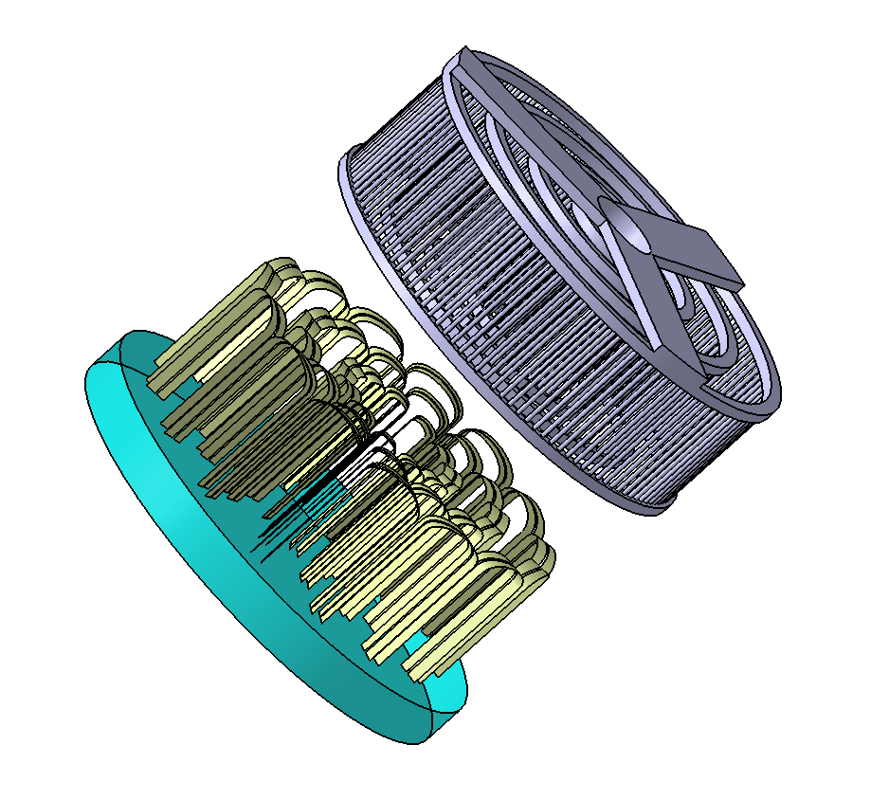
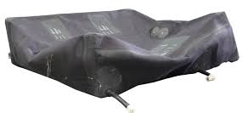
Mini-Bee : Hybrid Powered solution
Basic flight path
Cruise speed : 200km/h
Range : 850 km
MTOW : 1200kg
Climbing angle: 10°
Cruse altitude: 1500m
Max power 280 kW
Cruise flight : 90% of energy
6 Internal Vertical three-phase
Asynchronous electric engines
Fuel tank
Three-phase Generators
Under Studies
2 Engines Rotax 915is
Emrax
2 horizontal engines
Three-phase Generators
No Battery
Emrax
4 external engines

Slide 5
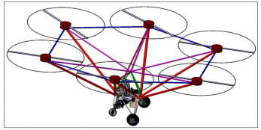
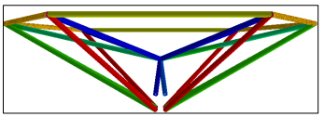
Actual 2PAX configuration for prototype

Slide 6
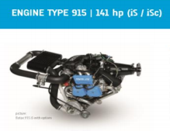
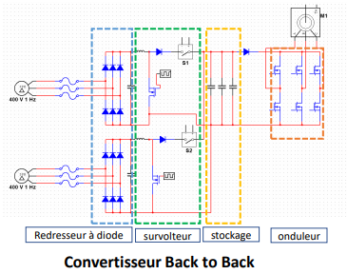
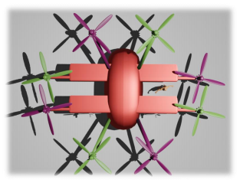
Synchrone standard configuration

Slide 7
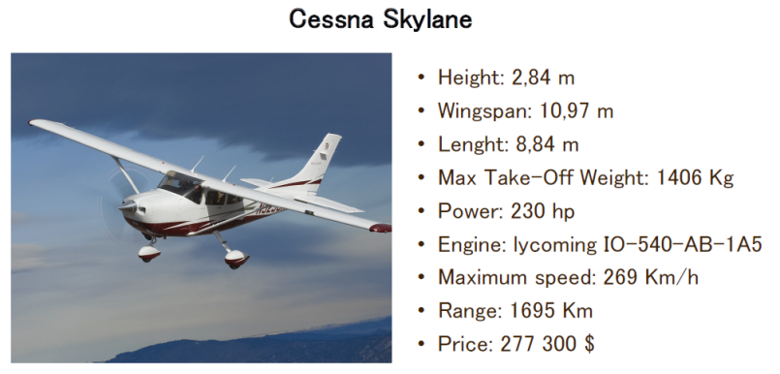
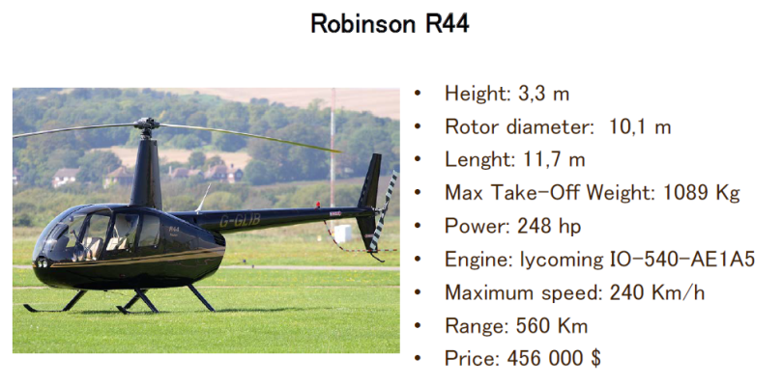
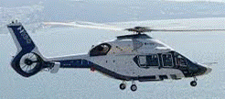
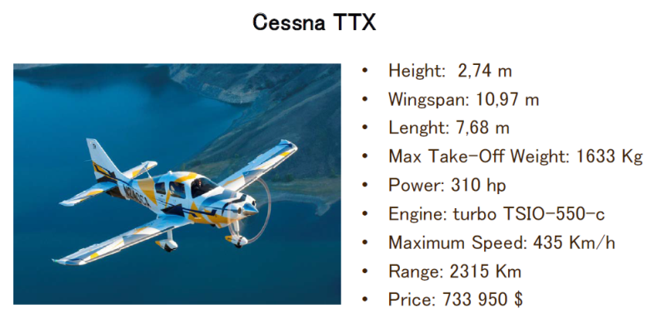
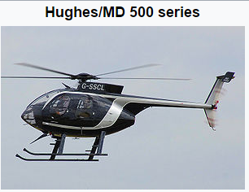
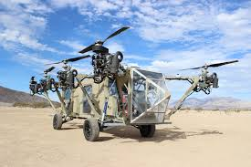
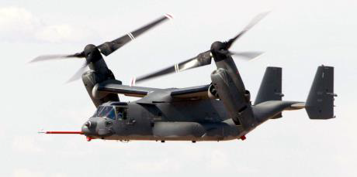
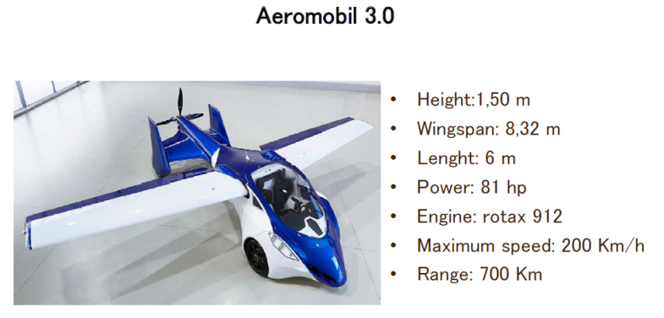
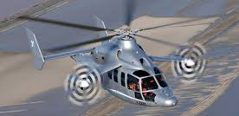
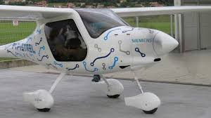
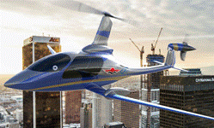
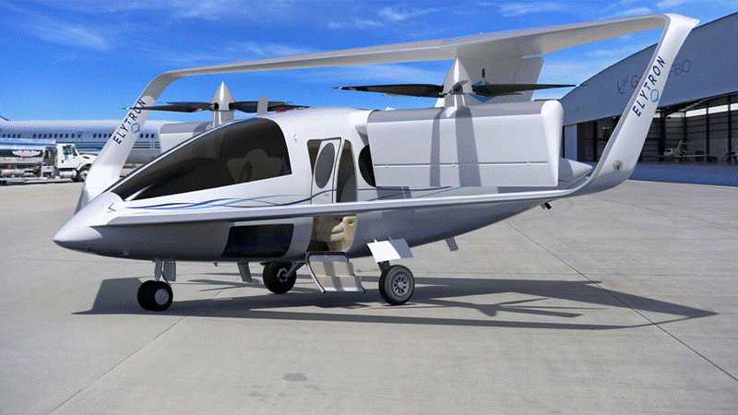
State of the art
Ecureuil
Airbus H160
Advanced Tactics (2016)
Osprey V22
X3 airbus
X2
Pipistrel
Mooney
Elytron

Slide 8
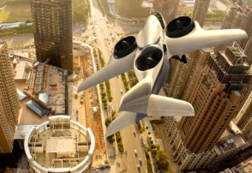
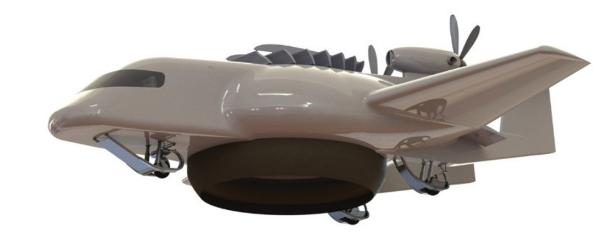
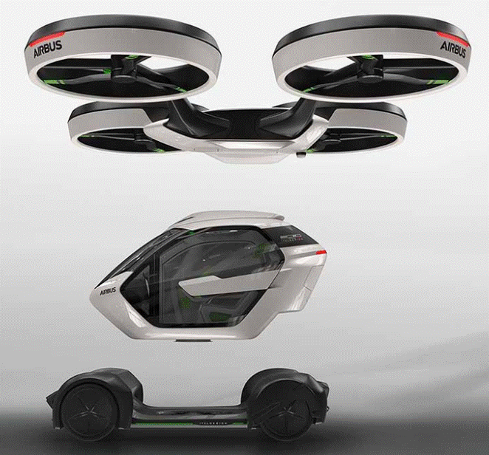
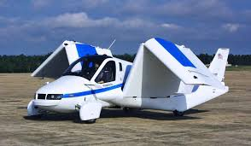
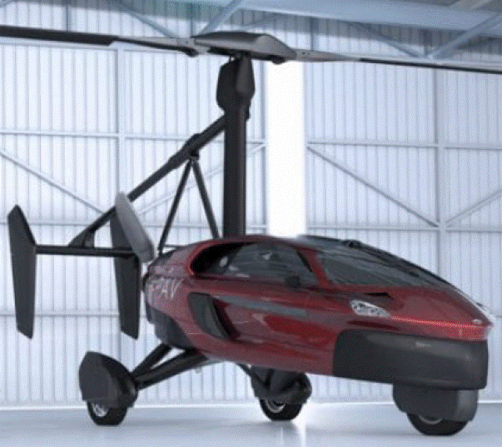
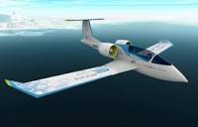
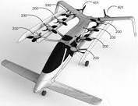
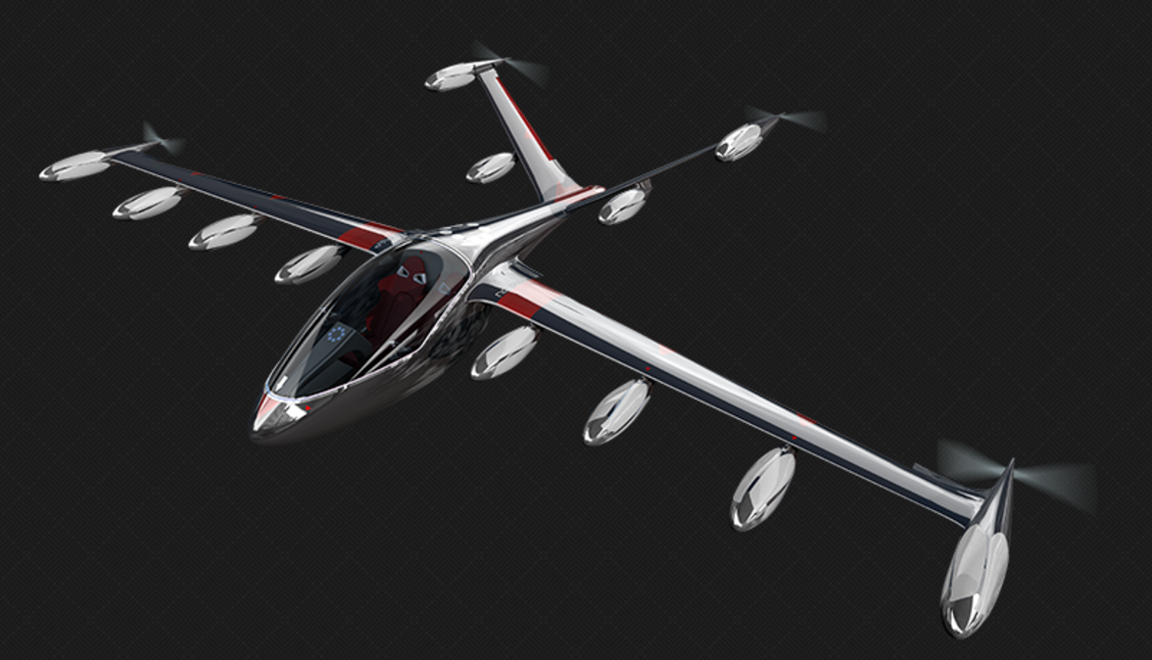
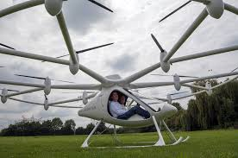
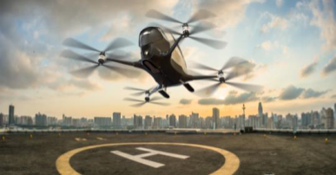
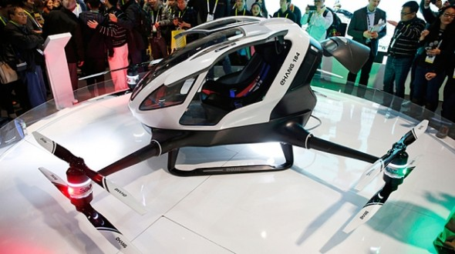
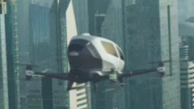
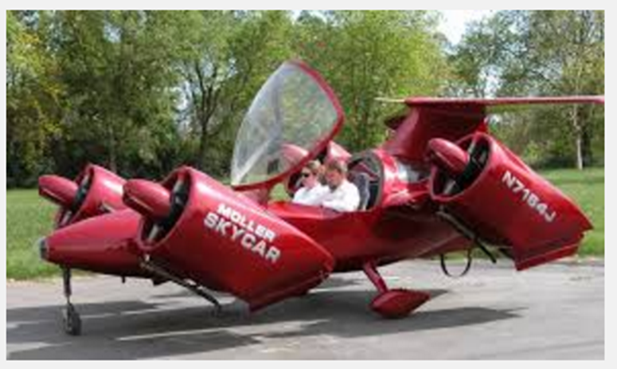
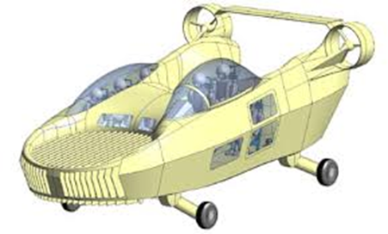
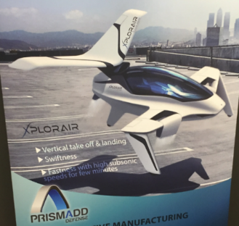
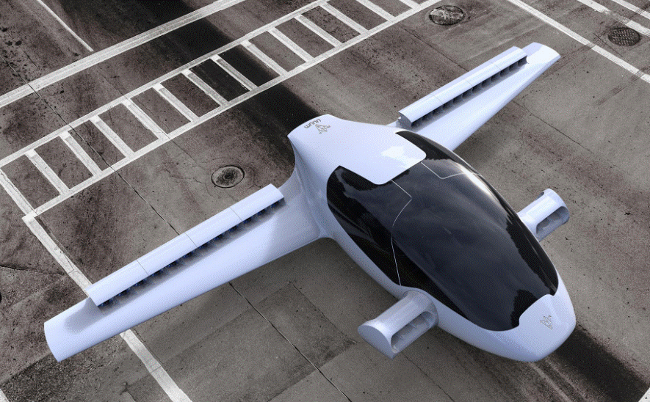
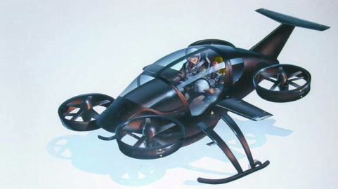
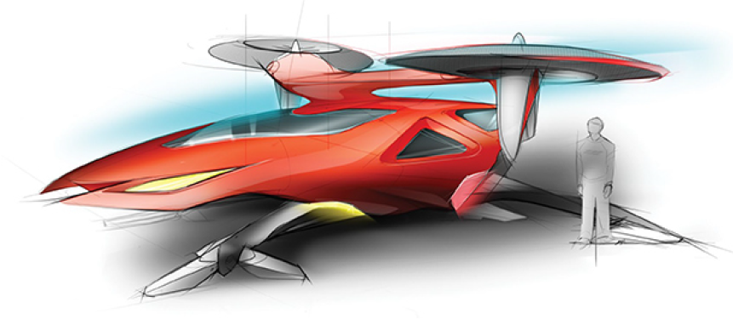
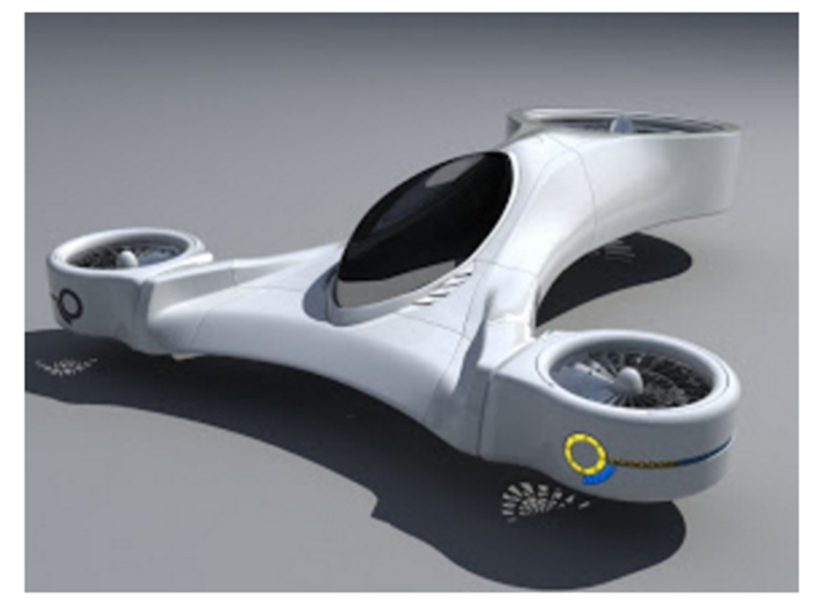
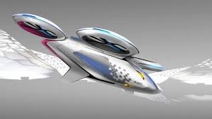
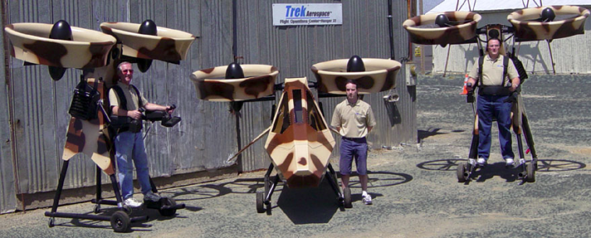
Other innovative projects
Agusta Westland
Zero (2015)
Terrafugia (<2015)
Pal-V (2015)
Airbus E-fan (2015)
Trifan 600 XTI (2015)
Helium (2016)
Airbus (2017)
E-volo (<2014)
eHang (fin 2015)
Kitty Hawk (2016)
zee.aero (2016)
Joby (2016) ~ 100m€
Moler skycar (<2016)
Urban aeronautics
(<2016)
Xplorair (2016)
Lilium (2016) ~100m€
Airbus (2016)
Boeing (2016)
SoloTrek Springtail
Macro industrie (2016)
Airbus Vahana (2016)
Olympus (2016)
Mini-Bee (2016)
Trekaero.com

Slide 9
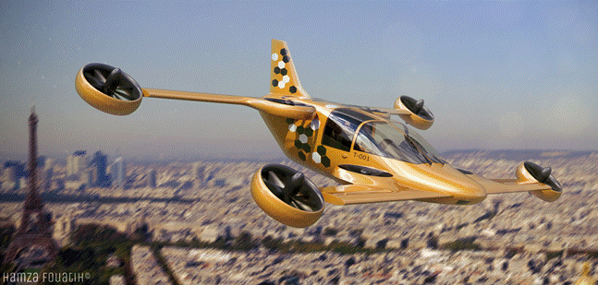
Sujet : Mécanique de vol des appareils VTOL dont hybride tiltable
Drive your Aircraft !

