Slide 2
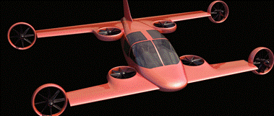
Mini-Bee
2PAX VTOL Hybrid Octocopter

Slide 3
Agenda
Mini-Bee description
  Concept and technical description
  SWOT analysis
TRL1 project
  Partners and project history
  TRL1 Tasks
  Aerodynamic studies
TRL2 project launch
  (TRL2 = Technology concept and application formulated)
  Annexes : State of the art, Other innovative projects

Slide 4
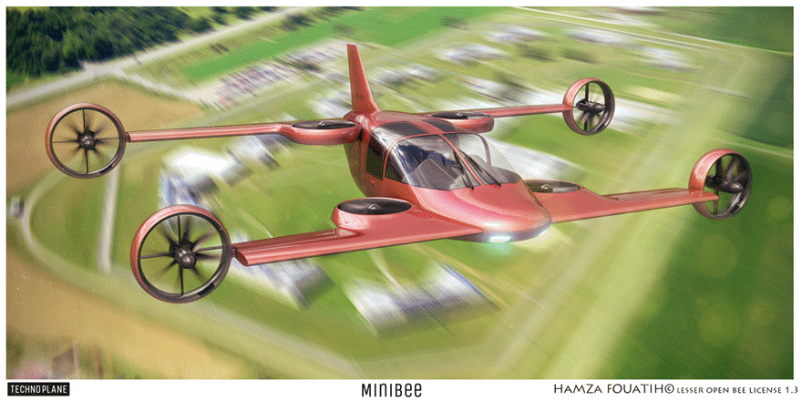
Mini-Bee : 2PAX VTOL Hybrid

Slide 5
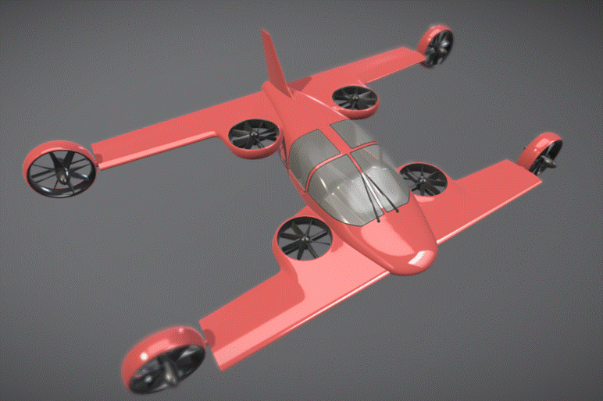
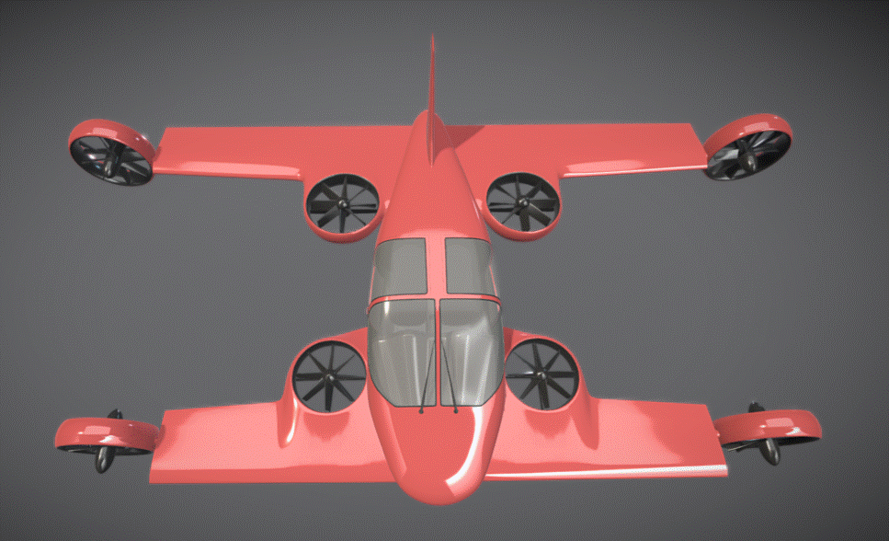
Mini-Bee description
Project state : beginning of TRL2
  Electric octocopter : 4 vertical + 4 tilt
  Hybrid energy : fuel + batteries
  2 seats, VIP configuration
Characteristics :
  VTOL capacity, short wings, 1.2 ton
  Range 600km, max speed 300km/h
  Electric controls and engines
Goals and market
  VIP, Air Ambulance, individual aircraft
  Estimated price 1m€ (for VIP)

Slide 6
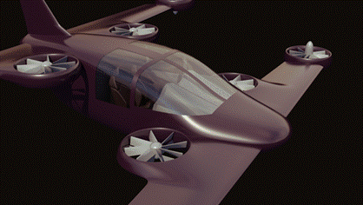
Architecture
Central vertical quadcopter
Rear electric generator
External tilt quadcopter
Gullwing doors
Fuel generators
Biplane
Battery kits
Electric flight controls
Tailwheel-type landing gear
Retractable front landing gear
3D printed metallic structure
Low noise nacelle

Slide 7
Technical description
Aircraft characteristics
2 seats, VTOL, Short wing for cruise flight
MTOW 1200 kg, Range 800km , Cruise speed 220 km/h
Wing surface 15m², no control surface
Engines
Central vertical quadcopter + External tilt quadcopter
4 hybrid fuel generator for central quad copter
4 electric engines for external tilt quadcopter
Electronic control of engines power and tilt angles
Cockpit interface
« Car like » pilot interface : Steering wheel, foot pedals, central screen

Slide 8
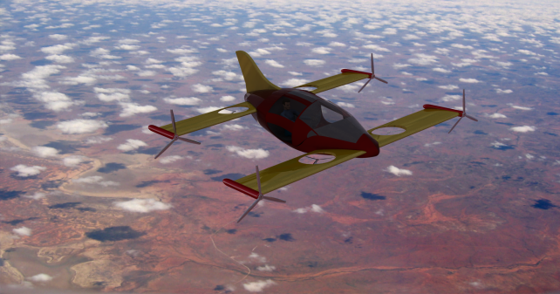
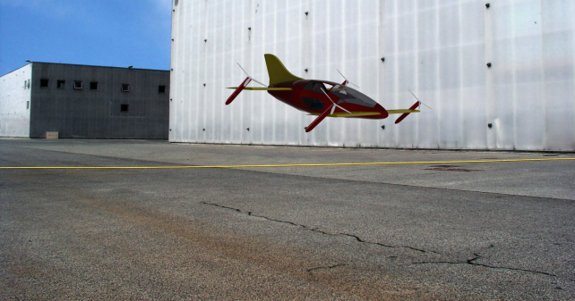
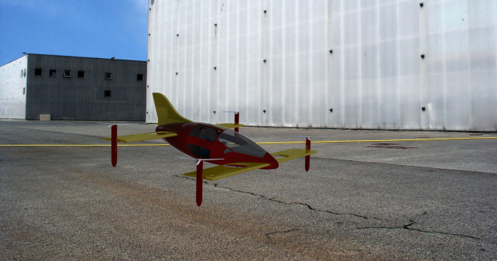
Take-off and flight transition
Cruise flight
Tilt transition
Estaca 2016
Supméca 2016
Vertical take-off

Slide 9
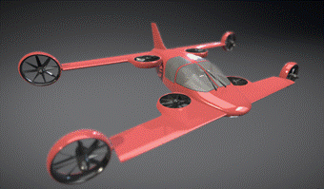
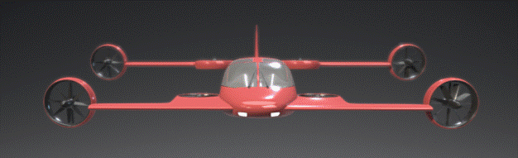
Cruise flight

Slide 10
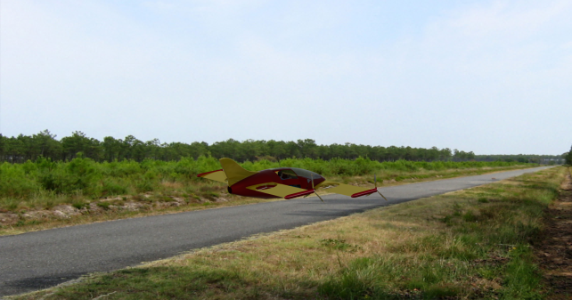
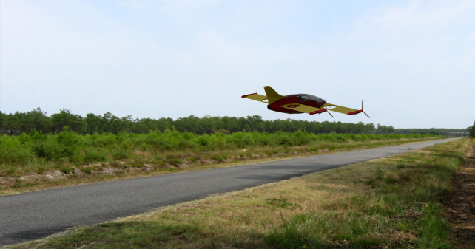
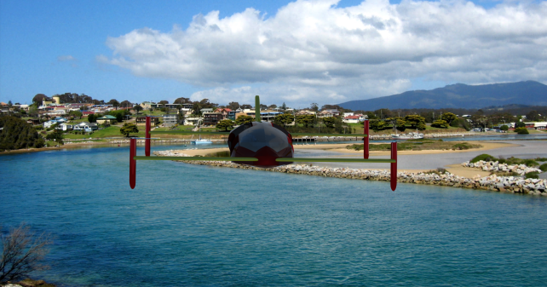
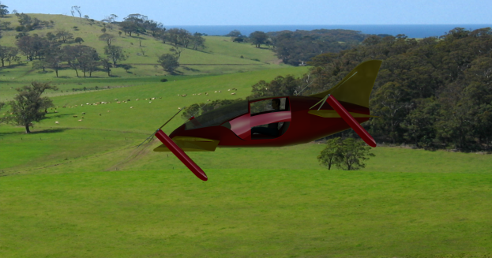
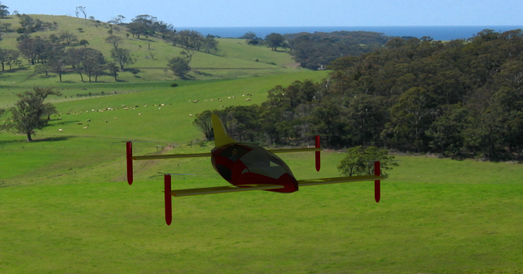
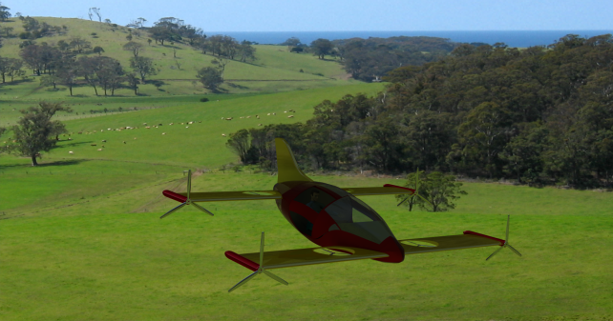
Take-off and tilt transition
By Estaca 2016

Slide 11
Technical data
MTOW : 1200 kg
Structure : 310kg
Fuselage : 80kg
Payload : 220 kg (2 PAX)
Systems : 125 kg
Engines : 240 kg (4 * generator + 8 Electric engines)
Batteries : 90kg
Fuel : 140kg
Target for TRL3 : MTOW 1000 kg

Slide 12
Estimated costs
Total costs : 700k€
System : 200k€
Fuselage : 150k€
Wing : 100k€
Engines : 100k€
Landing gear : 50k€
Interior : 50k€
Other : 50k€

Slide 13
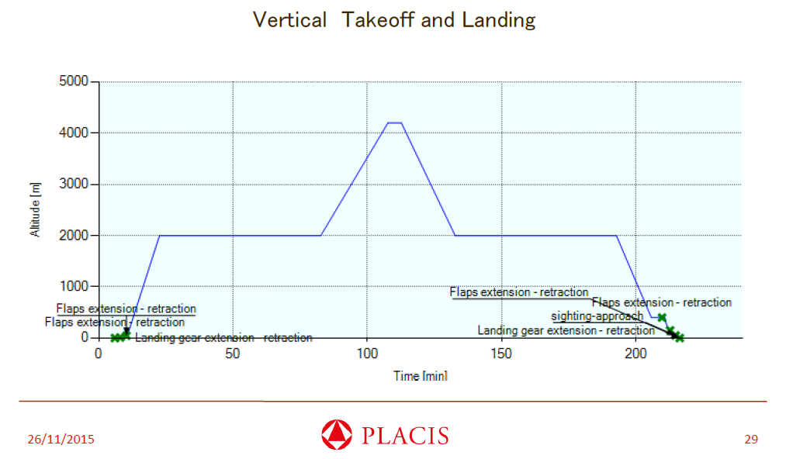
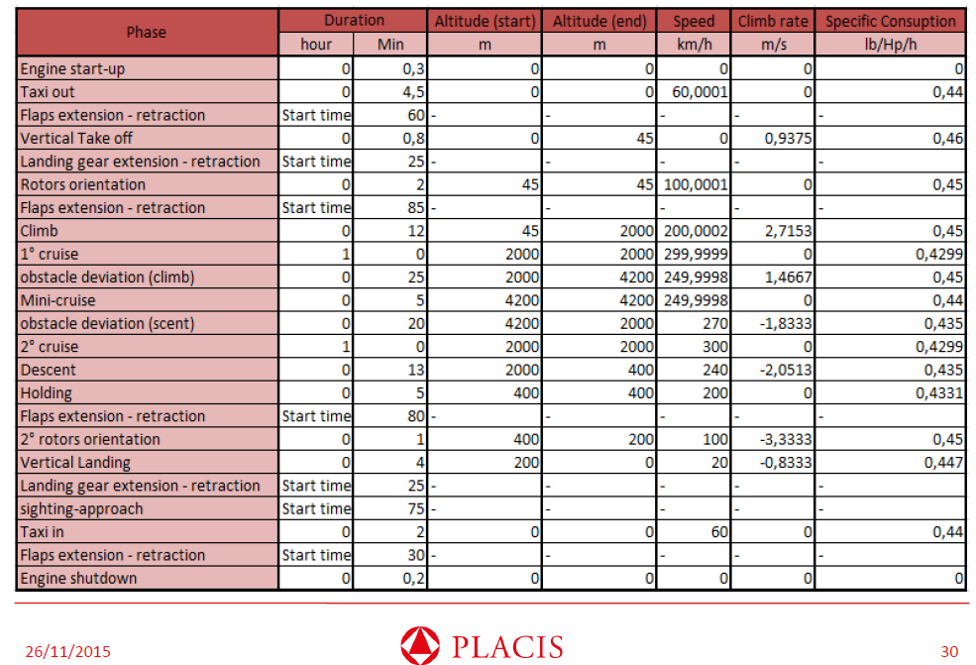
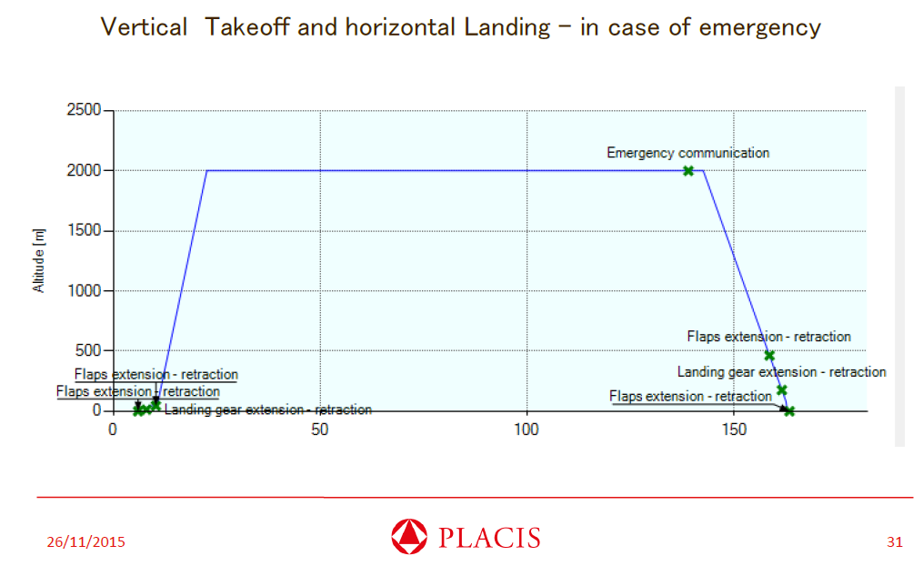
Mission profile

Slide 14
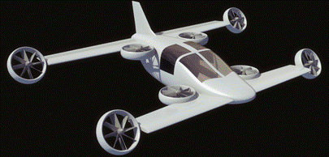
8 Electric Engines
Equipement proposed : 8 electric
55k special designed engines (12kg/engine)
Or 8 engines Yuneec Power Drive 60
Power needed 220 kW
Installed power 440kW
Hamza Fouatih 2016
provided by
90kg of batteries during take-off and vertical flight
fuel generator during cruise flight

Slide 15
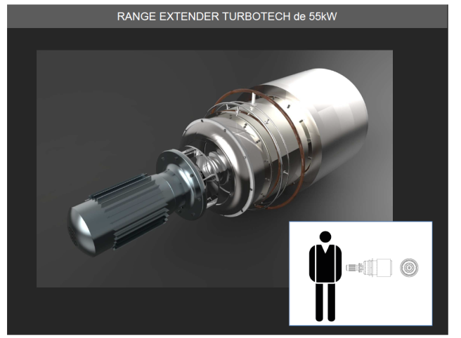
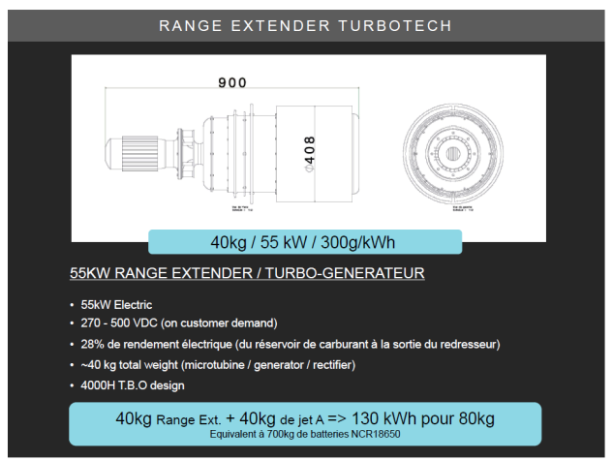
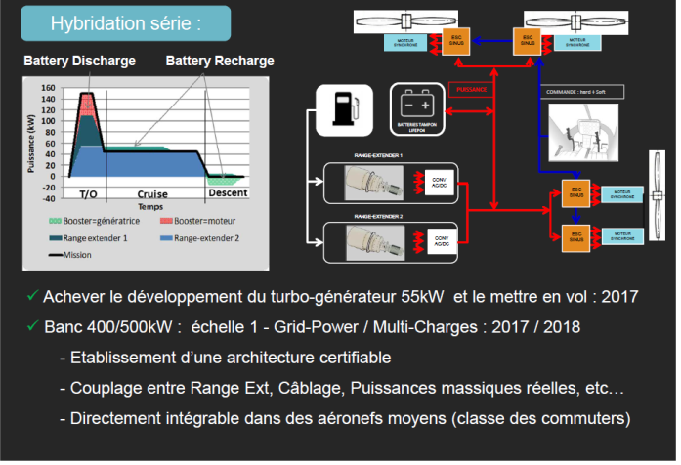
4 Electric fuel generator + Batteries
Equipement proposed : 4 Turbotech 55kW
Batteries : 1800 NCR 180650 in 10C (90kg)
Hamza Fouatih 2016

Slide 16
SWOT analysis
Strengths
Weakness
VTOL capacities
Speed of an aircraft
Double quadcopter back-up in case of engine failure
Fuel energy range
New configuration
Project at low TRL
Aerodynamic and leight weight structure
Propulsion and energy storage
Project implementation
Project funding
Opportunities
Threats
Cost reduction :
  Overall flight cost reduction compared to helicopter
  Low purchasing & maintenance cost of engines
New design space: tilt, octocopter
  Weight / VTOL
Project investment
All electric helicopter
All electric aircraft
Tilt rotor (bi and quadri)
Hybrid energy

Slide 17






Partners for R&D
Project coordinator
TRL1 Basic Definition
TRL2 Detailled Definition
In launch

Slide 18
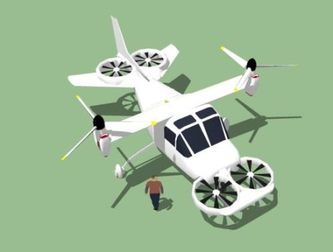
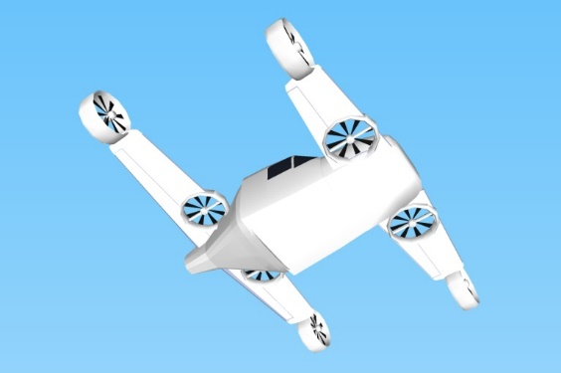



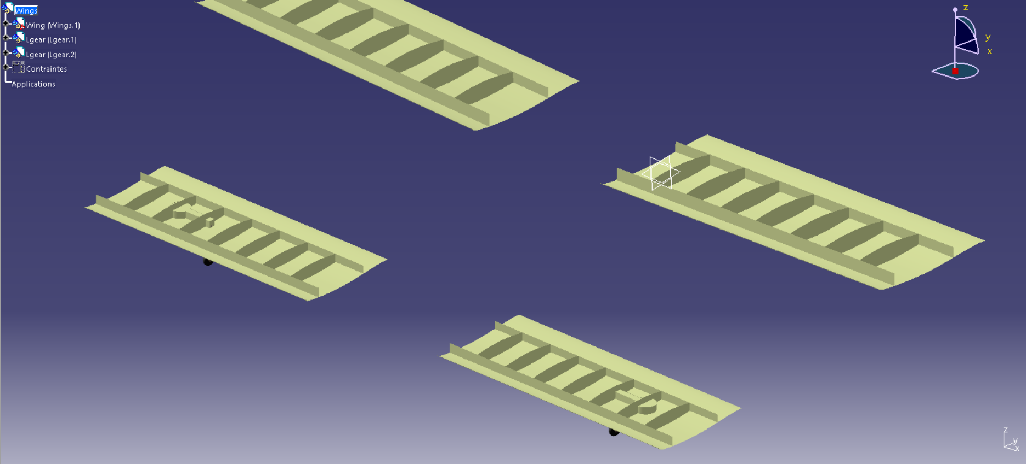
Project history
TRL0 Project Launch (2015)
Studies 2015/2016
TRL1 Basic Definition (2016)
Lesser Open Bee License 1-3
TRL2 Concept (2016)

Slide 19
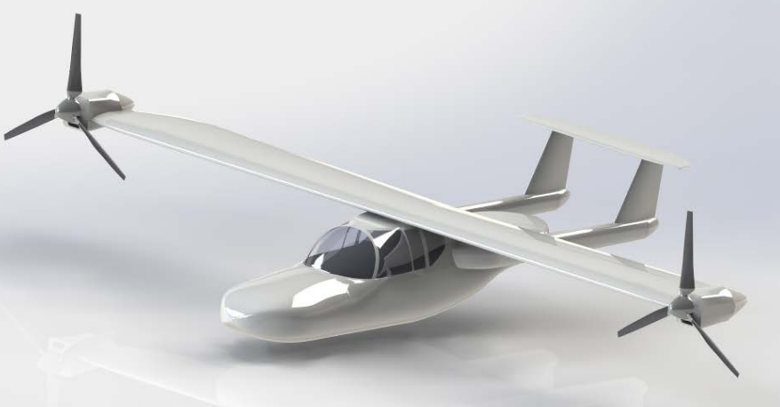
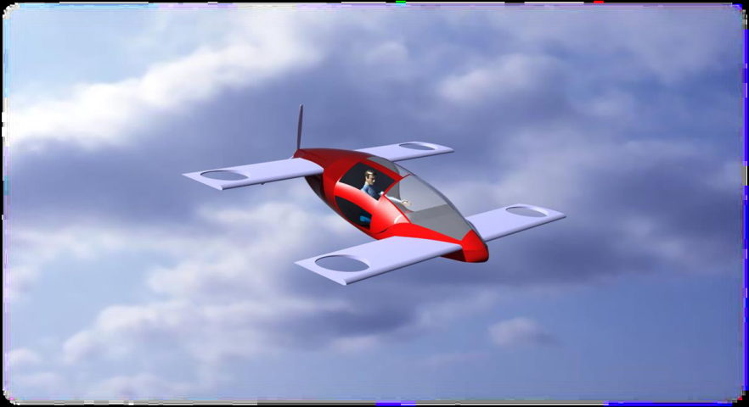
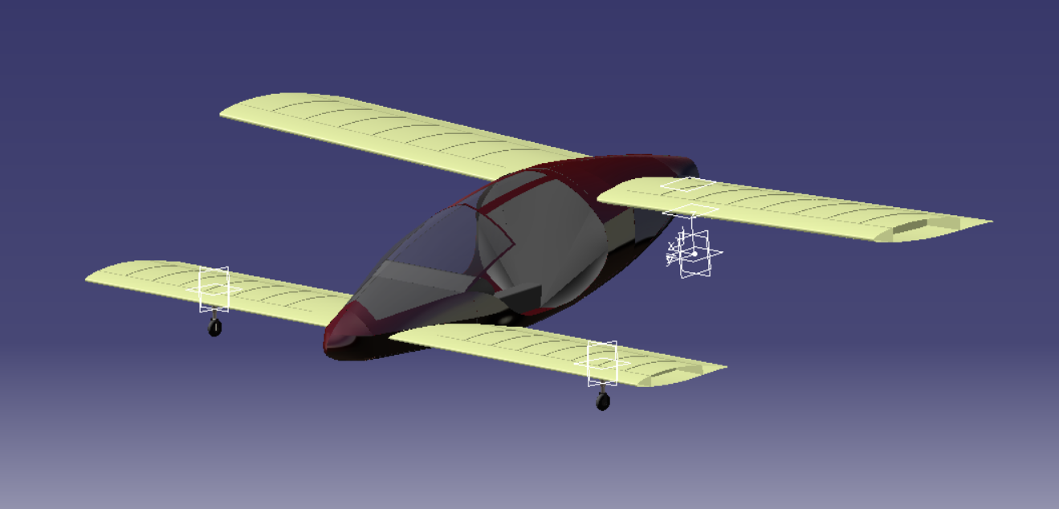
TRL1 project tasks
Polito 2015
Supmeca & Polito
2016 (Placis)
Supmeca
2016
Estaca
2016 group2
Estaca
2016 group1

Slide 20
Aerodynamic studies
Cockpit shape optimization
Supmeca 2016
Rotor shape optimization
Supmeca 2016
Vertical rotor air flow studies
Supmeca 2016

Slide 21
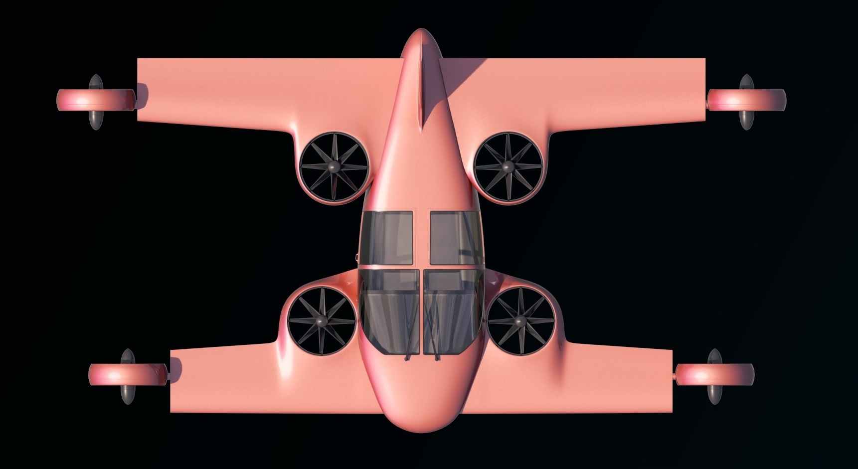

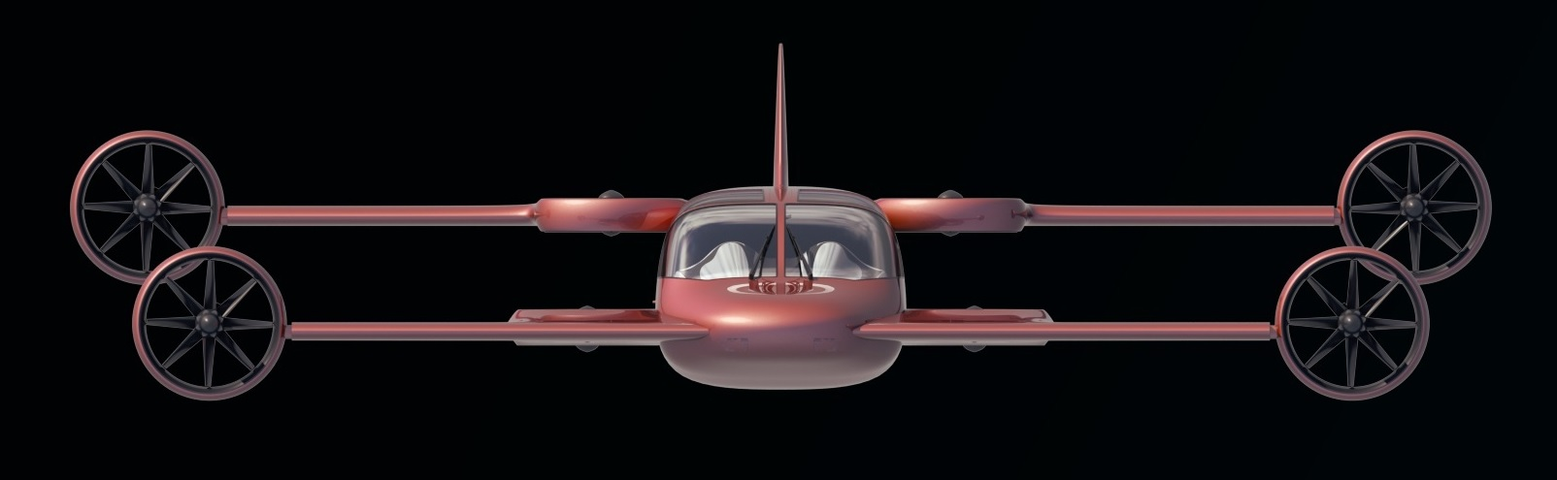
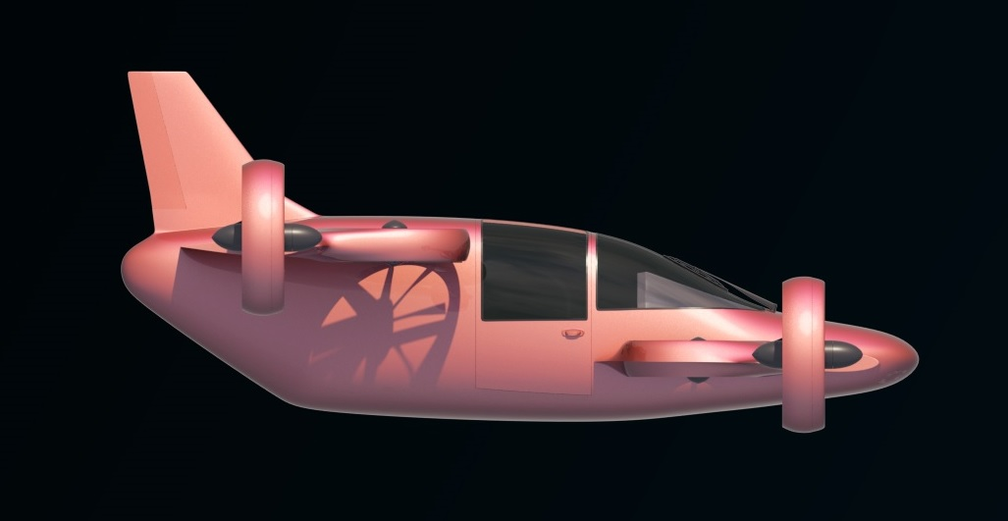
Mini-Bee project for TRL2
Mini-Bee (at end of TRL1)
2 PAX VIP
Electric Octocopter
Tilt quadcopter & vertical quadcopter
Hybrid energy : batteries & fuel
Estaca Laval 2016

Slide 22



















Overall main beeplane Project partners
Lesser Open Bee License 1-3
Coordinator :
Universities :
Institution & financial partners :
Design:

Slide 23
Actions for Mini-Bee TRL2 Project
Launch Mini-Bee TRL2 project :
  Assess detailled technical configuration
  Evaluate market opportunities, production and flight costs
  Define partnership for TRL2 and TRL3
  Draw project financial path
  Investigate for lovemoney phase

Slide 24
Partners to be defined
World
France
India
US
Project sponsors & finance
Electronics and equipement integration
Aircraft flight management control
Cokpit interface and project integration
Structure metallic 3D printer
Aircraft manufacturer
Luxury firm for VIP configuration
VIP end users
Air Ambulance end user

Slide 25



Targeted Industrial Schem
FAL for Standard Config & Air Ambulance
Flight control system & Equipements
IT Transport Management
Testing, Customer service & Worldwide Logistic
Final Assembly Line for VIP config
Head quarters
Metallic 3D printing
Engines

Slide 26
Financial project path
Estimated overall project 100m€

Slide 27
Annexes
Individual Air Vehicules

Slide 28
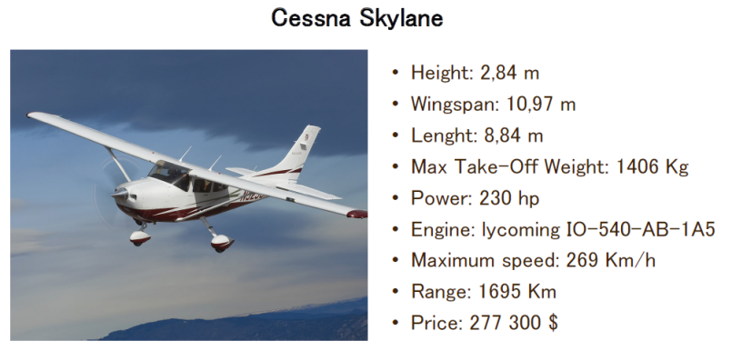
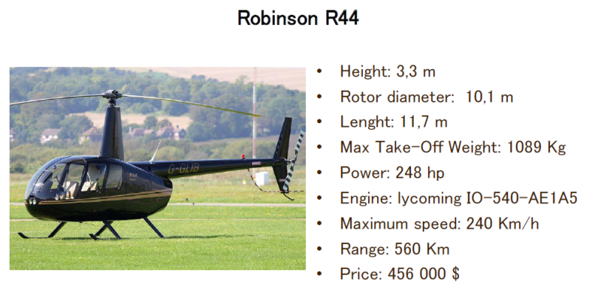
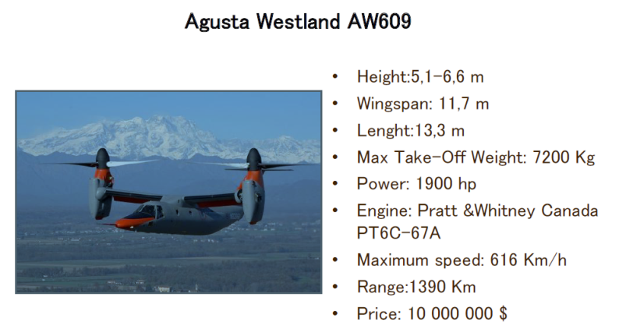
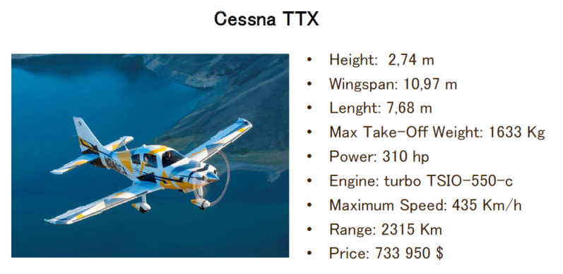
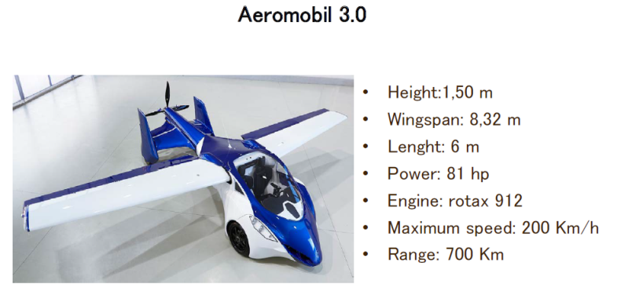
State of the art

Slide 29
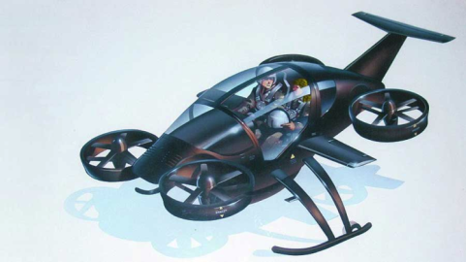
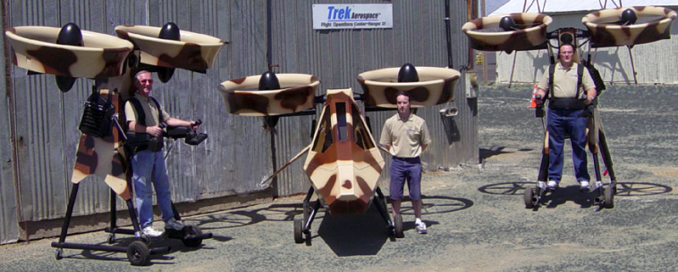
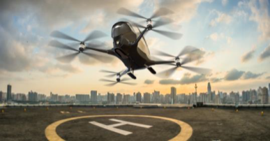
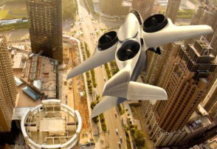
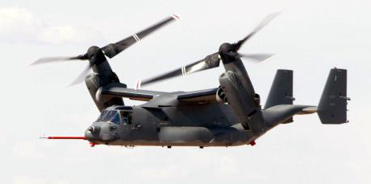
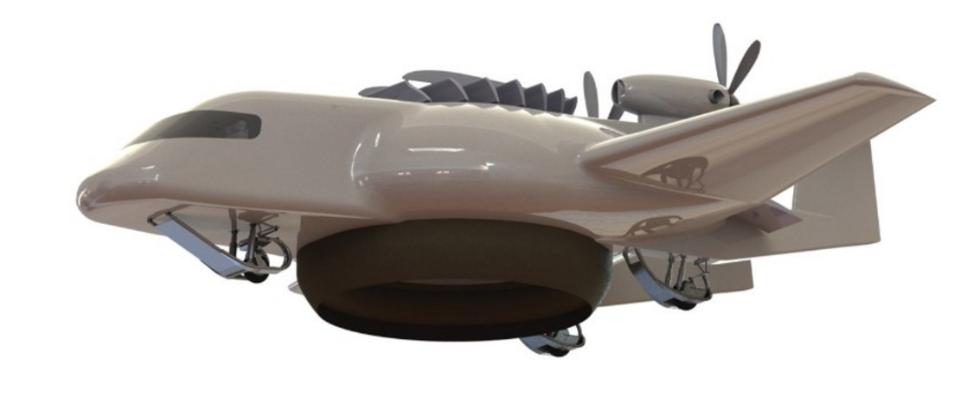
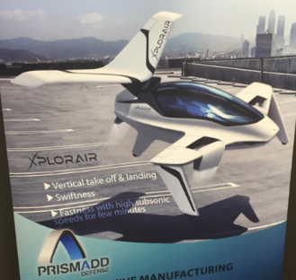
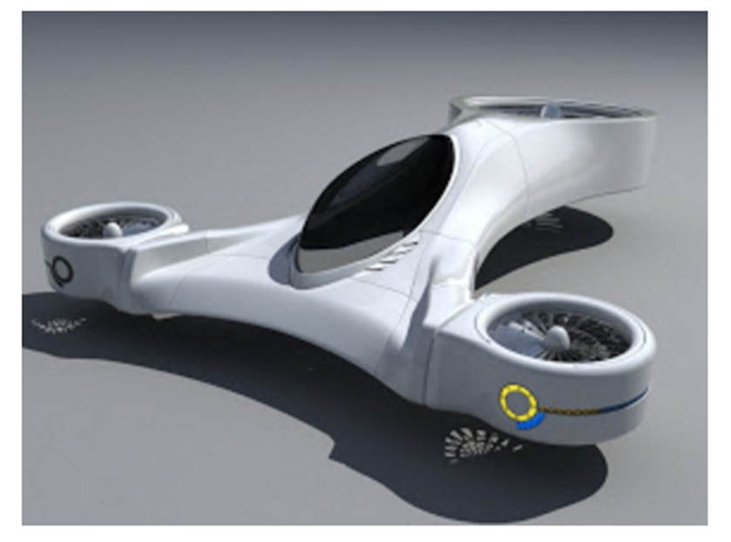
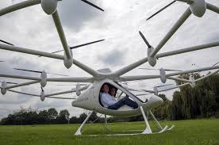
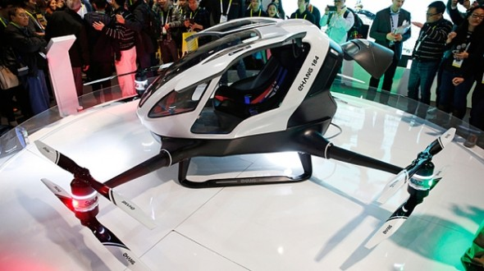
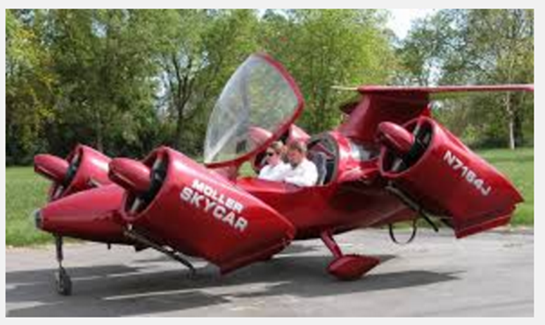
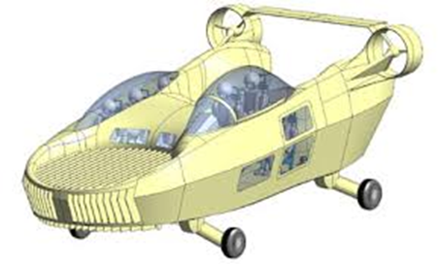
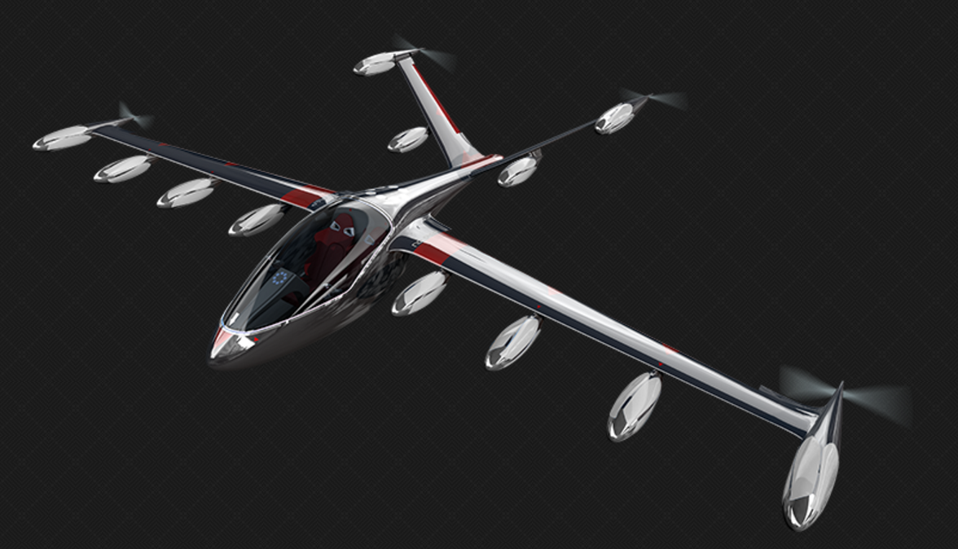





Other innovative projects
SoloTrek/Springtail
http://www.trekaero.com/
Trifan 600 XTI aircraft
Helium (2016)
Xplorair (2016)
Macro industrie (2016)
E-volo
eHang (fin 2015)
+Kitty Hawk
Moler skycar (2016)
Urban aeronautics (2016)
Joby
Lilium
zee.aero
Airbus (2016)
Boeing (2016)
Airbus E-fan (all electric)

Slide 30


Mini-Bee
2PAX VIP Hybrid Octocopter

