Slide 1
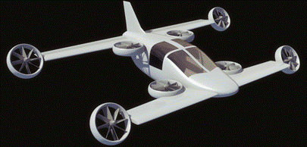
Mini-Bee
Hamza Fouatih 2016
Hybrid Octocopter, Beginning of TRL2
(Technology concept and/or application formulated)

Slide 2
Agenda
Mini-Bee description
  Concept and technical description
  SWOT analysis
TRL1 project
  Partners and project history
  TRL1 Tasks
  Aerodynamic studies
TRL2 project launch
  Annexes : State of the art, Other innovative projects

Slide 3
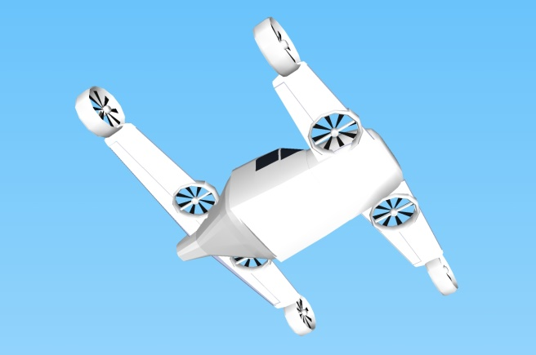
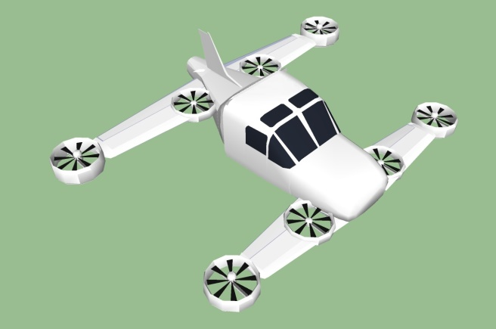
Mini-Bee description
Project state : beginning of TRL2
  Electric octocopter : 4 vertical + 4 tilt rotors
  Hybrid energy : fuel + batteries
  2 seats, VIP configuration
Characteristics :
  VTOL capacity, short wings, 1.2 ton
  Range 600km, max speed 300km/h
  Electric controls and engines
Goals and market
  VIP and Business Individual Air Vehicules
  Estimated price 450k€

Slide 4
Architecture
Central vertical quadcopter
Rear electric generator
External tilt quadcopter
Gullwing doors
Fuel generators
Biplane
Battery kits
Electric flight controls
Tailwheel-type landing gear
Hamza Fouatih 2016
Retractable front landing gear
3D printed metallic structure
Low noise nacelle

Slide 5
Technical description
Aircraft characteristics
2 seats, VTOL, Short wing for cruise flight
MTOW 1200 kg, Range 800km , Cruise speed 220 km/h
Wing surface 15m², no control surface
Engines
Central vertical quadcopter + External tilt quadcopter
4 hybrid fuel generator for central quad copter
4 electric engines for external tilt quadcopter
Electronic control of engines power and tilt angles
Cockpit interface
« Car like » pilot interface : Steering wheel, foot pedals, central screen

Slide 6
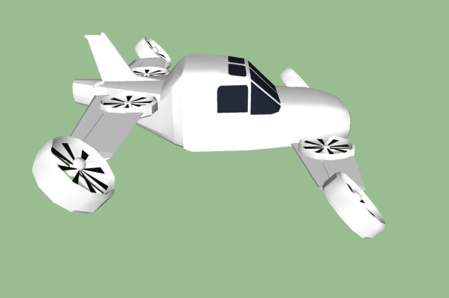
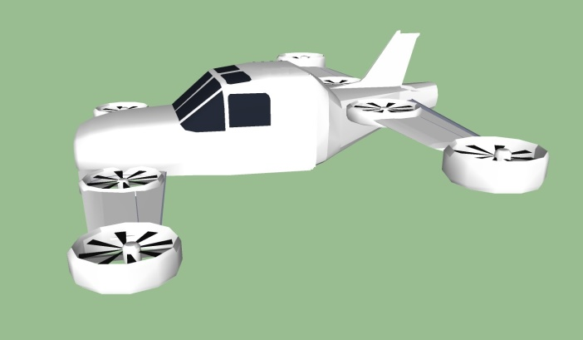
Take-off and flight transition
Cruise flight
Tilt transition
Vertical take-off
Supméca 2016

Slide 7
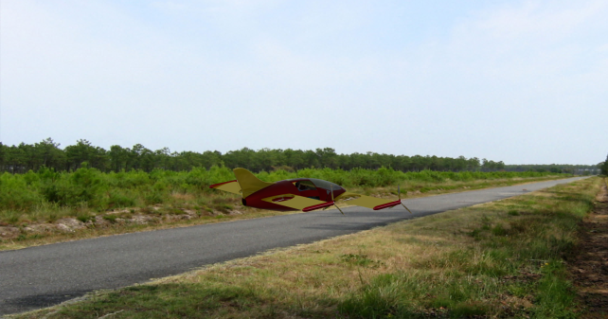
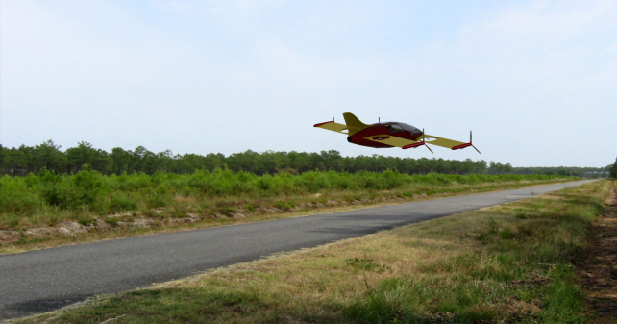
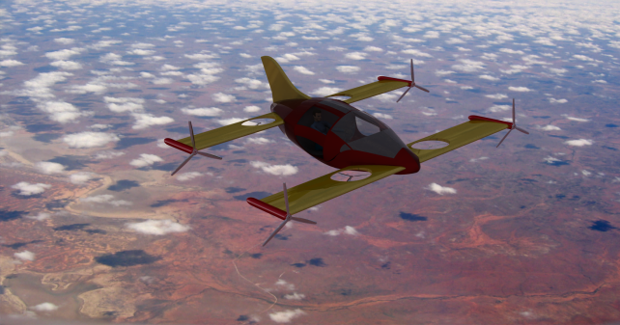
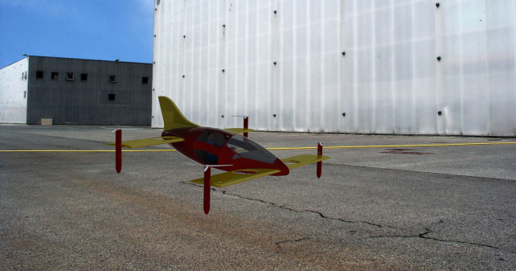
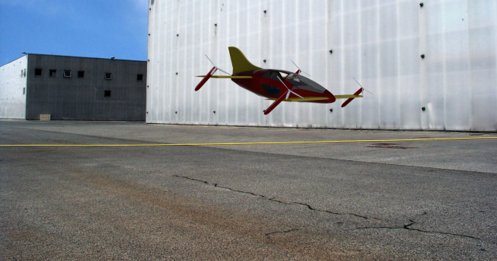
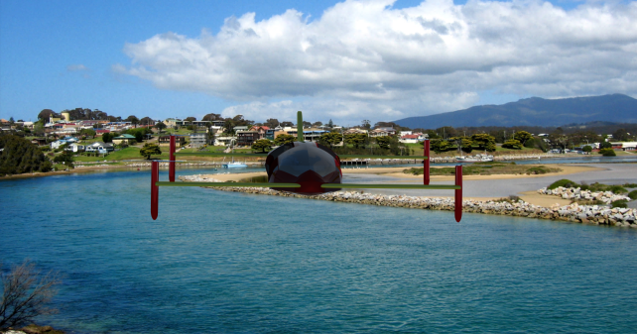
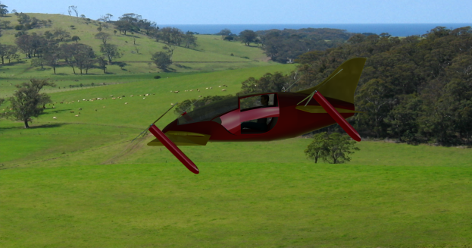
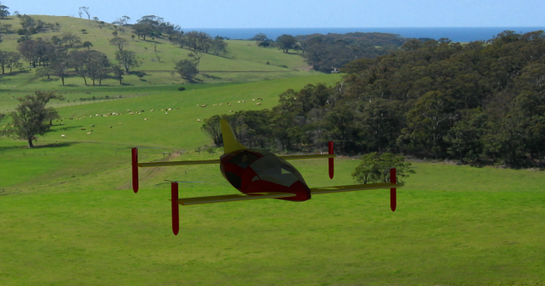
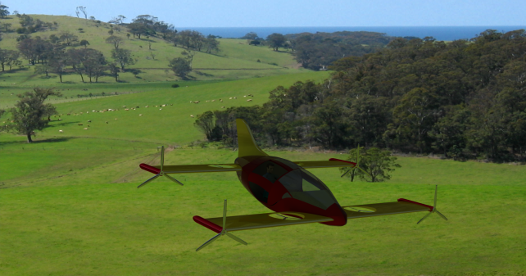
Take-off and tilt transition
By Estaca 2016

Slide 8
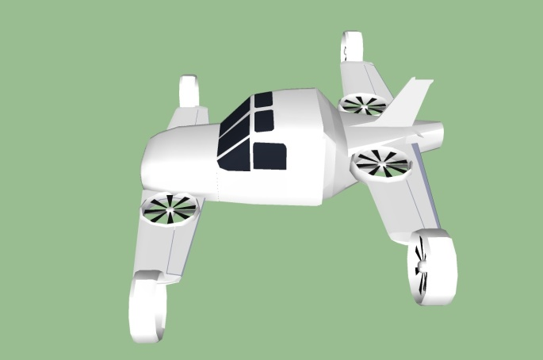
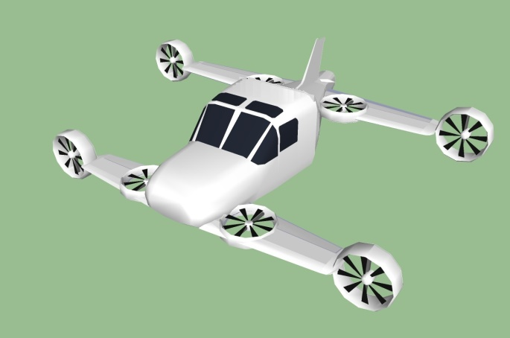
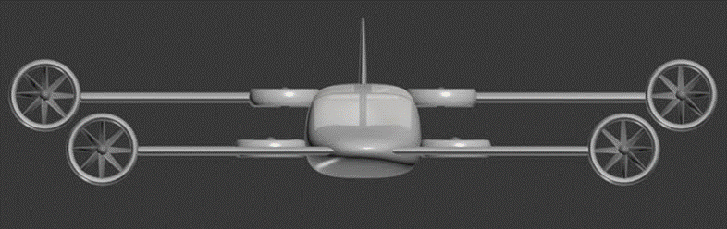
Cruise flight
Hamza Fouatih 2016

Slide 9
Technical data
MTOW : 1200 kg
Structure : 320kg
Fuselage : 80kg
Payload : 220 kg (2 PAX)
Systems : 125 kg
Engines : 236 kg (4 turbotech 160kg + 4 Yuneec 76kg)
Batteries : 80kg
Fuel : 140kg

Slide 10
Costs
Total costs : 400k€
Wing : 60k€
Fuselage : 90k€
Landing gear : 10k€
Engines : 60k€
System : 180k€

Slide 11
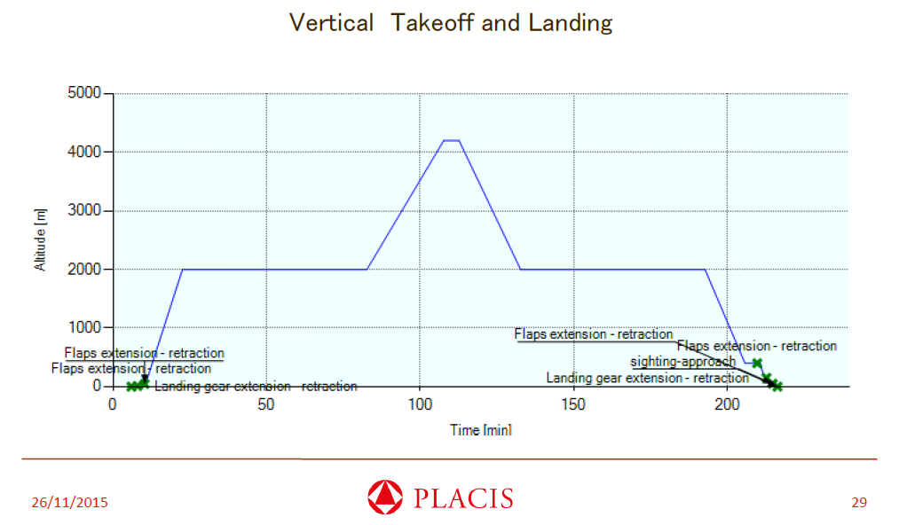
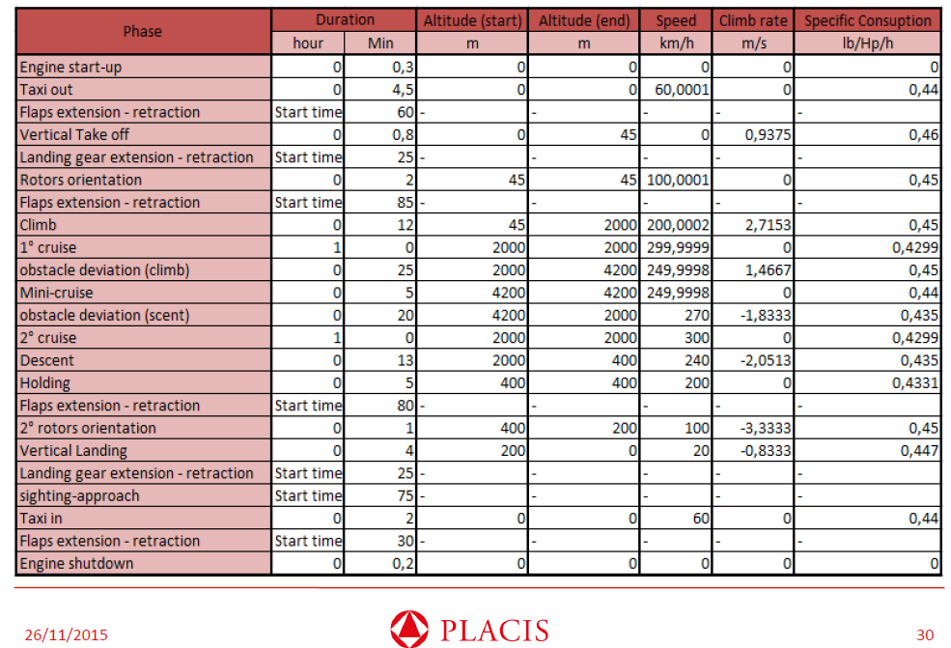
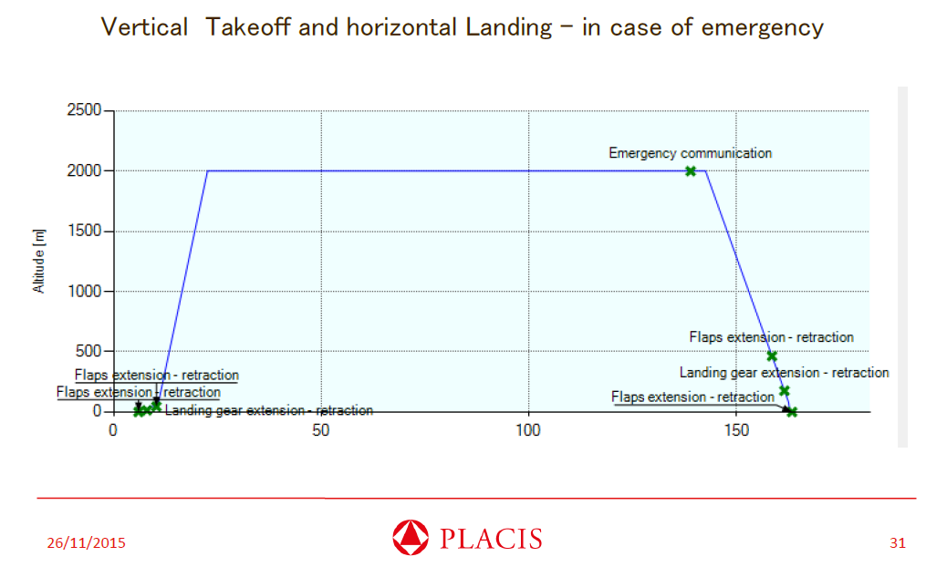
Mission profile

Slide 12
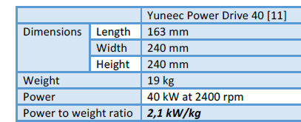
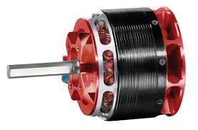
Engines for vertical rotor
Equipement proposed : 4 electric engines Yuneec Power Drive 40
Power 160 kW
provided by 80kg of batteries (at 150kW/kg) during take-off
and by fuel generator during cruise flight
Hamza Fouatih 2016

Slide 13
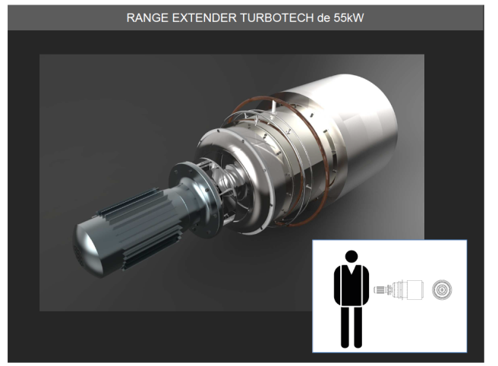
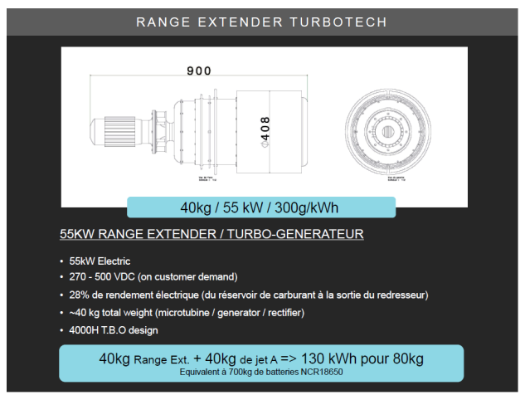
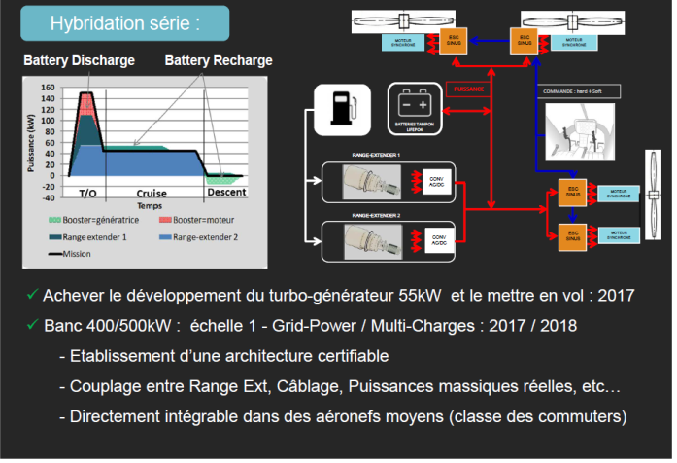
Electric generator for vertical quadcopter
Equipement proposed : 4 Turbotech 55kW for central quad copter
Fuel energy : 220 kW for take-off and low speed flight
Hamza Fouatih 2016

Slide 14
SWOT analysis
Strengths
Weakness
VTOL capacities
Speed of an aircraft
Double quadcopter back-up in case of engine failure
Fuel energy range
New configuration
Project at low TRL
Aerodynamic and leight weight structure
Propulsion and energy storage
Project implementation
Project funding
Opportunities
Threats
Cost reduction :
  Overall flight cost reduction compared to helicopter
  Low purchasing & maintenance cost of engines
New design space: tilt, octocopter
  Weight / VTOL
Project investment
All electric helicopter
All electric aircraft
Tilt rotor (bi and quadri)
Hybrid energy

Slide 15





Partners for R&D
Project coordinator
TRL1 Basic Definition
TRL2 Detailled Definition
To be launched

Slide 16
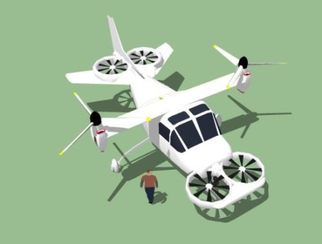




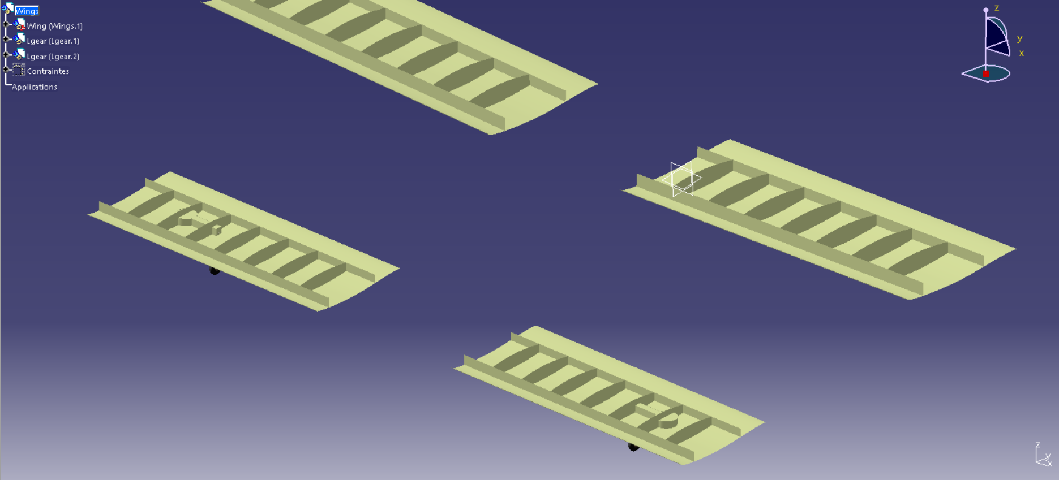
Project history
TRL0 Project Launch (2015)
Studies 2015/2016
TRL1 Basic Definition (2016)

Slide 17
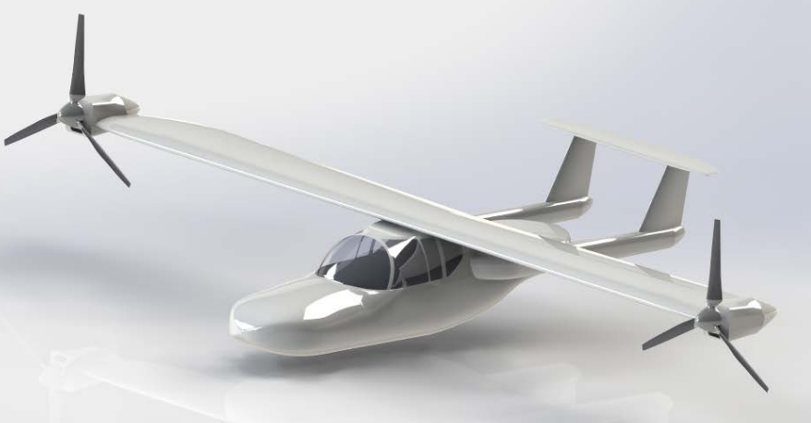
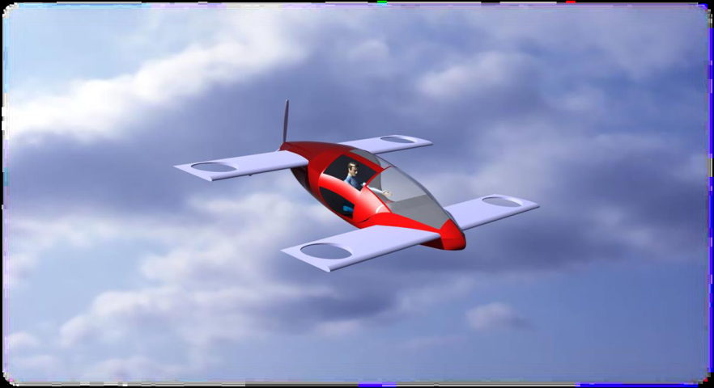
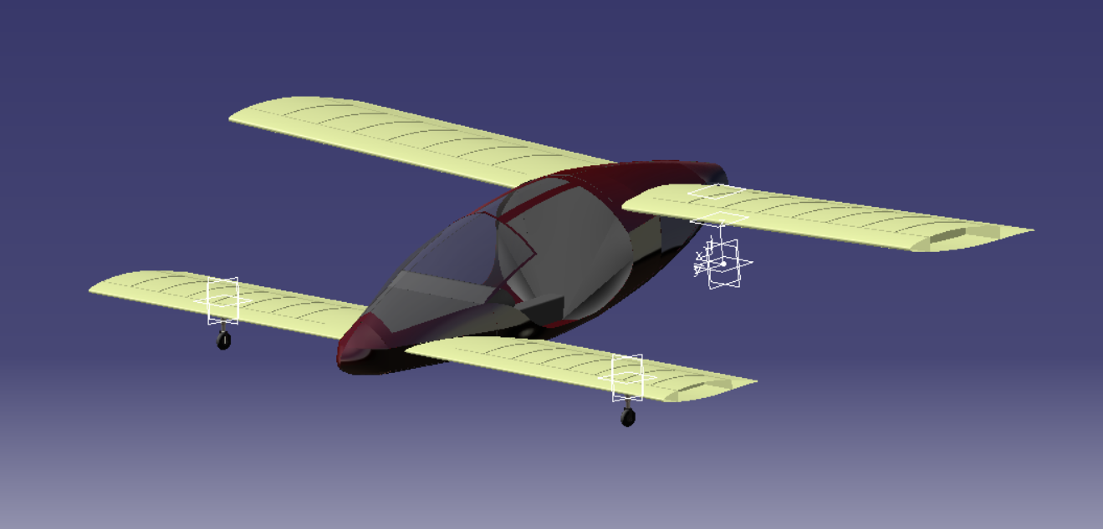
TRL1 project tasks
Polito 2015
Supmeca & Polito
2016 (Placis)
Supmeca
2016
Estaca
2016 group2
Estaca
2016 group1

Slide 18
Aerodynamic studies
Cockpit shape optimization
Supmeca 2016
Rotor shape optimization
Supmeca 2016
Vertical rotor air flow studies
Supmeca 2016

Slide 19
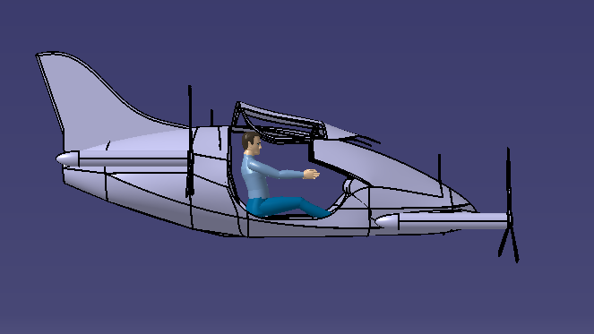
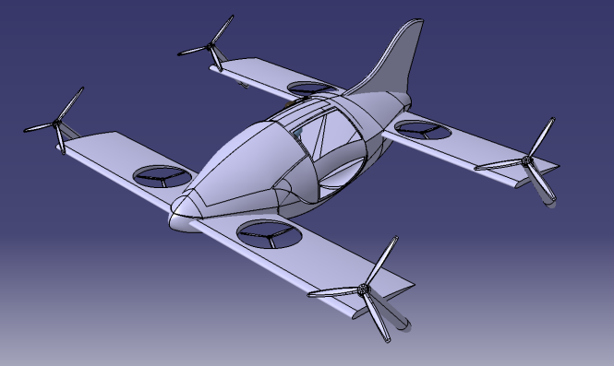
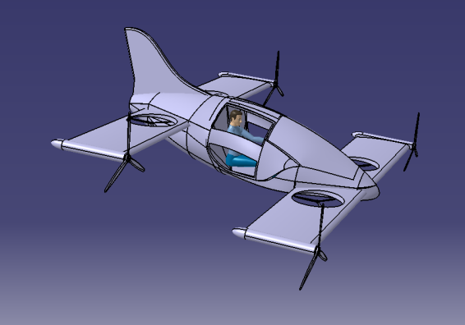
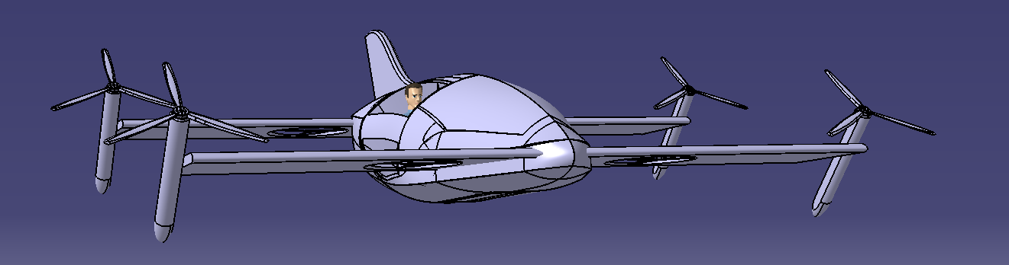
Configuration at end of TRL1
Estaca Laval 2016

Slide 20



Mini-Bee project for TRL2
Mini-Bee (at end of TRL1)
2 PAX VIP
Electric Octocopter
Tilt quadcopter & vertical quadcopter
Hybrid energy : batteries & fuel

Slide 21
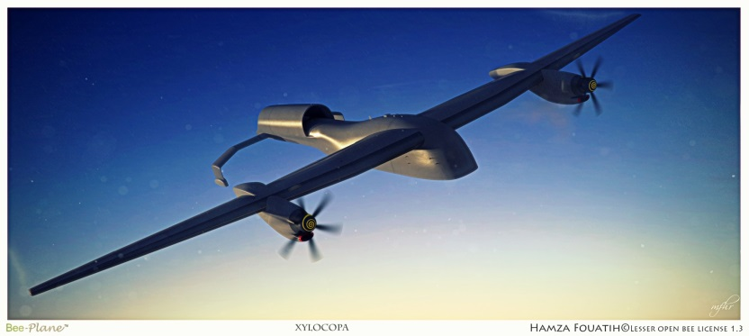




















Project partners
Lesser Open Bee License 1-3
Coordinator :
Universities :
Institution & financial partners :
Design:

Slide 22
Actions for Mini-Bee TRL2 Project
Launch Mini-Bee TRL2 project :
  Assess detailled technical configuration
  Evaluate market opportunities, production and flight costs
  Define partnership for TRL2 and TRL3
  Draw project financial path
Hamza Fouatih 2016

Slide 23
Partners to be defined
Project sponsors
Electronics and equipement integration
Aircraft flight management control
Aircraft manufacturer
Cokpit interface and project integration
Structure 3D printer

Slide 24
Annexes
Individual Air Vehicules

Slide 25
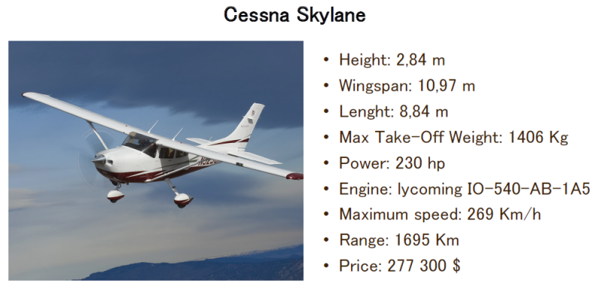
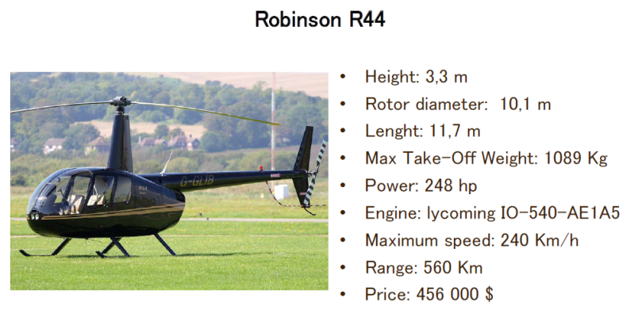
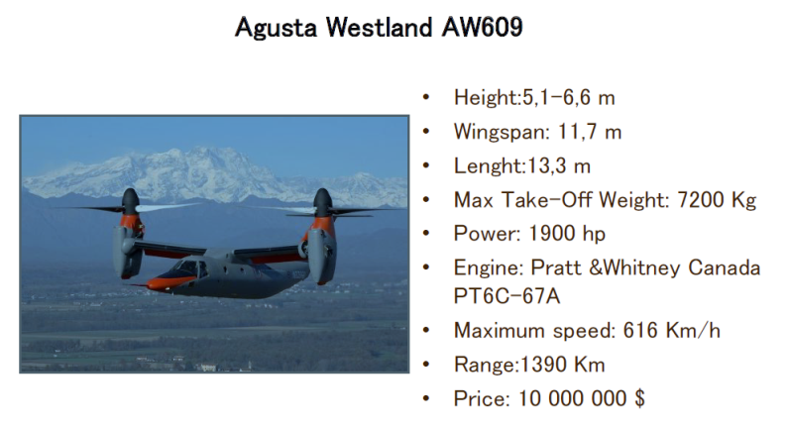
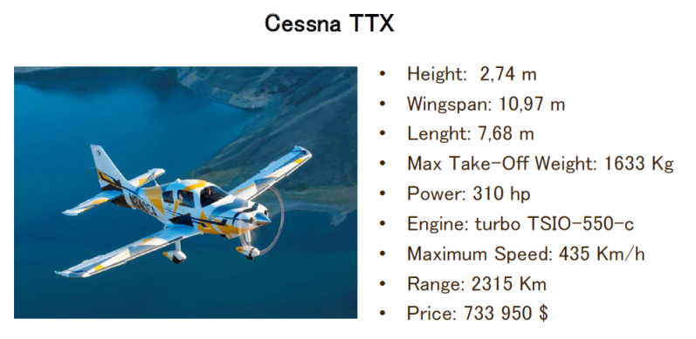
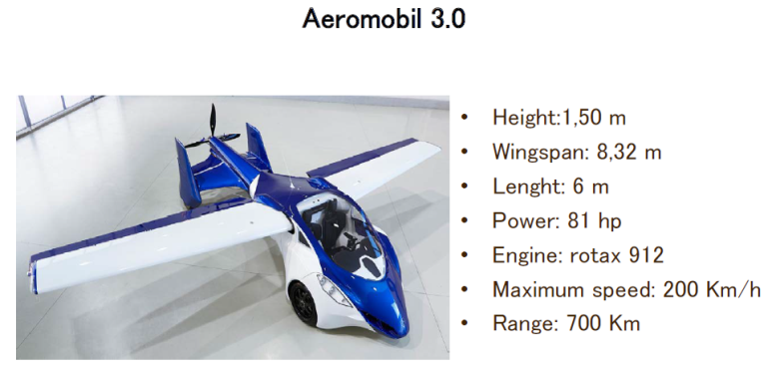
State of the art

Slide 26
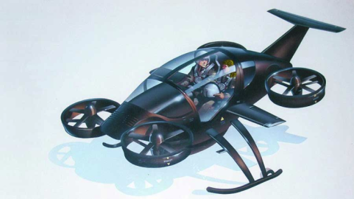
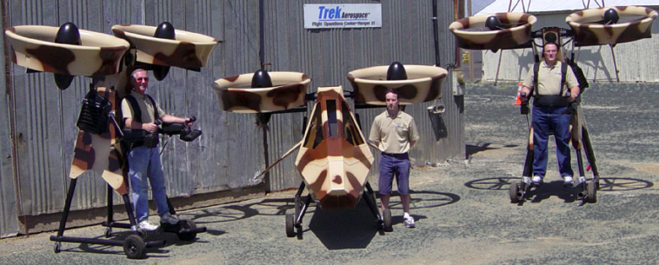
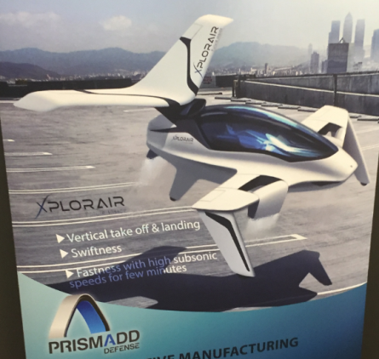
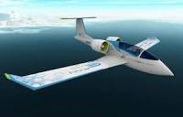
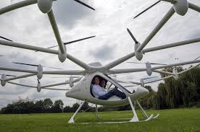
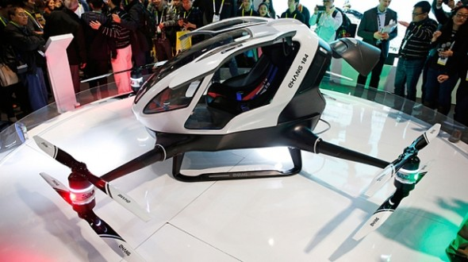
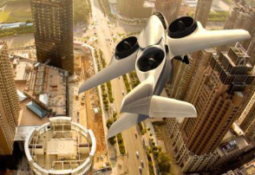
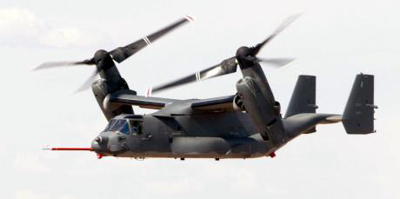
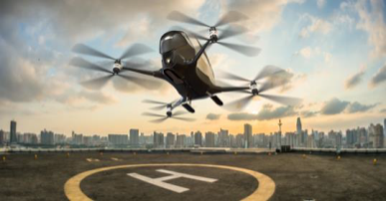
Other innovative projects
SoloTrek/Springtail
http://www.trekaero.com/
Xplorair (2016)
Airbus E-fan (all electric)
E-volo
eHang (fin 2015)

Slide 27

Mini-Bee
2PAX VIP Hybrid Octocopter
Hamza Fouatih 2016

