Slide 1

Red VTOL TRL4
2PAX VTOL hybrid multicopter
Ultra light air ambulance
-
EASA Certification Framework

Slide 2
Agenda (1/2)
Objectives
High Level Certification Framework
  EASA - European Aviation Safety Agency
  High Level Certification Framework
  SC-VTOL-02 Small-Category VTOL-Capable Aircraft
  CS- 27 Small Rotorcraft
  ToR RMT.0134 (27&29.029)
  CS-VLR – CS for Very Light Rotorcraft
  CS-29 – Large Rotorcraft
  Conclusion – CS-27, SC-VTOL-capable, CS-29 and CS-VLR
  DOARI 2021-01 Consultation
System & Sub-System Certification Framework
  CS-E Engines
  SC E-19 Electric/Hybrid Propulsion System
  CS-P Propellers
  CS-26 - Additional airworthiness specifications for operations
  AMC-20 - Products, Parts and Appliances

Slide 3
Agenda (2/2)
  CS-34 – Aircraft Engine Emissions and Fuel Venting
  NPA 2017-01
  ToR RMT.0514
  Air Transport by VTOL-capable aircraft
  FAQ n.21935 / Why is my small rotorcraft charged as medium rotorcraft under F&C?
  FAQ n.19463 / Can parachutes receive an ETSO authorization?
Extra material
  EASA Product List
  EASA Rotorcraft and VTOL Symposium 2019
  EASA Rotorcraft and VTOL Symposium 2020
  EASA Rotorcraft and VTOL Symposium 2021
  EASA Rotorcraft and VTOL Symposium 2022
  EASA Rotorcraft and VTOL Safety Symposium 2023
  EASA Rotorcraft and VTOL Safety Symposium 2024
  Rotorcraft & VTOL (Community and Overview)
Conclusion about Certification Framework
Listing of official links on EASA website
Glossary

Slide 4
Objectives
Define the Certification Framework in which our concept is included
Identify main texts that orient design to anticipate certification process
Analyse level of maturity of the enforced regulation, especially in « VTOL-capable aircraft » and associated « VTOL-capable technologies » as SC-VTOL-02 is still under improvement
The document is also an enabler for discovering associated technologies or orientations to make our concept much more coherent and relevant with market orientations and certification aspects

Slide 5
High Level Certification Framework
Main texts that define type or class of the aircraft
Extra regulation about technical specifications
Analysis of the maturity of Rule Making

Slide 6
EASA - European Aviation Safety Agency
EASA is the official European Agency that provides Standards & Specifications for Safety of Aviation.
Any text you refer to as a certification base shall come from EASA (check stamp and issue date).
Some versions of the texts are released for enforcement, and some are published in the frame of development procedure like Technical consultation or Rule Making Task (other procedures exist like Technical Advisory Committee and could be interesting for industrial that open the way to new standards).

Slide 7
EASA - European Aviation Safety Agency
(refer to picture on the next slide)
1 - EASA website : EASA is the European Aviation Safety Agency that ensures certification and safety of Aviation, you will find on its website all official information (do not trust any other website or referential that would not be released or approved by EASA itself).
2 - Select “EASA Pro” : EASA Pro is the part of the EASA website that will bring you information about certification and other standards that you need to get your aircraft certified.

Slide 8
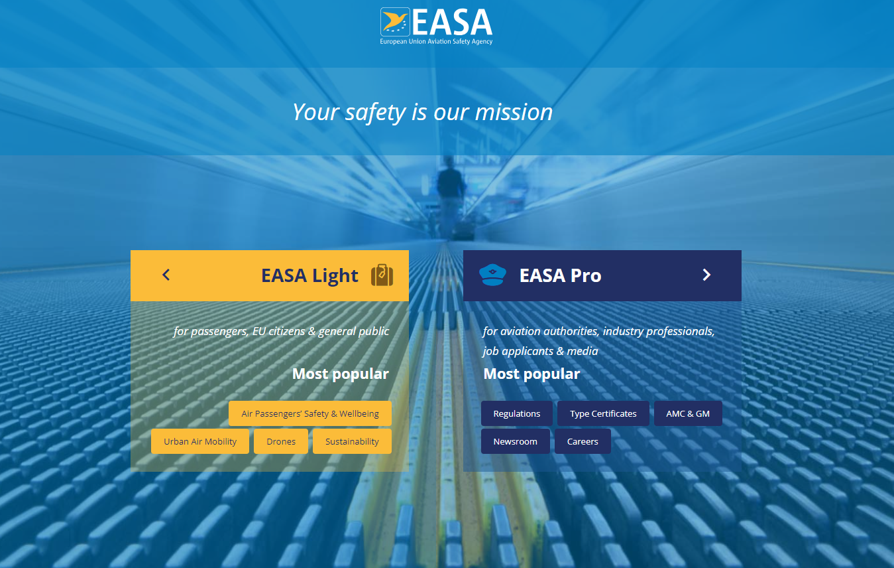
EASA - European Aviation Safety Agency
Official source

Slide 9
EASA - European Aviation Safety Agency
This is main gate to switch from Light to Pro space (if unable to find that page click on any logo EASA on the left-hand top corner of any page to drop to that page)
Click on “EASA Pro” to access the complete library

Slide 10
High Level Certification Framework
Where to classify Mini-Bee in EASA Certification Framework ?
Mini-Bee is currently considered by EASA as :
A small rotorcraft, in the frame of CS-27,
with VTOL-capable characteristics, in the frame of SC-VTOL-02
Design of Mini-Bee shall comply with both :
CS-27 Small Rotorcraft (Amendment 10, 27th January 2023) &
SC VTOL-capable (issue 2, June 2024).

Slide 11
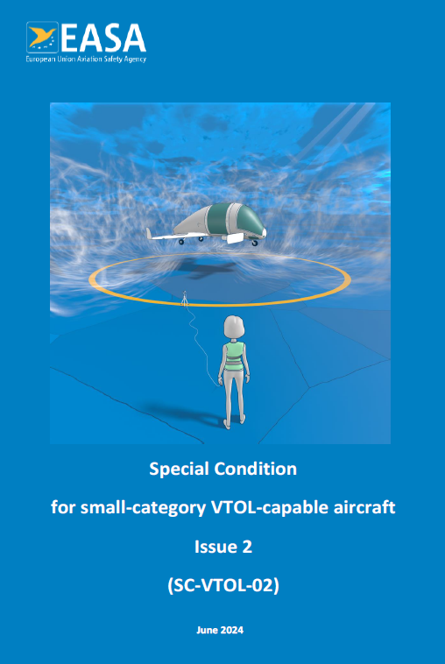
SC-VTOL-02 Small-Category VTOL-Capable Aircraft
(refer to sc_vtol_issue_2.pdf or sc_vtol_issue_2_with_highlighted_text.pdf)
Special Conditions for Type Certificate applicants (Issue 2, June 2024)
VTOL-capable : aircraft that has capacities to take-off and land vertically but “which differ from conventional rotorcraft or fixed-wing aircraft.” (refer to Statement of issue, page ii), by the way EASA has transformed VTOL small aircraft into “VTOL-capable aircraft” to fit new candidate aircraft.
Mini-Bee is submitted to SC-VTOL as being a VTOL-capable aircraft.
Safety Analysis : “determine suitability of each design and part” & “prevent single failures from resulting in a catastrophic effect” (refer to VTOL.2250(c))
Weight / Occupants : bringing Max Certified Take-Off Mass to 5700kg / 2584lb and 9 occupants
Lift/Thrust system : the complete hybrid chain must be considered as a lift/thrust system, from fuel reservoir to the tip of each of the 60 propellers. (refer to VTOL.2400 (a) to (f))
Recorders : ensure recording and safeguarding of the last 5 hours of flight path, speed, ATS communications, significant safety information for the crew (refer to VTOL.2555 (a) to (f))
High Electrical Power : ensure an adequate consideration of EWIS in the certification of VTOL-capable aircraft (refer to VTOL.2517 (a) & (b))

Slide 12
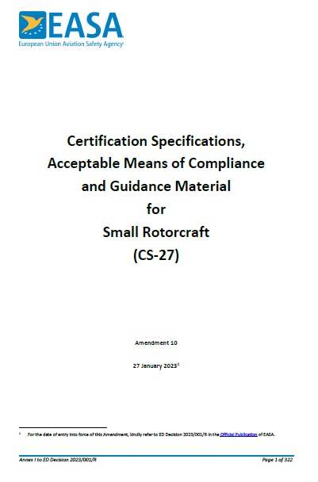
CS- 27 Small Rotorcraft
(refer to cs_27_amendment_10.pdf or change_information_-_cs-27_amendment_10.pdf)
Certification Specifications, Acceptable Means of Compliance and Guidance Materiel (Amendment 10, 27th January 2023)
Small Rotorcraft: Mini-Bee with its multiple propellers on the top operates like one small rotorcraft
Weight / Occupants: consideration max weight 3750kg and 4 occupants
Occupants: from 1 to 4

Slide 13
ToR RMT.0134 (27&29.029)
Regular update of rotorcraft AMC, 11 September 2017
The EASA rotorcraft certification specifications (CS-VLR, CS-27 and CS-29) are unique in the EASA regulatory framework in which the acceptable means of compliance (AMC) contained in Book 2 of the certification specifications (CS-VLR, CS-27 and CS-29) directly refer to the respective FAA Advisory Circulars (ACs). The FAA regularly reviews and updates the advisory circular (AC) material to maintain their relevance and improve the certification process. There is a need for EASA to keep abreast of these changes in order to ensure that they can be accepted as AMC in Book 2 of the CSs.
(refer to ToR RMT.0134 (27&29.029) Issue 2.pdf)
Process is largely finished, Q4 2017.
Main reason for that ToR RMT : “The EASA rotorcraft certification specifications (CS-VLR, CS-27 and CS-29) are unique in the EASA regulatory framework in which the AMC contained in Book 2 of the CSs directly refer to the respective FAA Advisory Circulars (ACs). FAA AC 27-1B has been adopted by EASA as Book 2 to CS-VLR and CS-27, and AC 29-2C has been adopted as Book 2 to CS-29.” (refer to 1. Why we need to change the rules issue/rationale)
Design of Mini-Bee oscilliates between CS-VLR, CS-27 or CS-29 whenever the most adapted to the proposed design

Slide 14
CS-VLR – CS for Very Light Rotorcraft
(refer to cs_vlr_amdt3.pdf)
CS-VLR (Amendment 3, 17/12/2018)
ED Decision 2018-015-R (CS-VLR-27-29 Amdt), and EN to ED Decision 2018-015-R (CS-VLR-27-29) : precising intentions and consequent modifications of CS-VLR amdt3 and CS-27 amdt 6 (also CS-29 amdt 6) defined in documents (below) Change information - CS-VLR Amdt 3.pdf and Change information - CS-27 Amdt 6.pdf (also Change information - CS-29 Amdt 6.pdf)
Change information - CS-VLR Amdt 3.pdf
BOOK2CS-VLR BOOK 2 —ACCEPTABLE MEANS OF COMPLIANCE (as refered in previous slide)
AMC VLR General
AC 27-1B Change 7, dated 4 February 2016
Change information - CS-27 Amdt 6.pdf
All additional and removal amendments are largely incorporated in CS-27 Amendment 10 (AC 27-1B incorporated into CS-27 under AMCs)
VLR refers to : simple design, 2 occupants max, not powered by turbine or rocket engine, VFR day ops only (MB ok check mass)

Slide 15
CS-29 – Large Rotorcraft
(refer to CS-29 Amendment 9 (corrected).pdf)
Certification Specifications, Acceptable Means of Compliance and Guidance Material for Large Rotorcraft, Amendment 9, 14 June 2021
What to consider in CS-29, mainly:
Major difference with CS-27 : multi-engine power and/or maximum weight (including combination with number of occupants)
Specific Equipment and Operations covered by CS and AMC 29 (mainly for Public Transportation destination)
Why considering CS-29 when designing under CS-VLR, CS-27 and/or SC-VTOL:
Remind of CS-21 : an ‘equivalent airworthiness code’, any specification of the designed rotorcraft could bring it to have to comply with Specifications included in CS-29 (night operations, flying over sea, weight overpassing, complex system, …)
Candidate’s design under CS-27 can be brought to comply with CS-29 if its design exits bounders of CS-27 (risk to be considered)

Slide 16
Conclusion – CS-27, SC-VTOL-capable, CS-29 and CS-VLR
Candidates to certification shall pay attention to :
Consider their certification framework and
Demonstrate design enters (under reserve to be reclassified).
To go further with Continuing Airworthiness, refer to :
Easy Access Rules for Continuing Airworthiness
Mini-Bee shall comply with requirements of:
CS-27 Small Rotorcraft as a Small Helicopter (in its general design and behavior)
SC VTOL-capable for special aspects that are not yet covered by CS-27 (like power system and lift/thrust system)
CS-29 Large Rotorcraft as an advice for some design drivers (especially BOOK2 and Human Factors aspetcs) or in case of infringment of design (not covered by CS-27 itself)
VLR only if design enters frame of restrictions (mass, occupants, …)

Slide 17
DOARI 2021-01 Consultation (1/3)
Competence of flight test crew involved in VTOL flight test activities (30 June 2021)
This DOARI is intended to address competences of flight test crew involved in flight test activities on aircraft that meet the applicability criteria of SC-VTOL-01 i.e.:
a person-carrying vertical take-off and landing (VTOL) heavier-than-air aircraft in the small category, with lift/thrust units used to generate powered lift and control;
distinct from conventional aeroplanes by its VTOL capability or;
distinct from conventional rotorcraft by the use of distributed propulsion;
with a passenger seating configuration of 9 or less and;
a maximum certified take-off mass of 3 175 kg (7 000 lbs) or less.
No longer valid, only consider principles
Those considerations about Flight Test Crewing in matter of Flight Test Conditions, Airworthiness Equivalent Level and Licensing reminds us to suggest design that matches and/or fits the better current requirements, despite some lacks or discontinuities in regulations.

Slide 18
DOARI 2021-01 Consultation (2/3)
(refer to doari_2021-01_consultation_paper.pdf)
DOARI 2021-01 Consultation Paper refers to deviation that could be possible to applicable airworthiness codes, certifications or specifications, especially here Part21, FCL / Aircrew and CS-23/25/27/29.
3 Problems to keep at mind :
Designers having DOA (Design Organisation Approval) shall provide a FTOM (Flight Test Operations Manual) in Appendix XII to Part 21
SC-VTOL should be considered an ‘equivalent airworthiness code’ as addressed in Appendix XII, to understand the applicability of the Appendix = meaning is clarified in 5 EASA position - a
Align aircraft to be certified i.a.w. SC-VTOL with the current Part FCL categorization into ‘aeroplanes’, ‘helicopters’ and ‘powered-lift aircraft’ to establish minimum flight crew licence requirement = constant question of FCL to be aligned with new design (EASA) or design to be aligned with current requirements in FCL (DOA) in 5 EASA position – b and c (also refer to specifically FCL.010, and more generally Annex IV to Regulation (EU) 2018/1139)
No longer valid, only consider principles

Slide 19
DOARI 2021-01 Consultation (3/3)
Conclusions of such enhancement about Test Crew Conditions fixes on driving principle for our design*.
*Despite interesting, the DOARI is no longer valid as it tackled with Part21-AMC/GM-ELA that has been deleted from Part21-AMC/GM. (refer to Part21 issue02 amendment16)
Design thinking should be based on :
Preparation of the Flight Test Operations, so that showing design enters the frames of certification being candidate to,
VTOL aircraft like Mini-Bee are assimilated to CS-27 rotorcraft as a base (in matter of technical specifications), so design of flying (controls, handling qualities, performances, …) shall be matching CS-27, and
VTOL aircraft like Mini-Bee are assimilated to CS-27 as a category of aircraft for Licensing in reference to Aircrew, so that training methods and principles of flight should / shall be similar (as a remind for the design choices too / philosophy of flight).
No longer valid, only consider principles

Slide 20
System & Sub-System Certification Framework
Certification applicable to any system and sub-system (as described in SC-VTOL-02)
Enables to define limitation of the concept regarding operations

Slide 21
CS-E Engines (1/2)
(refer to crd_master_-_sc_e-19_2021-04-07.pdf)
Provides details of discussions and suggestions on the SC-E-19 between Industrials and EASA, opportunity for Industrial to orient certification I the direction of their expectations
Examples of [Industrial] Comment / Suggestion and [EASA] Response
  Serie or Parallel hybrid?
    [J. Buttner] Comment “Changes of requirements comparing serial hybrid with parallel hybrid propulsion?”
    [EASA] Response “Requirements provided in the SC E-19 are deemed to be technology agnostic. Specific Means of Compliance may however be proposed for a kind a hybrid propulsion architecture.”
  Which voltage? More that 320V?
    [Rolls Royce] Comment “AMC EHPS.330(d) & Associated AMC should at least cover CS-E 80 (equipment) and its AMC and the use of DO-160”
    + [Rolls Royce] Suggestion “DO-160 EMC effects is just covering electrical systems up to 270V dc, max 320V, surge voltage 425V. EHPS systems of significantly higher voltage require a new test definition concerning EMC.”
    [EASA] Response “Dedicated working groups in several standardization bodies are currently working on the topic. The results of these WG is intended to be used as a MoC.”

Slide 22
CS-E Engines (2/2)
(refer to cs-e_amendment_7.pdf)
CS-E (amendment 7, 15/12/2023)
Certification Specifications and Acceptable Means of Compliance for Engines
Piston Engine : covered by Subpart B and Subpart C
Should be complied through integration of a certified aeronautic engine (ex Rotax)
Instead : shall have to comply with each of the requirements
To go further with CS-E Engines, refer to :
Special Condition Time Limited Dispatch (TLD) for Piston Engines
Easy Access Rules for Engines (CS-E)
As a reminder : Engine is part of the Lift / Thrust System
(refer to VTOL.2400 (a) to (f))

Slide 23
SC E-19 Electric/Hybrid Propulsion System (1/2)
(refer to Consultation Paper SC_EHPS - 2020-01-24.pdf)
Limit date for comments and suggestion was 06/03/2020
  Need to check next sessions to cease opportunity to make listen to constraints we would like to get incorporated
(refer to sc_e-19_issue_1_electric_hybrid_propulsion_system_-_2021-04-07.pdf)
Released version on the 7th of April 2021 after consultation for SC-E-19 issue1 (including IM/AMC, Interpretative Material / Acceptable Means of Compliance)
A - General
B - Design and Construction
C - Systems and Equipment
D – Substantiation
Associated Interpretative Material / Means of Compliance
Many discussions on new power technologies for NAM and
One official referential : SC e-19

Slide 24
SC E-19 Electric/Hybrid Propulsion System (2/2)
(refer to Certification_of_Electric_Hybrid_Propulsion_Systems_1722413016.pdf)
At the time, we are writting the document, EASA releases that CM for EHPS TC with 2 propositions:
  Aircraft approach, or
  Engine Approach.
Each part can have its own TC or be seen as part of a more or less integrated system candidating for a TC.
Bringing better vision of certification process for integrated system (function, system, integration, airworthiness, crashworthiness, …)

Slide 25
CS-P Propellers
(refer to cs-p_amendment_2.pdf)
CS-P (amendment 2, 24/06/2020)
Certification Specifications and Acceptable Means of Compliance for Propellers
Propellers : covered by al Subpart : Subpart A, Subpart B, Subpart C and Subpart D.
Should be complied through integration of certified aeronautic Propellers (if available “on the shelf”)
To go further with CS-P Propellers, refer to :
Easy Access Rules for Propellers (CS-P)
As a reminder : Propeller is part of the Lift / Thrust System
(refer to VTOL.2400 (a) to (f))

Slide 26
CS-26 - Additional airworthiness specifications for operations
(refer to cs-26_issue_4.pdf)
CS-26 (Issue 4, 28 Sept 2022)
Large aeroplane tyre pressure monitoring | Helicopter ditching and water impact occupant survivability
Specifications in Subpart-A
  General,
  Purpose and
  Scope
Subpart C (Helicopters)
  Fire Extinguishers,
  Water Emergency Equipment (in different parts)
  (also refer to Appendix F)
Provision for Mini-Bee : case of special operations or public transportation

Slide 27
AMC-20 - Products, Parts and Appliances
(refer to AMC-20 Amendment 21 (corrected on 11.05.2021).pdf)
General Acceptable Means of Compliance for Airworthiness of Products, Parts and Appliances (Amendment 21, 21 April 2021, corrected on 11 May 2021)
2. RELEVANT SPECIFICATIONS / “For aircraft certification, some of the related CSs are : […] for rotorcraft: equivalent specifications in CS-27 and CS-29.”
Consideration of bridges between certification referentials beyond types

Slide 28
CS-34 - Aircraft Engine Emissions and Fuel Venting (1/4)
(refer to CS-34 Amendment 4.pdf)
CS-34 Amendment 4
Implementation of the latest CAEP amendments to ICAO Annex 16 Volumes I, II, and III — CAEP/11, 14 July 2021
AMC and GM to Part 21, Issue 2, Amendment 13
CS-34 Amendment 4, CS-36 Amendment 6, CS-CO2 Issue 2
Commission Delegated Regulation (EU) 2021/1087 amending Article 9(2) of Regulation (EU) 2018/1139 was adopted on 7 April 2021. This amendment incorporates the latest amendments to Volumes I, II and III of Annex 16 to the Chicago Convention to align the European Union (EU) regulatory framework with the International Civil Aviation Organization (ICAO) Standards and Recommended Practices (SARPs).

Slide 29
CS-34 - Aircraft Engine Emissions and Fuel Venting (2/4)
Commission Delegated Regulation (EU) 2021/1088, amending Commission Regulation (EU) No 748/2012, was adopted by the European Commission on 7 April 2021. This amendment aligns the certification procedures for environmental protection with Volumes I, II and III of Annex 16 to the Chicago Convention.
The objective of this Decision is to support the application of these two Regulations by also aligning the related acceptable means of compliance (AMC) & guidance material (GM) and certifications specifications (CS) with the latest amended ICAO SARPs in Volumes I, II and III of Annex 16 to the Chicago Convention as well as with the guidance material in the related ICAO Doc 9501 Environmental Technical Manual (ETM).
To achieve the above-mentioned objective, this Decision amends the AMC & GM to Part 21, CS-34, CS-36 and CS-CO2.

Slide 30
CS-34 - Aircraft Engine Emissions and Fuel Venting (3/4)
The amendments are expected to ensure a high uniform level of environmental protection and to provide a level playing field for all actors in the aviation market.
ED Decision 2021/011/R
  Fuel tank : refer to and comply with CS 34.1 Fuel venting and GM1 34.1 Fuel venting
  Rotax Engine : should be complied with by certification (CS 34.2 Aircraft engine emissions and GM1 34.2 Aircraft engine emissions
Explanatory Note to ED Decision 2021/011/R
  Entry into service
Change Information — CS-34 Amendment 4
  Highlight of changes appearing in ED Decision 2021/011/R
… and …

Slide 31
CS-34 - Aircraft Engine Emissions and Fuel Venting (4/4)
AMC & GM to Part 21 — Issue 2, Amendment 13
  Working document for ED Decision 2021/011/R
CS-36 Amendment 6
  CS, AMC and GM for Aircraft Noise
  CS 36.1 Aircraft noise and GM1 36.1 Aircraft noise
CS-CO2 Issue 2
  CS, AMC and GM for Aeroplanes CO2 Emissions
  CS CO2.1 Aeroplanes CO2 Emissions and GM1 CO2.1 Aeroplanes CO2 Emissions
Corrigendum to Decision 2021/011/R
  Working document for CS-CO2 Issue 2
Should Rotax comply with it: Mini-Bee will have to watch any new version of requirements till certification (in relationship with CS-E and CS e-19)

Slide 32
NPA 2017-01
(refer to NPA 2017-01.pdf)
Implementation of the CAEP/10 amendments on climate change, emissions and noise
Aircraft noise (RMT.0513) & climate change (RMT.0514)
Affected rules:
— Regulation (EC) No 216/2008;
— Part-21 and related AMC/GM;
— CS-34;
— CS-36;
— CS-CO2 (new)
Evolutions of our referentials, amongst which CS-CO2…

Slide 33
ToR RMT.0514
(refer to ToR RMT.0514 Issue 2.pdf)
Implementation of the latest CAEP amendments to ICAO Annex 16 Volumes I, II, and III
Extract from the document:
  4. What are the deliverables
  Notice of Proposed Amendments (NPA)s proposing draft amendments to:
  — Basic Regulation
  — Part-21
  — AMC and GM to Part 21
  — CS-34, CS-36, and CS-CO2.
Evolutions of our referentials are still to be expected from it…

Slide 34
FAQ n.21935 / Why is my small rotorcraft charged as medium rotorcraft under F&C?
Commission Implementing Regulation (EU) 2019/2153 establishes the EASA Fees and Charges and defines in Part V point (2) the following categories of Rotorcraft Products for this purpose (only):
- VTOL Large Aircraft refers to CS 29 and CS 27 cat A aircraft;
- VTOL Small Aircraft refers to CS-27 aircraft with maximum take-off weight (MTOW) below 3 175 kg and limited to 4 seats, including pilot;
- VTOL Medium Aircraft refers to other CS-27 aircraft.
According to EASA TCDS R.008, the AS350 rotorcraft is a CS27 rotorcraft with MTOW below 3 175kg and a seating capacity of 6, including the pilot. Hence it must be classified as Medium Rotorcraft as per the above definition.
According to EASA TCDS R.146, the AS355 rotorcraft is a CS27 rotorcraft with MTOW below 3 175kg and a seating capacity of 6 (or 7, if an optional two-place seat is installed), including the pilot. Hence it shall be classified as Medium Rotorcraft as per the above definition.
Only one characteristic non-complying with CS or SC is enough to re-classify your vehicle to an upper category (occupants, weight, power, complexity, …)

Slide 35
FAQ n.19463 / Can parachutes receive an ETSO authorization?
Personnel parachutes within the scope of EASA are only emergency parachutes for glider and aerobatics pilots. All other parachutes (recreational, tandem etc.) are under the responsibility of the relevant Member States. EASA has published a list of parachute approvals granted by NAAs prior to EASA, which fall under the EASA responsibility.
(refer to Easy Access Rule CS- ETSO.pdf)
EASA does not seem to make a reference to parachute (ie Zefhir or Galaxy GRS) as AMC for safety recovery in lift/thrust failure… to be further studied in the next thorough certification analysis…

Slide 36
Extra material
List of others concepts in progress for design and prototype
Symposiums about Rotorcraft & VTOL aircraft are the opportunity to nuderstand how EASA deals with managing the Safety our those NAM

Slide 37
EASA Product List
Ex1: “TC Holder” research field selected as “Volocopter” /”Ascendance Flight” … : no result !
Ex2: “Product Category” research field selected as “VTOL” : lots of helicopters …
EASA Product list | EASA (europa.eu)

Slide 38
EASA Rotorcraft and VTOL Symposium 2019
(Refer to 2019_EASA_Rotorcraft&VTOL_Symposium.pdf and other Presentation support)
Description
Date & time
Day 1, 10/12/2019, 09:00 - 17:30
Day 2, 11/12/2019, 09:00 - 15:30
Description of the event
The EASA Rotorcraft and VTOL Symposium is a unique forum in Europe to discuss the latest developments for rotorcraft from a safety perspective.
This symposium is existing for 12 years and has a growing recognition in the community. For this year's edition the scope will be extended in order to cover all types of Vertical Take-off and Landing Aircraft (VTOL). Other changes and additions:
Update on the Rotorcraft Safety Roadmap,
Dedicated session on VTOL (Vertical Takeoff and Landing) to present the status of the future Means of Compliance to support the Special Condition on VTOL released in July 2019,
A Safety Promotion workshop aimed to promote Helicopter Technologies with Safety Benefits.
EASA led Symposium about Rotor since long time ago but made appear VTOL in that Symposium in 2019.

Slide 39
EASA Rotorcraft and VTOL Symposium 2020
Description of the event:
The EASA Rotorcraft and VTOL Symposium 2020 is a unique forum in Europe to discuss the latest developments for rotorcraft from a safety perspective. Due to the COVID 19 circumstances this year, the Symposium will take place as a live virtual event focusing on VTOL developments and safety perspectives. Our speakers will be EASA Experts from various disciplines and will present the latest developments to enable the safe operation of VTOL aircrafts.
The live session on December 9 from 14:00 till 16:00 will concentrate on the Rotorcraft Safety Roadmap.
The uploaded 10 video presentations are focusing on the current status of the Means of Compliance to support the Special Conditions on VTOL:
1 - Human Factors assessment for installed systems and equipment for use by the crew
2 - VTOL Design Loads and Interaction of Systems and Structures
3 - Doors and Landing Gear
4 - Ditching, Emergency Flotation and Limited Overwater Operations
5 - Advance of EASA Position on Energy Reserve
6 - U-space
7 - Artificial Intelligence (AI) Roadmap
8 - VTOL Flight Envelopes and Stall characteristics
9 - VTOL Structural Durability; Aeroelasticity; Protection of Structure; Materials and Processes; Special Factors of Safety
10 - Fire Protection in Designated Fire Zones
EASA draws the framework of VTOL certification to come…

Slide 40
EASA Rotorcraft and VTOL Symposium 2021
Description:
The EASA Rotorcraft and VTOL Symposium is a unique forum in Europe to discuss the latest developments for rotorcraft from a safety perspective. This Symposium is the opportunity when Authorities, Industry, Operators, Pilots, Safety Investigators, Researchers and all those vesting an interest in improving rotorcraft safety worldwide, can share and exchange ideas. It will take place within the frame of the European Rotors, on 16th and 17th November 2021, at the Trade Fair Centre in Cologne, Germany.

Slide 41
EASA Rotorcraft and VTOL Symposium 2022
Description:
The EASA Rotorcraft and VTOL Symposium is a unique forum in Europe to discuss the latest developments for rotorcraft from a safety perspective. This Symposium is the opportunity when Authorities, Industry, Operators, Pilots, Safety Investigators, Researchers and all those vesting an interest in improving rotorcraft safety worldwide, can share and exchange ideas. It will take place within the frame of the European Rotors, on 8-9 November 2022. European Rotors takes place on 8-10 November at the Trade Fair Centre in Cologne, Germany.

Slide 42
EASA Rotorcraft and VTOL Safety Symposium 2023
Description:
The EASA Rotorcraft and VTOL Safety Symposium is a unique forum in Europe to discuss the latest developments for rotorcraft from a safety perspective.
This Symposium is the opportunity when Authorities, Industry, Operators, Pilots, Safety Investigators, Researchers and all those vesting an interest in improving rotorcraft safety worldwide, can share and exchange ideas.
It will take place on 27 November 2023 as the kick off event within the frame of the European Rotors. EASA will join and contribute to the other technical conferences during the European Rotors that takes place on 28-30 November, also at the “IFEMA MADRID” convention in Madrid.
The European Rotors also included two other EASA events:
The VAST ESPN-R Safety Workshop – Unanticipated Yaw
Rotor Safety Zone – ESPN-R Hoist and Load, Pilot Training
Since 2023, Symposium adds the term “Safety” in its title and develops topics like integrating VTOLs in the Circulation and Pilot training and licensing…

Slide 43
EASA Rotorcraft and VTOL Safety Symposium 2024
Coming soon…
4th of November 2024 😉

Slide 44
Air Transport by VTOL-capable aircraft
Page evoks:
  Urban Passenger Services
  Regional Passenger Services
  VEMS Services
  Sightseeing Flights (Transportation A to A Leisure)
Many targets for VTOL, of which Medical aid…

Slide 45
Rotorcraft & VTOL (Community and Overview)
Many interesting information about
  How to built future of those VTOL-capable aircraft ? (Community)
  What is a VTOL-capable aircraft ? (Overview)
  How to know more about VTOL-capable aircraft … ? (further information on the page)

Slide 46
Conclusion about Certification Framework
Currently Mini-Bee is considered as a Small Rotorcraft with consideration of Special Conditions VTOL-capable : design of it is new but will have to comply with legacy of that type and category.
Further step : consider each certification text then deduce constraints and options for our concept, especially VLR or Small category as a main design driver.
Options : enter in the process of consultation or community to make ear our expectations and participate in building new regulation (CS, SC but also AMC, GM or even RMT).

Slide 47
Listing of official links on EASA website (1/6)
EASA - European Aviation Safety Agency (slide
EASA | European Union Aviation Safety Agency (europa.eu)
High Level Certification - CS- 27 Small Rotorcraft
CS-27 Amendment 10 - Regular update of the Certification Specifications for Small Rotorcraft (CS-27) | EASA (europa.eu)
Easy Access Rules for Continuing Airworthiness
Easy Access Rules for Continuing Airworthiness - Revision from July 2024 - Available in pdf, online & XML format | EASA (europa.eu)
High Level Certification - SC-VTOL-02 Small-Category VTOL-Capable Aircraft
Special Condition for VTOL and Means of Compliance | EASA (europa.eu)
ToR RMT.0134 (27&29.029)
ToR RMT.0134 (27&29.029) - Regular update of rotorcraft AMC | EASA (europa.eu)
CS-VLR – CS for Very Light Rotorcraft
CS-VLR Amendment 2 | EASA (europa.eu)

Slide 48
Listing of official links on EASA website (2/6)
CS-29 – Large Rotorcraft
CS-29 Amendment 9 | EASA (europa.eu)
DOARI 2021-01 Consultation
DOARI 2021-01 Consultation - Competence of flight test crew involved in VTOL flight test activities | EASA (europa.eu)
CS-E Engines
CS-E Amendment 7 - Regular update of CS-E | EASA (europa.eu)
Special Condition Time Limited Dispatch (TLD) for Piston Engines
Special Condition Time Limited Dispatch (TLD) for Piston Engines - CS-E, all amendments | EASA (europa.eu)
Easy Access Rules for Engines (CS-E)
Easy Access Rules for Engines (CS-E) - Initial issue & amendments 1-5 — Amendment 5 available also in xml format | EASA (europa.eu)

Slide 49
Listing of official links on EASA website (3/6)
SC E-19 Electric / Hybrid Propulsion System
Final Special Condition SC E-19 - Electric / Hybrid Propulsion System - Issue 01 | EASA (europa.eu)
Proposed CM ref. CM-21. A-004 Issue 01 on “Acceptable approaches for the certification of Electric/Hybrid Propulsion Systems” | EASA (europa.eu)
Propellers
CS-P Amendment 2 | EASA (europa.eu)
Easy Access Rules for Propellers (CS-P)
Easy Access Rules for Propellers (CS-P) - initial issue & amendment 1 | EASA (europa.eu)
CS-26 - Additional airworthiness specifications for operations
CS-26 Issue 4 - Large aeroplane tyre pressure monitoring | Helicopter ditching and water impact occupant survivability | EASA (europa.eu)
AMC-20 - Products, Parts and Appliances
AMC-20 Amendment 21 | EASA (europa.eu)

Slide 50
Listing of official links on EASA website (4/6)
CS-34 - Aircraft Engine Emissions and Fuel Venting
CS-34 Amendment 4 - Implementation of the latest CAEP amendments to ICAO Annex 16 Volumes I, II, and III — CAEP/11 | EASA (europa.eu)
NPA 2017-01
NPA 2017-01 - Implementation of the CAEP/10 amendments on climate change, emissions and noise | EASA (europa.eu)
ToR RMT.0514
ToR RMT.0514 - Implementation of the latest CAEP amendments to ICAO Annex 16 Volumes I, II, and III | EASA (europa.eu)
FAQ n.21935
Why is my small rotorcraft charged as medium rotorcraft under F&C? | EASA (europa.eu)

Slide 51
Listing of official links on EASA website (5/6)
FAQ n.19463
Can parachutes receive an ETSO authorization? | EASA (europa.eu)
EASA Rotorcraft and VTOL Symposium 2019
Rotorcraft and VTOL Symposium 2019 | EASA (europa.eu)
EASA Rotorcraft and VTOL Symposium 2020
Rotorcraft and VTOL Symposium 2020 - Virtual Event | EASA (europa.eu)
EASA Rotorcraft and VTOL Symposium 2021
Rotorcraft and VTOL Symposium 2021 - Hybrid event (partially online and partially physical meeting) | EASA (europa.eu)
EASA Rotorcraft and VTOL Symposium 2022
EASA Rotorcraft and VTOL Symposium 2022 | EASA (europa.eu)
EASA Rotorcraft and VTOL Safety Symposium 2023
EASA Rotorcraft and VTOL Safety Symposium 2023 - Madrid, Spain (IFEMA) - Physical | EASA (europa.eu)

Slide 52
Listing of official links on EASA website (6/6)
Air Transport by VTOL-capable aircraft
Air Transport by VTOL-capable aircraft | EASA (europa.eu)
Rotorcraft & VTOL (Community and Overview)
Rotorcraft & VTOL | EASA (europa.eu)

Slide 53
Glossary (1/2)
AC: Advisory Circular
AMC: Acceptable Means of Compliance
ATS: Air Traffic Service
CAEP: Committee on Aviation Environmental Protection
CM: Certification Memorandum
CS: Certification Specifications
DOA: Design Organization Approval
DOARI: DOA Review Item
EASA: European Aviation Safety Agency
ED: EASA Decision
EHPS: Electro Hybrid Power System
ELA: European Light Aircraft
ETM: Environmental Technical Manual
ETSO: European Technical Standard Order
EWIS: Engine Wiring Interconnection System
FAA: Federal Aviation Agency
GM: Guidance Material
ICAO: International Civil Aviation Organisation
Kg: kilogramm
Lbs: pounds
LR: Large Rotorcraft
MoC: Means of Compliance

Slide 54
Glossary (2/2)
NAM : New Air Mobilities
NPA: Notice of Proposed Amendment
PAX: Passenger
RMT: Rule Making Task
SARP: Standards And Recommended Practices
SC: Special Conditions
SR: Small Rotorcraft
TCDS: Type Certificate Data Sheet
TLD: Time Limited Dispatch
ToR: Term of Reference
TRL: Technology Readiness Level
VEMS: VTOL or Vehicle for Emergency Medical Service
VLR: Very Light Rotorcraft
VTOL: Vertical Take Off and Landing
WG: Working Group

Slide 55

Thanks for reading
-
Support was written in collaboration with :
ONG/NGO Red VTOL, Xavier DUTERTRE
TechnoPlane, Coordinator of Mini-Bee Project
Christophe MARIONNEAU, ALTEN SUD OUEST for ALTEN Solidaire

