Slide 2
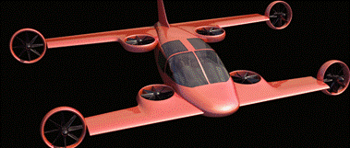
Mini-Bee
2PAX VTOL Hybrid Octocopter

Slide 3
Agenda : Mini-Bee TRL2 description
  TRL2 Partners
  Concept and technical description
  Cabine configurations
  Vehicule and system description
  SWOT analysis
  Project history
  Annexes :
  State of the art
  Other innovative projects

Slide 4
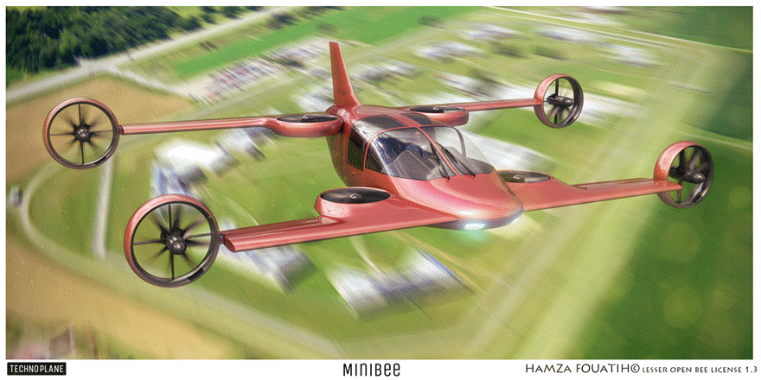
Mini-Bee : 2PAX VTOL Hybrid

Slide 5
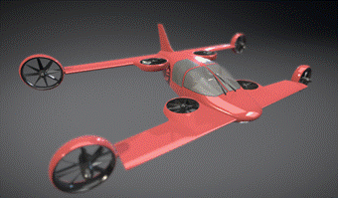




























Mini-Bee Project partners
Lesser Open Bee License 1-3
Coordinator :
Universities :
Institution & financial partners :
Design:

Slide 6
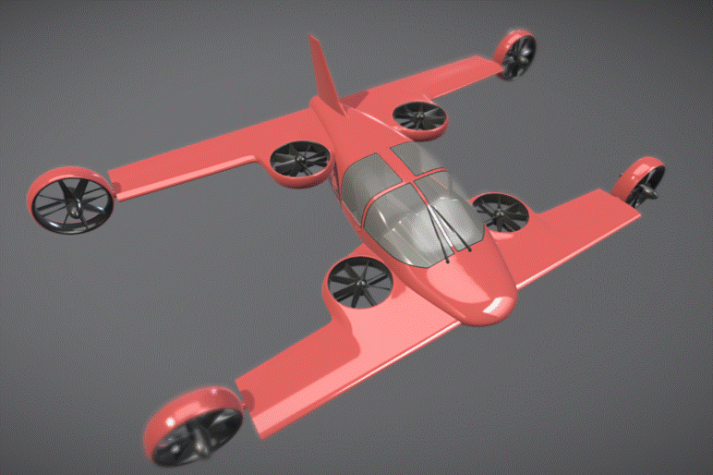
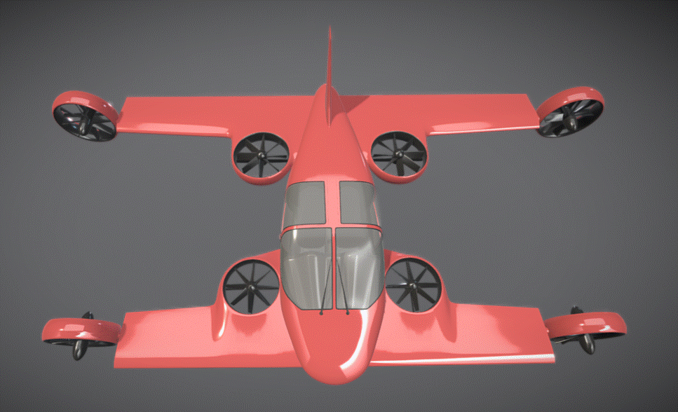
Mini-Bee description
Project state : TRL2
  Electric octocopter : 4 vertical + 4 tilt
  Hybrid energy : fuel + batteries
  2-3 seats
Characteristics :
  VTOL capacity, short wings, 1.2 ton
  Range 600km, max speed 300km/h
  Electric controls and engines
Goals and market
  VIP, Taxi, Air Ambulance
  Estimated price 1m€ (0,7 to 2m€)

Slide 7
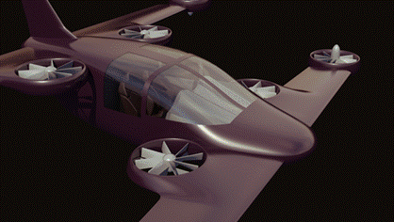
Architecture
Central vertical quadcopter
Rear electric generator
External tilt quadcopter
Gullwing doors
Fuel generators
Biplane
Battery kits
Electric flight controls
Tailwheel-type landing gear
Retractable front landing gear
3D printed metallic structure
Low noise nacelle

Slide 8
Technical description
Aircraft characteristics
2 to 3 seats, VTOL, Short wing for cruise flight
MTOW 1200 kg, Range 600km , Cruise speed 220 km/h
Wing surface 15m², no control surface
Engines
8 electric engines : Central vertical quadcopter + External tilt quadcopter
4 fuel generators + Batteries
Electronic control of engines power and tilt angles
Cockpit interface
« Car like » pilot interface : Steering wheel, foot pedals, central screen

Slide 9
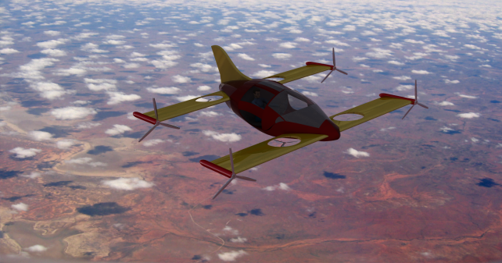
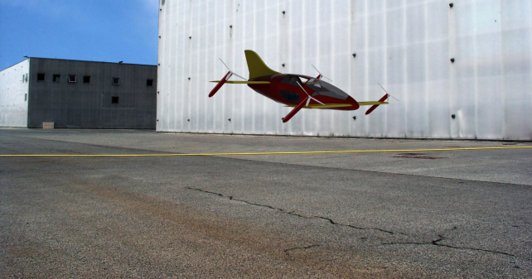
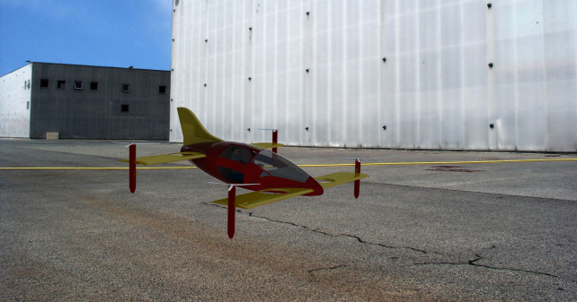
Take-off and flight transition
Cruise flight
Tilt transition
Estaca 2016
Supméca 2016
Vertical take-off

Slide 10
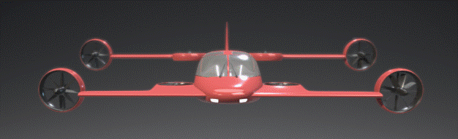
Cruise flight

Slide 11
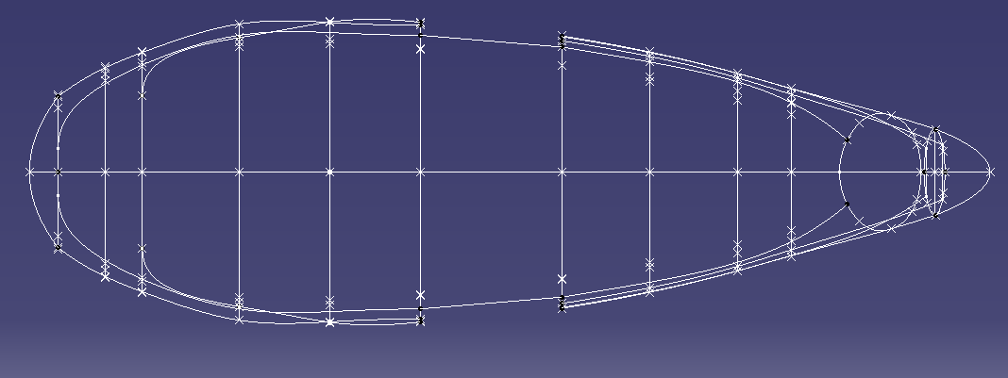
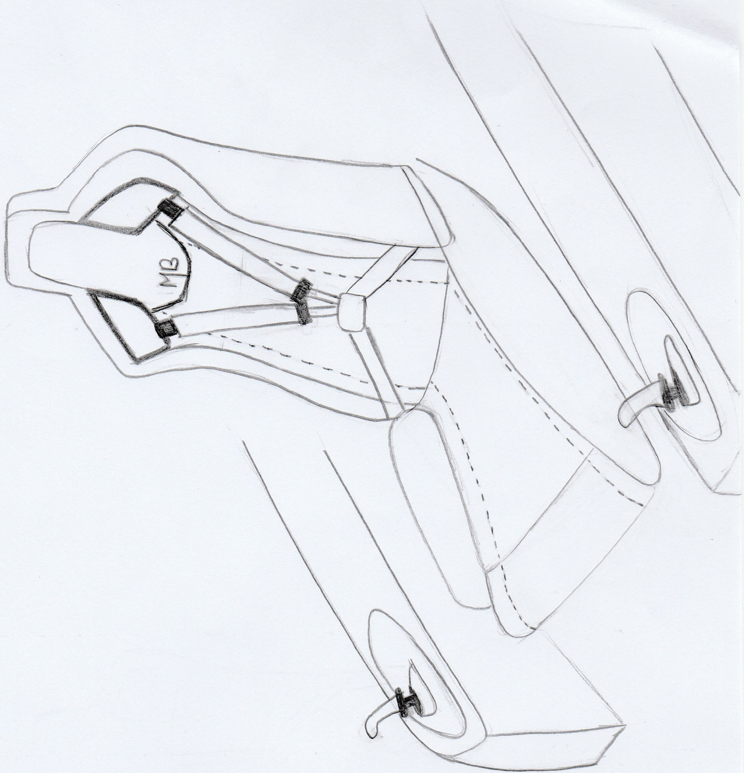
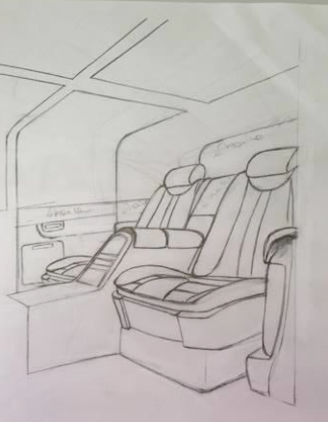
Cabine configurations
Sport
VIP
Ambulance
Taxi
Utilities
1 PAX
2 PAX
3 PAX
4 PAX (light)

Slide 12
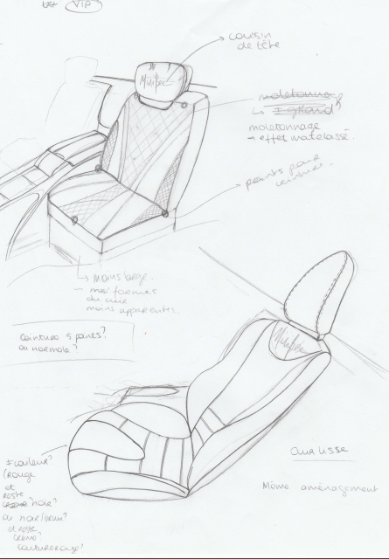
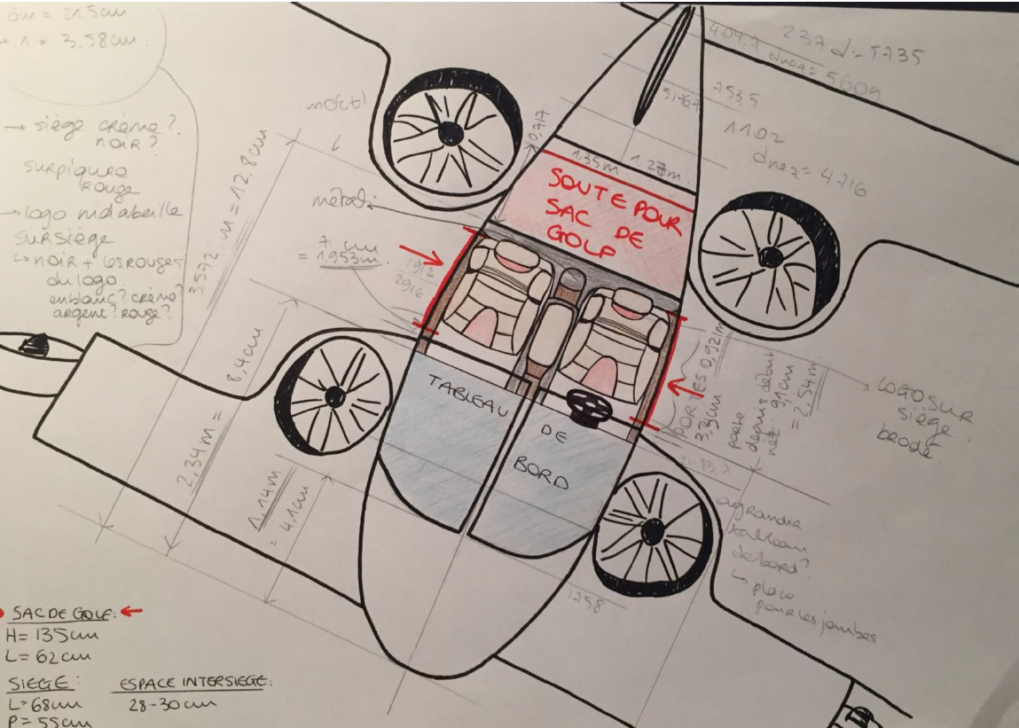
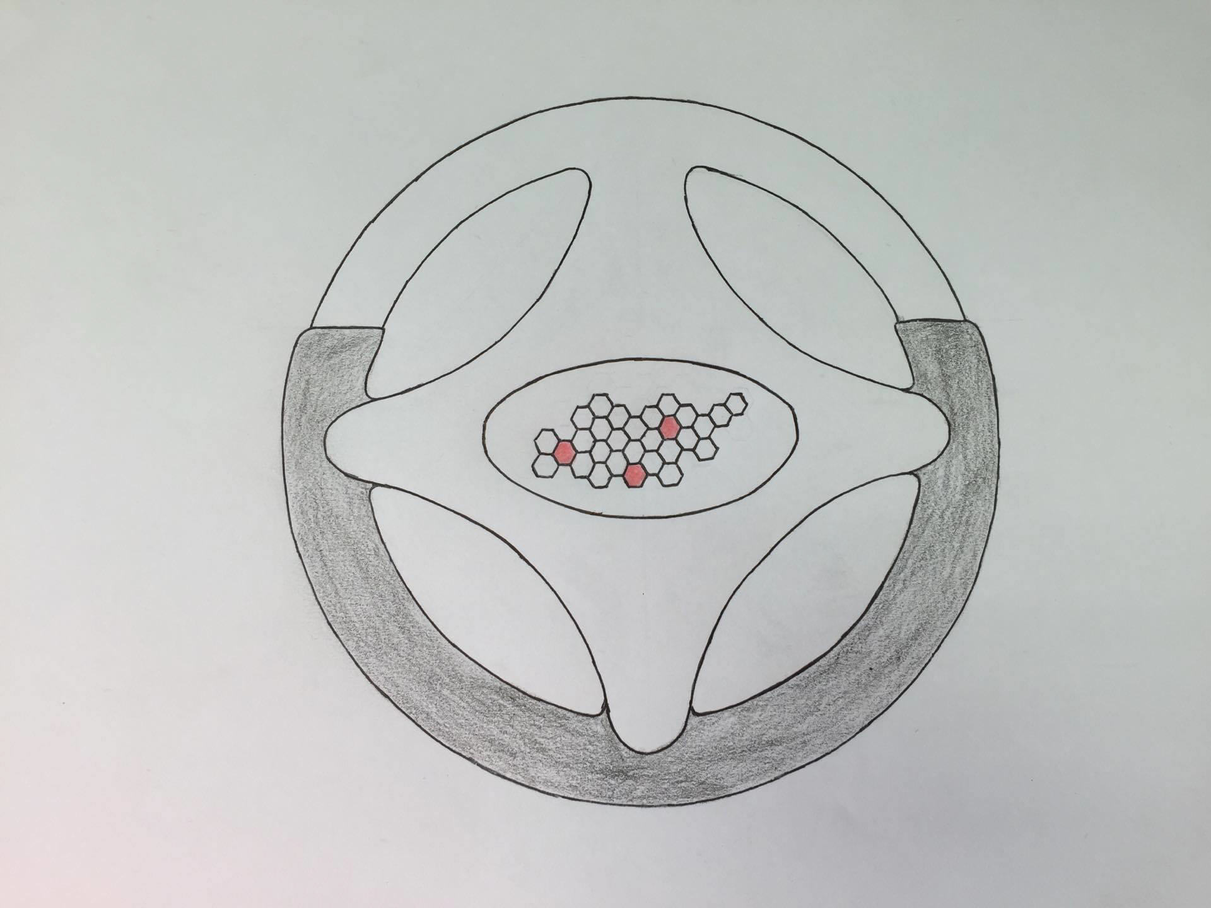
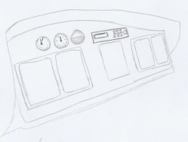
VIP Configuration

Slide 13
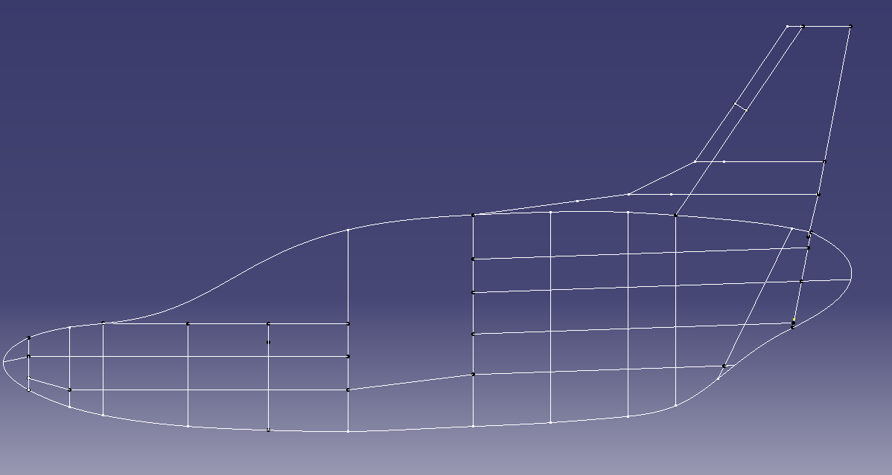
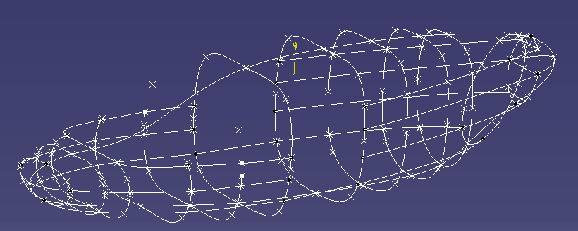
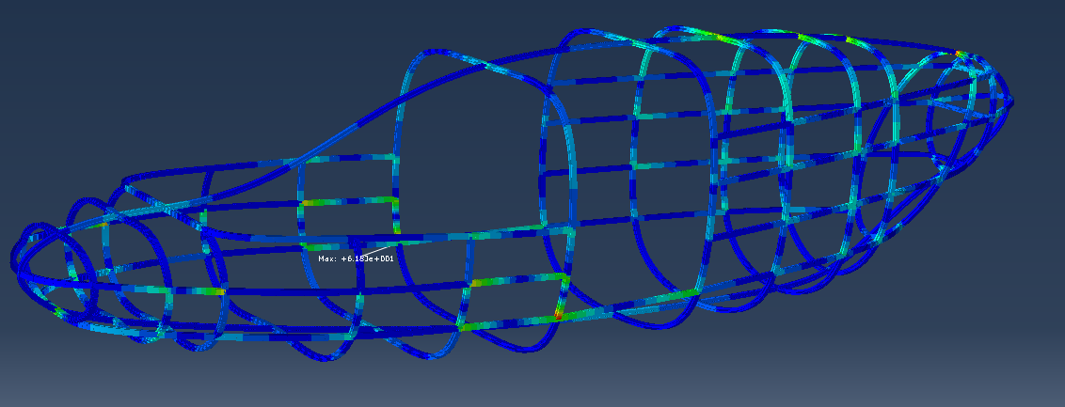
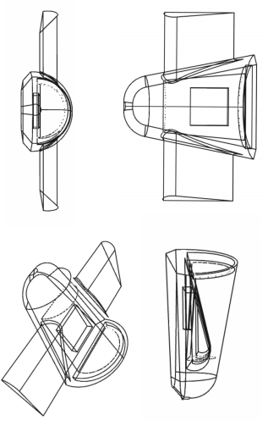
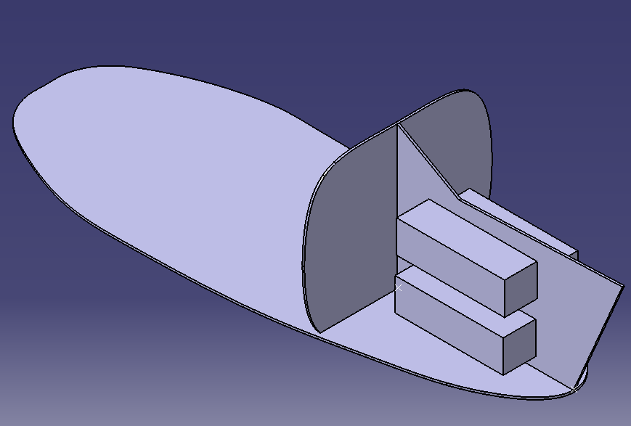
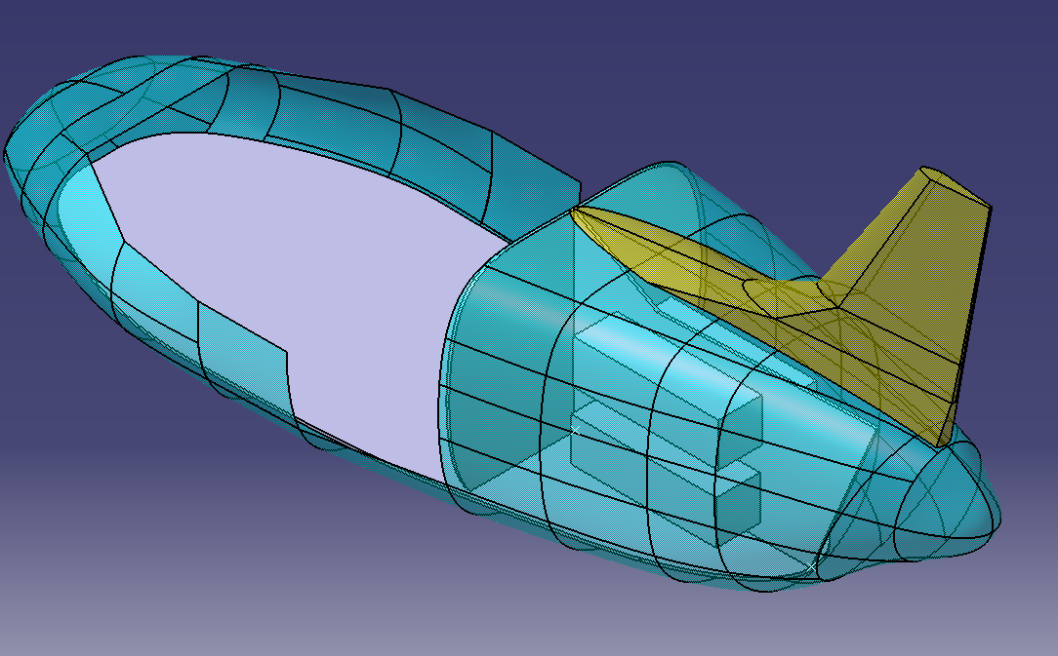
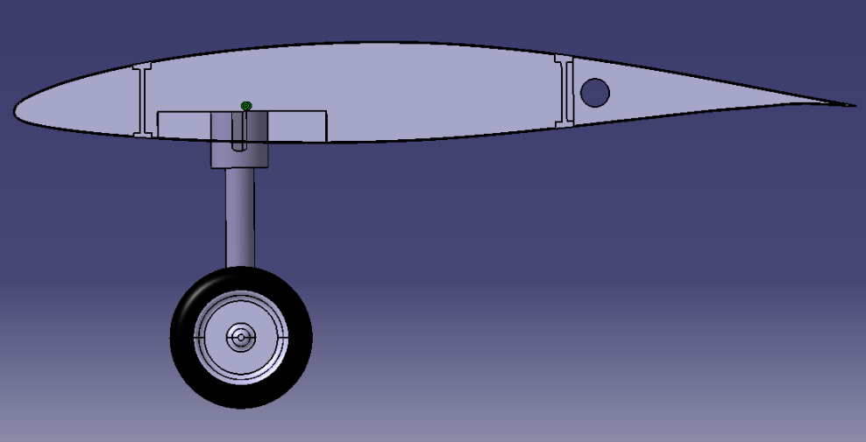
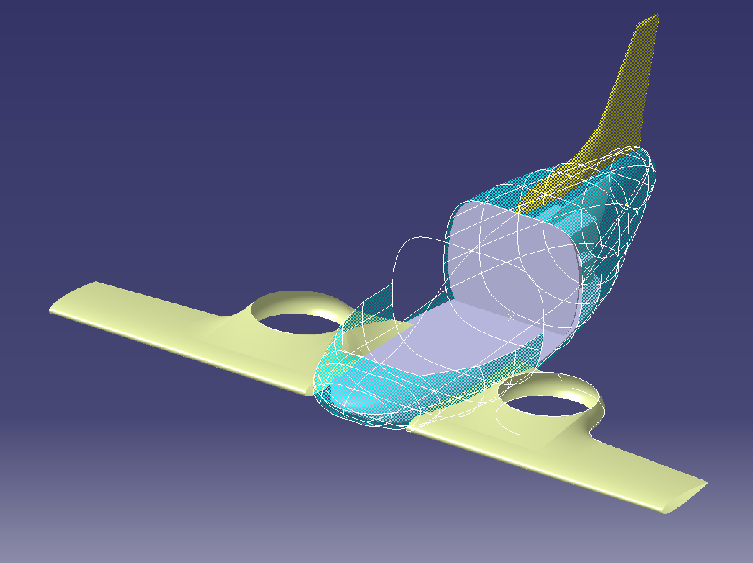
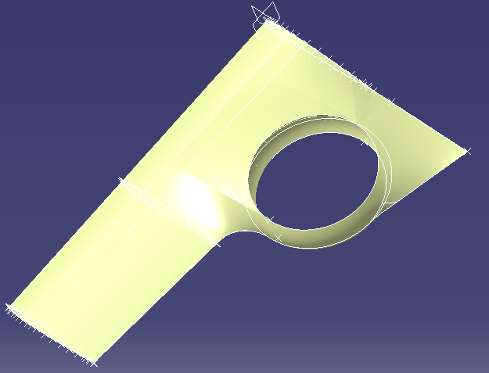
Architecture
Generators
Batteries
Cockpit
Generators
Batteries

Slide 14
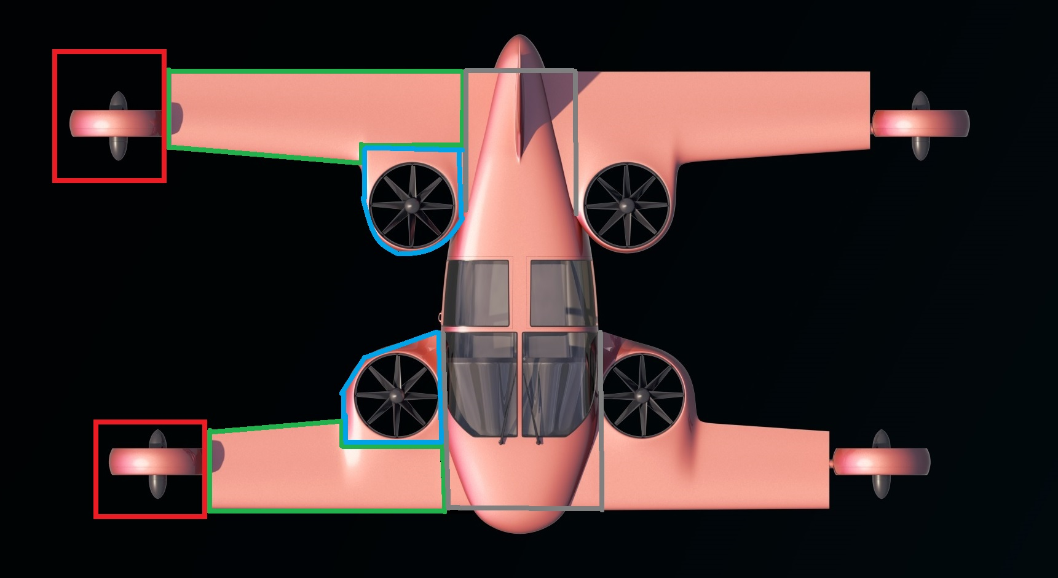
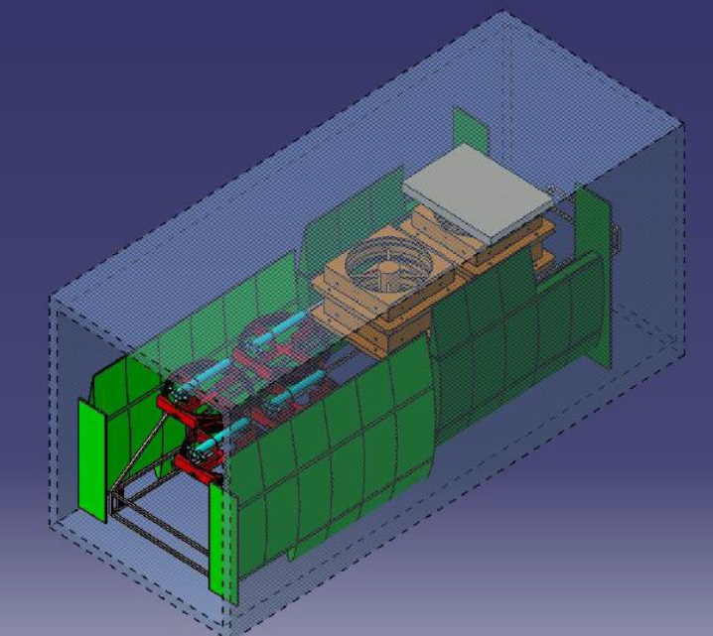
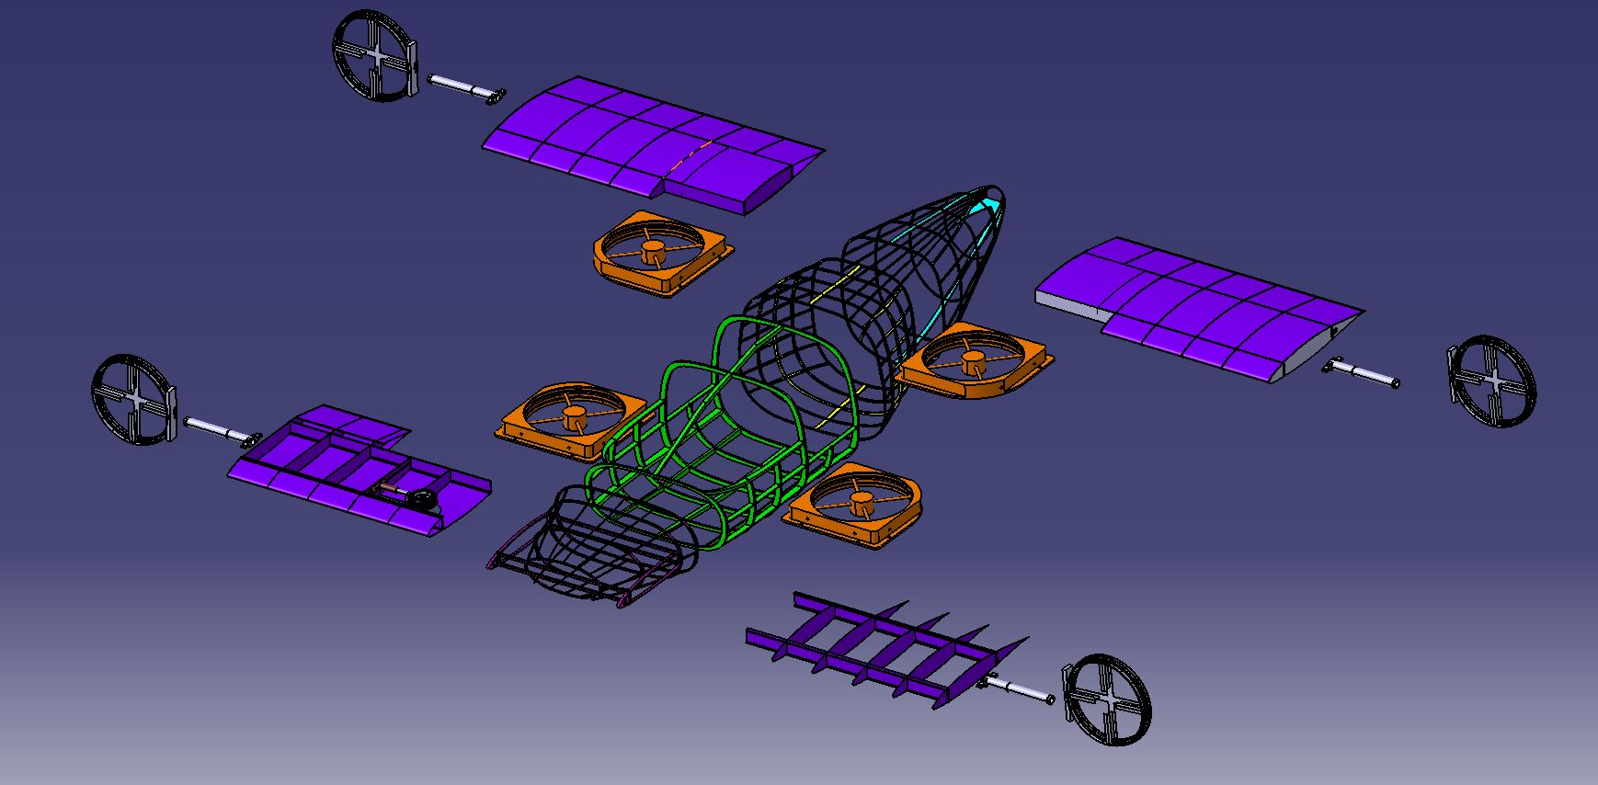
Modular structure
Production, delivery and MRO optimization
Delivery in 20’ Container
Taxi :
VTOL Short intra city
Short wings, high NACA
Vertical central engines
Fixed landing gear
2 main flight configurations
VIP :
VTOL + cruise
Longuer wings
Fuel capacities
Retractable landing gear
Estaca 2016

Slide 15
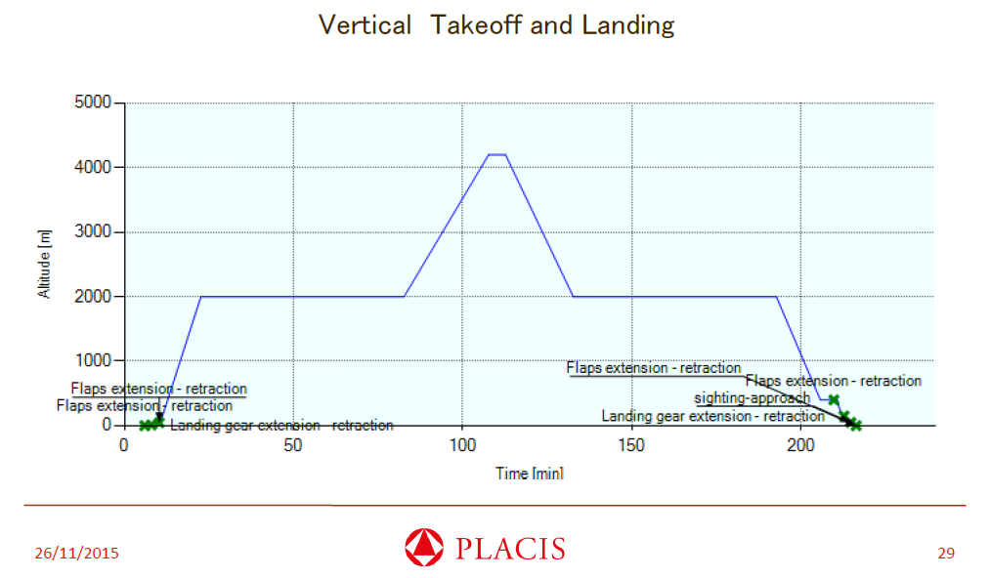
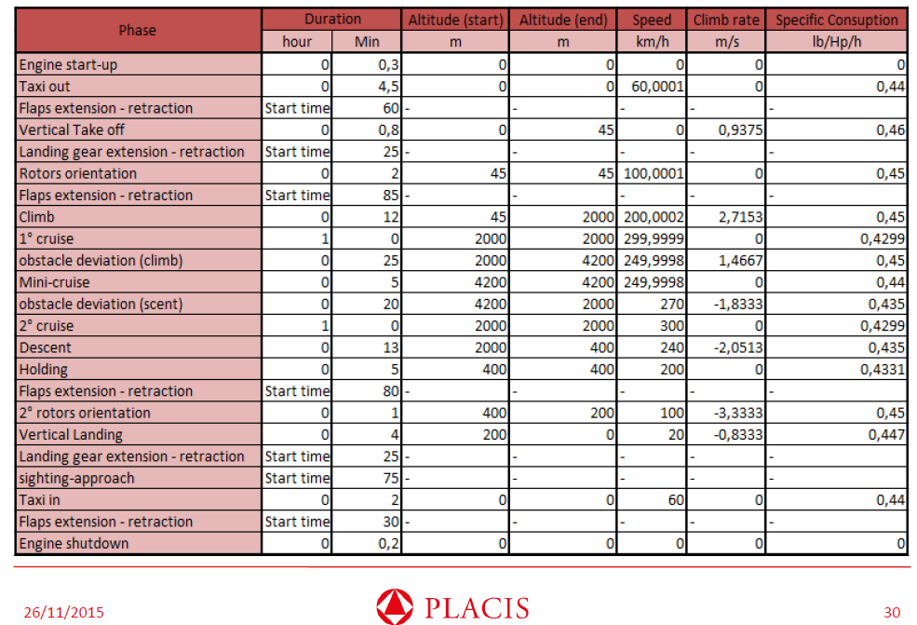
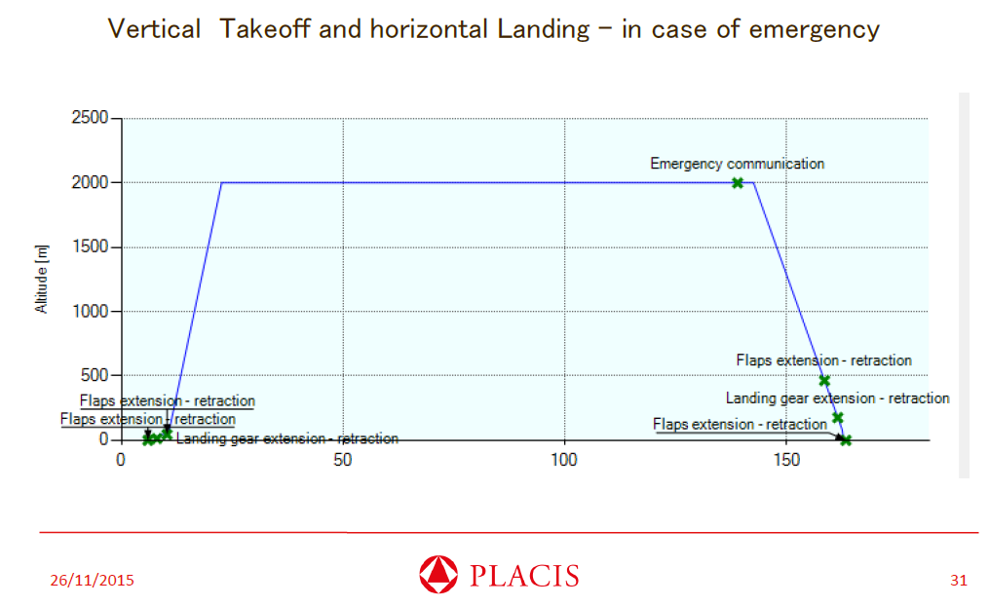
Mission profile

Slide 16
8 Electric Engines
Equipement proposed : 8 electric engines 55k (50kg)
55kW special designed engines (12kg/engine)
Or 8 engines Yuneec Power Drive 60kW
Power needed 220 kW
Installed power 440kW
provided by
90kg of batteries during take-off and vertical flight
4 fuel generators during cruise flight

Slide 17
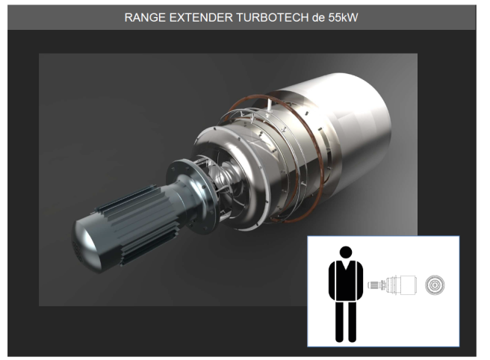
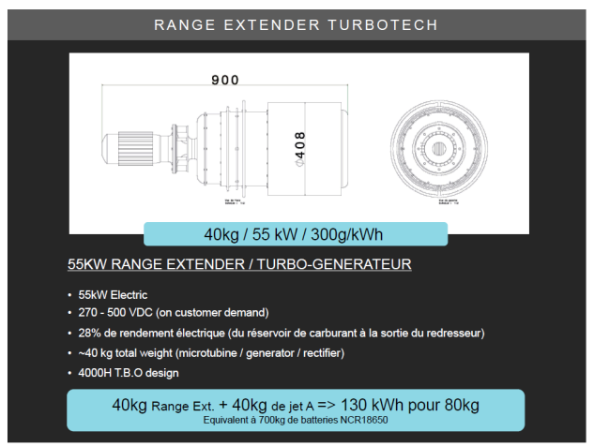
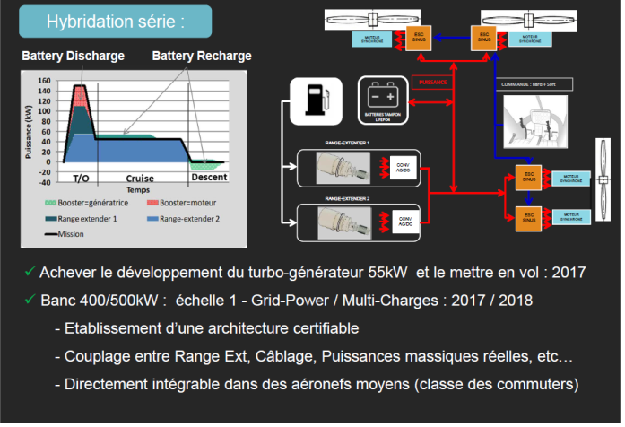
4 Electric fuel generator + Batteries
Equipement proposed : 4 Turbotech 55kW (160kg)
Batteries : 1800 NCR 180650 in 10C (90kg)

Slide 18
Data
MTOW : 1200 kg
Structure : 310kg
Fuselage : 80kg
Payload : 220 kg (2 PAX)
Systems : 125 kg
Engines : 240 kg
Batteries : 90kg
Fuel : 140kg
Total costs : 700k€
System : 200k€
Fuselage : 150k€
Wing : 100k€
Engines : 100k€
Landing gear : 50k€
Interior : 50k€
Other : 50k€
Target for standard configuration : Price = 700k€
Target for TRL3 : MTOW 1000 kg

Slide 19
SWOT analysis
Strengths
Weakness
VTOL capacities
Speed of an aircraft
Double quadcopter back-up in case of engine failure
Fuel energy range
Aircraft Design and configuration
Lesser open source collaborative project
New configuration
Project at low TRL
Aerodynamic and leight weight structure
Propulsion and energy storage
Project implementation
Project funding
Opportunities
Threats
Cost reduction :
  Overall flight cost reduction compared to helicopter
  Low purchasing & maintenance cost of engines
New design space: tilt, octocopter
  Weight / VTOL
Project investment
All electric helicopters and VTOL vehicules
All electric aircrafts
Drones
Tilt rotor
Hybrid energy
Others innovative projects

Slide 20



Partners for R&D
Project coordinator
Lesser Open Bee License 1-3
TRL2 Detailled Definition
In process
TRL1 Basic Definition

Slide 21
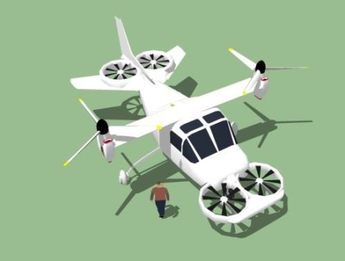
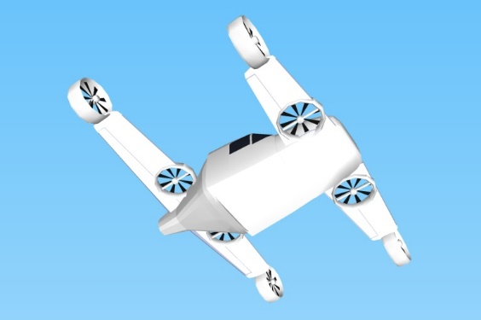



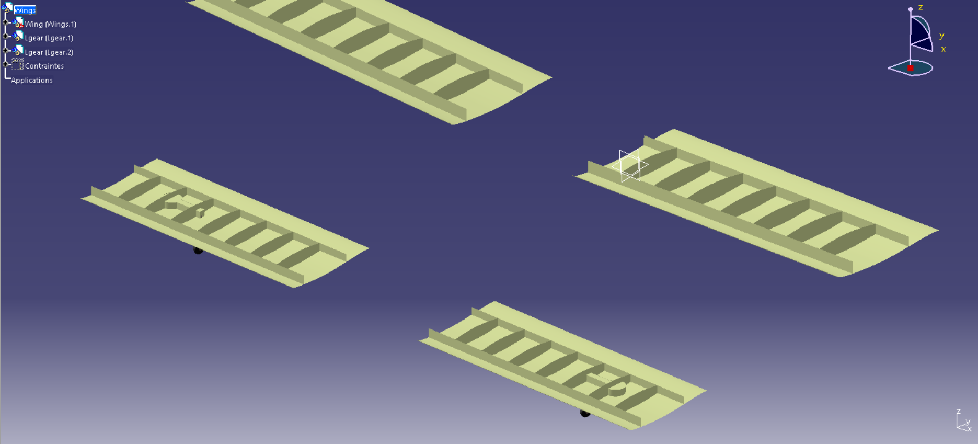


Project history
TRL0 Project Launch (2015)
Studies 2015/2016
TRL1 Basic Definition (2016)
Lesser Open Bee License 1-3
2016/2017
TRL2 Concept (2016) in Process
Meet us in
Le Bourget Air Show 2017 !

Slide 22
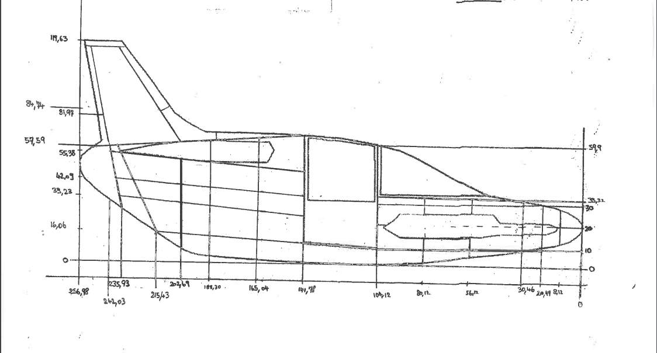
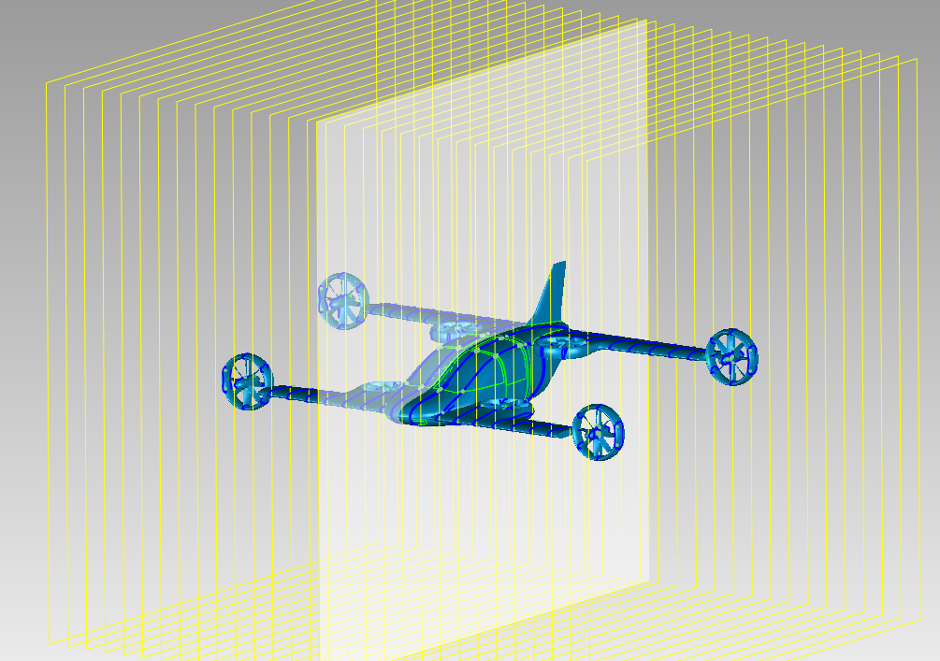
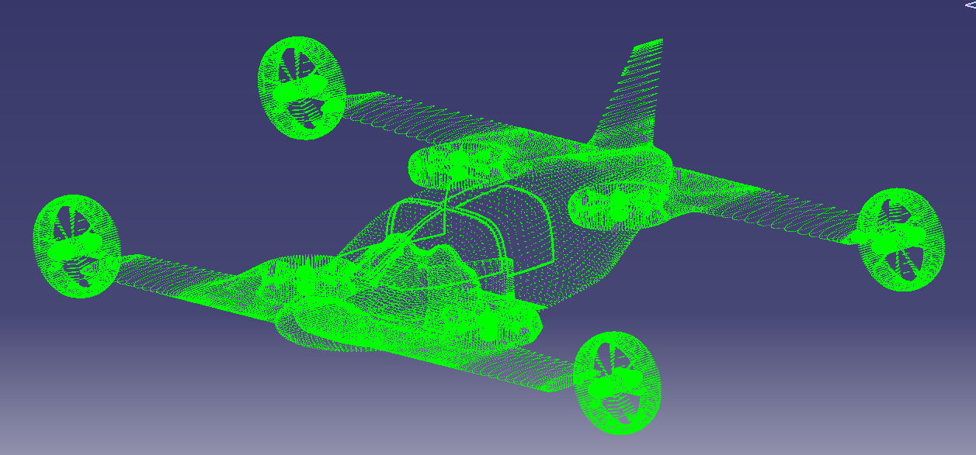
Aerodynamic studies
Cockpit shape optimization
Supmeca 2016
Rotor shape optimization
Supmeca 2016
Numerical studies
Supmeca, end of 2016
Vertical rotor air flow studies
Supmeca 2016

Slide 23
Actions for Mini-Bee TRL2 Project
Mini-Bee TRL2 tasks :
  Refine detailled technical and equipement configuration
  Evaluate market opportunities, production and flight costs
  Define partnership for TRL2 and TRL3
  Draw project financial path
  Investigate for lovemoney phase

Slide 24
Partners to be defined
World
France
Asia
US
Project sponsors & finance
Electronics and equipement integration
Aircraft flight management control
Cokpit interface and project integration
Structure metallic 3D printer
Aircraft manufacturer
Luxury firm for VIP configuration
VIP end users
Air Ambulance end user

Slide 25

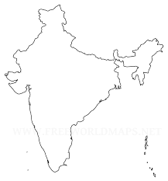

Targeted Industrial Schem
US
FAL for Standard Config & Air Ambulance
Flight control system & Equipements
India
Europe
IT Transport Management and project funding
Testing, Customer service & Worldwide Logistic
Normandy
Final Assembly Line for VIP config
Head quarters
Metallic 3D printing
Engines

Slide 26
Financial project path
Detailled numerical mock-up
First flight
Test flights
Final developments
Qualification
Commercialisation / Operations
Estimated overall project 100m€
Actual step : Lovemoney for 500k€ to 2m€

Slide 27
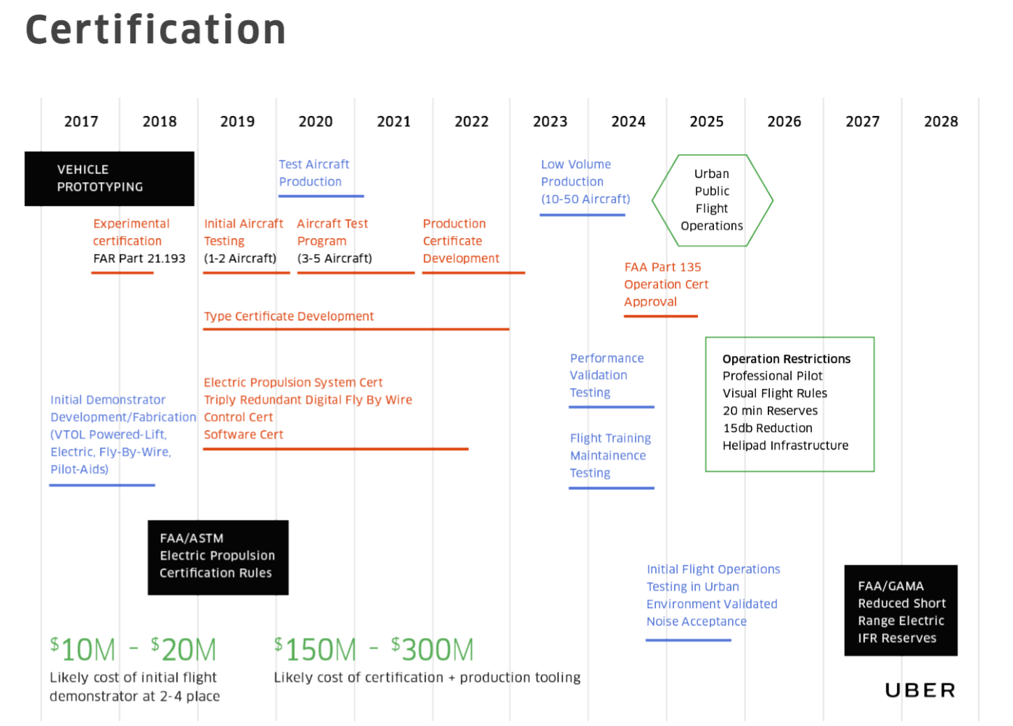
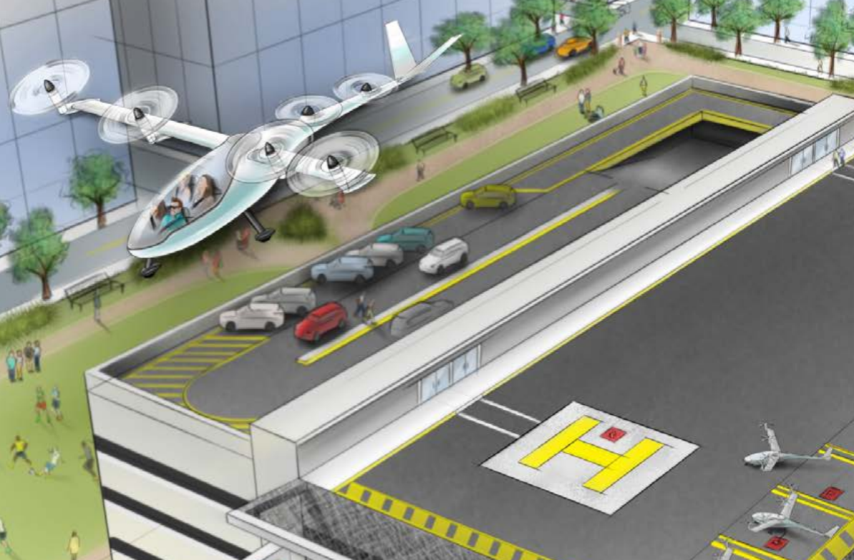
Uber Elevate planning

Slide 28
Annexes
Individual Air Vehicules

Slide 29
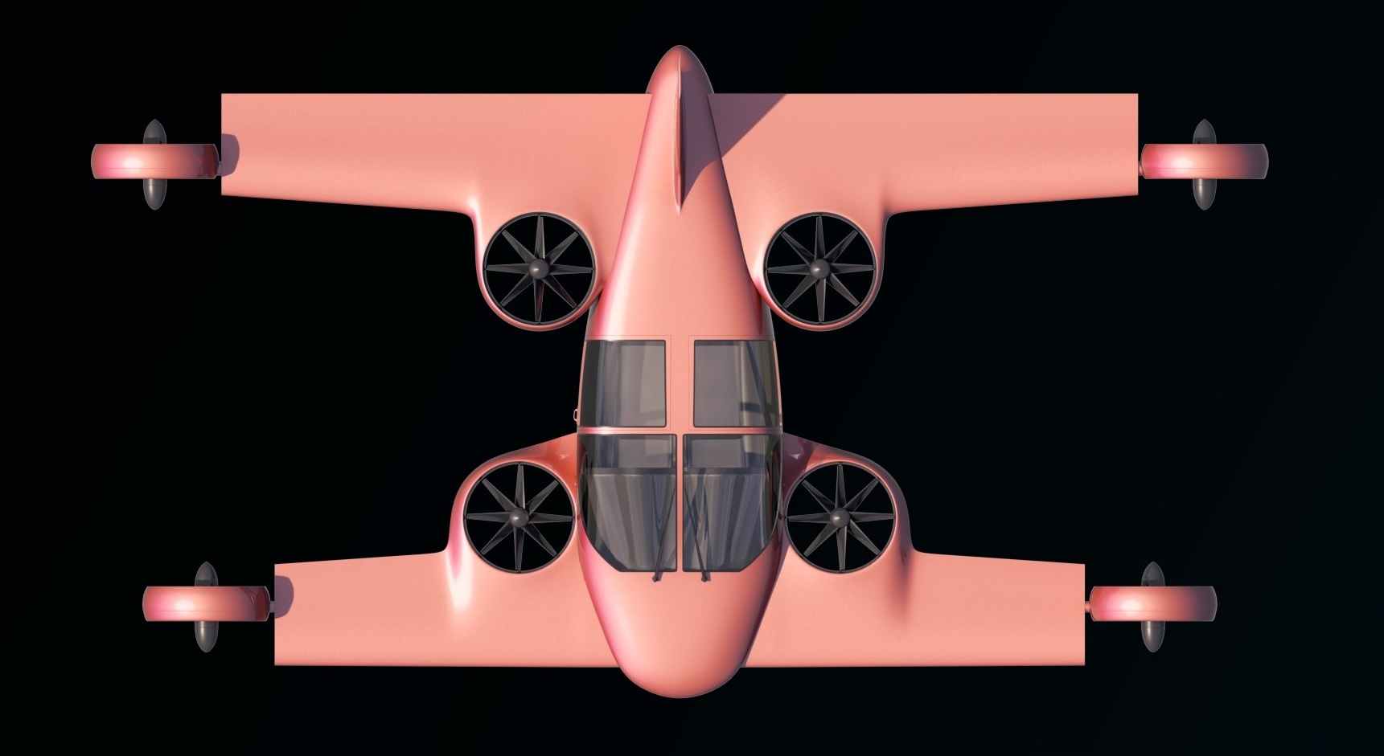
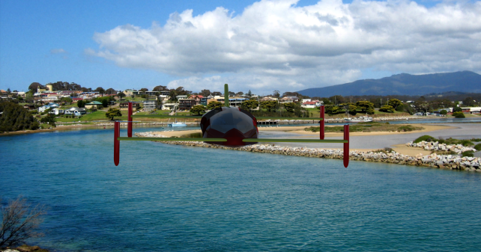
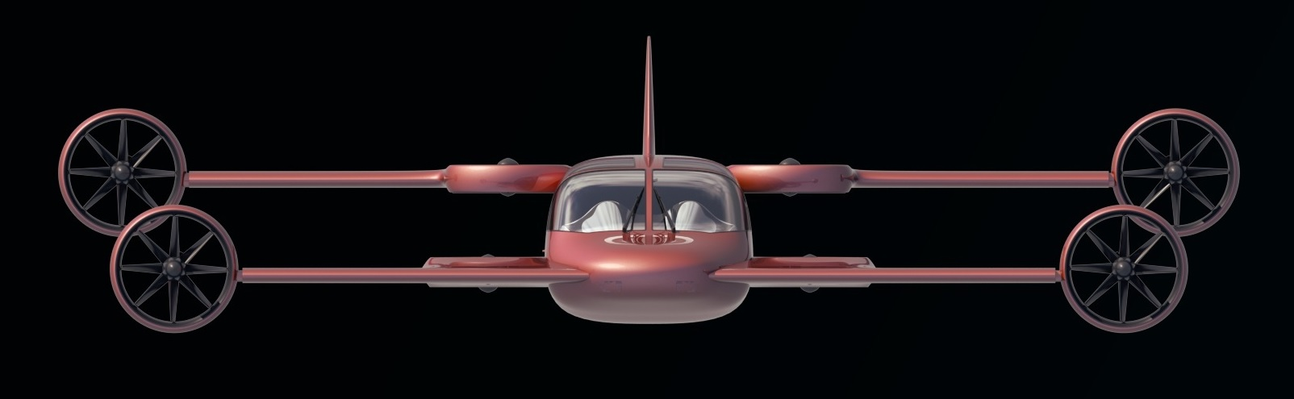
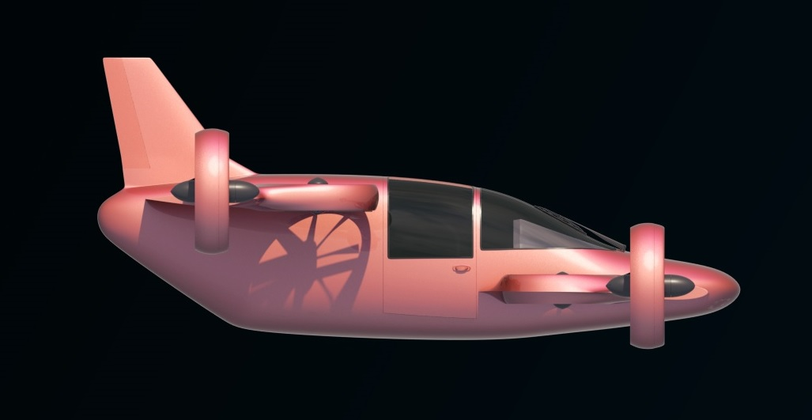
Mini-Bee project for TRL2
Lesser Open Bee License 1-3
Mini-Bee (at end of TRL1)
2 PAX VIP
Electric Octocopter
Tilt quadcopter & vertical quadcopter
Hybrid energy : batteries & fuel
Estaca Laval 2016

Slide 30
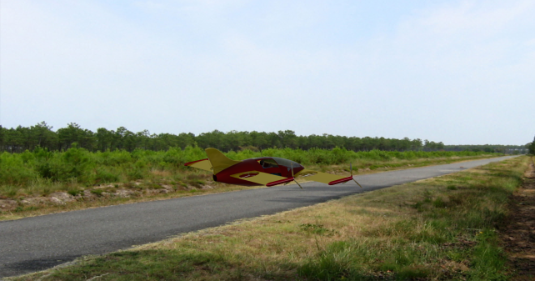
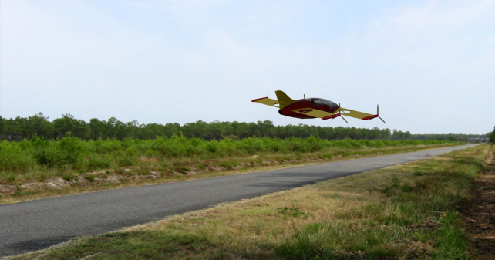



Take-off and tilt transition
By Estaca 2016

Slide 31



TRL1 project tasks (2015/2016)
Polito 2015
Supmeca & Polito
2016 (Placis)
Supmeca
2016
Estaca
2016 group2
Estaca
2016 group1

Slide 32










State of the art
X3 airbus
Osprey V22
Airbus H160
Ecureuil
X2

Slide 33





















Other innovative projects
Agusta Westland
Zero (2015)
Airbus E-fan (2015)
Trifan 600 XTI (2015)
Helium (2016)
E-volo (<2014)
eHang (fin 2015)
Kitty Hawk (2016)
zee.aero (2016)
Joby (2016) ~ 100m€
Moler skycar (<2016)
Urban aeronautics
(<2016)
Xplorair (2016)
Lilium (2016) ~10m€
Airbus (2016)
Boeing (2016)
SoloTrek Springtail
Macro industrie (2016)
Airbus Vahana (2016)
Olympus (2016)
Mini-Bee (2016)
Trekaero.com

Slide 34


Mini-Bee
2 PAX VIP Hybrid Octocopter
Lesser Open Bee License 1-3

