Slide 1
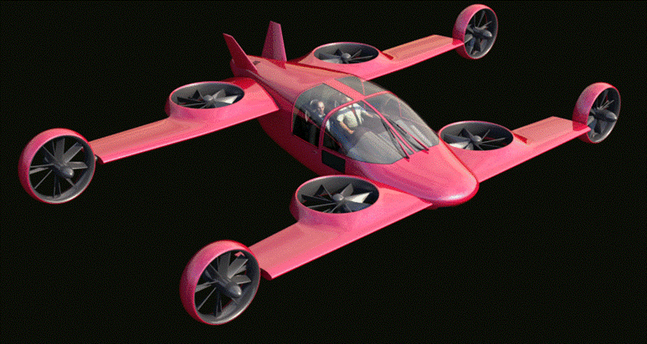
Drive your Aircraft !

Slide 2
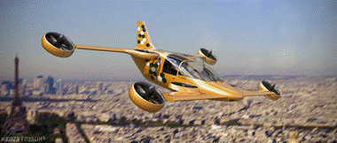
Mini-Bee Plane - Agenda
  Problem
  Solution
  Market
  Description
  Team / Partners
  Key Success drivers
  Configurations
  Modular structure
  Project state and actions
  Annexes :
  State of the art
  Other innovative projects

Slide 3
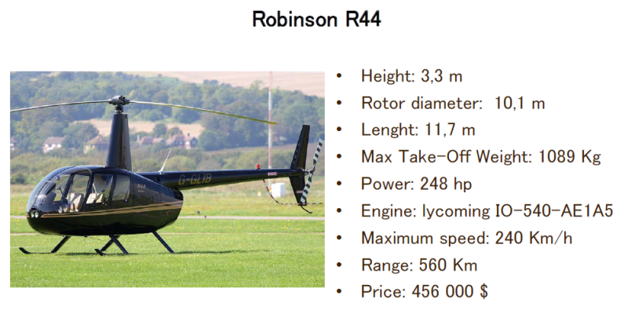
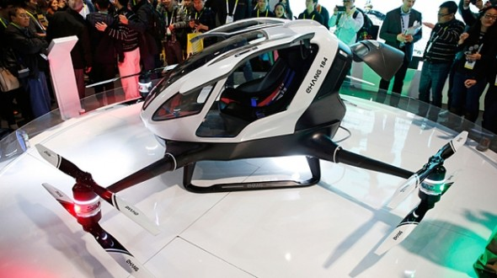
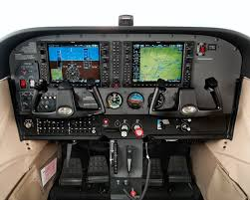
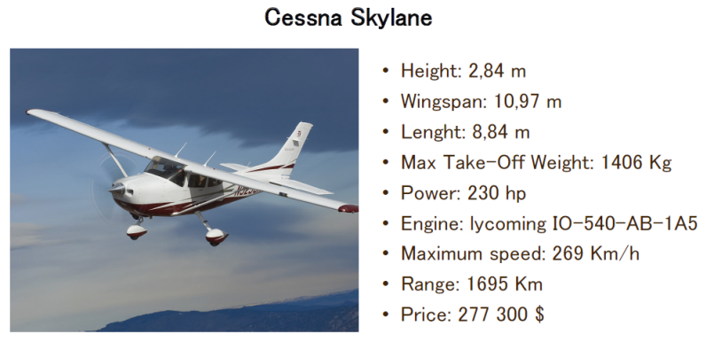
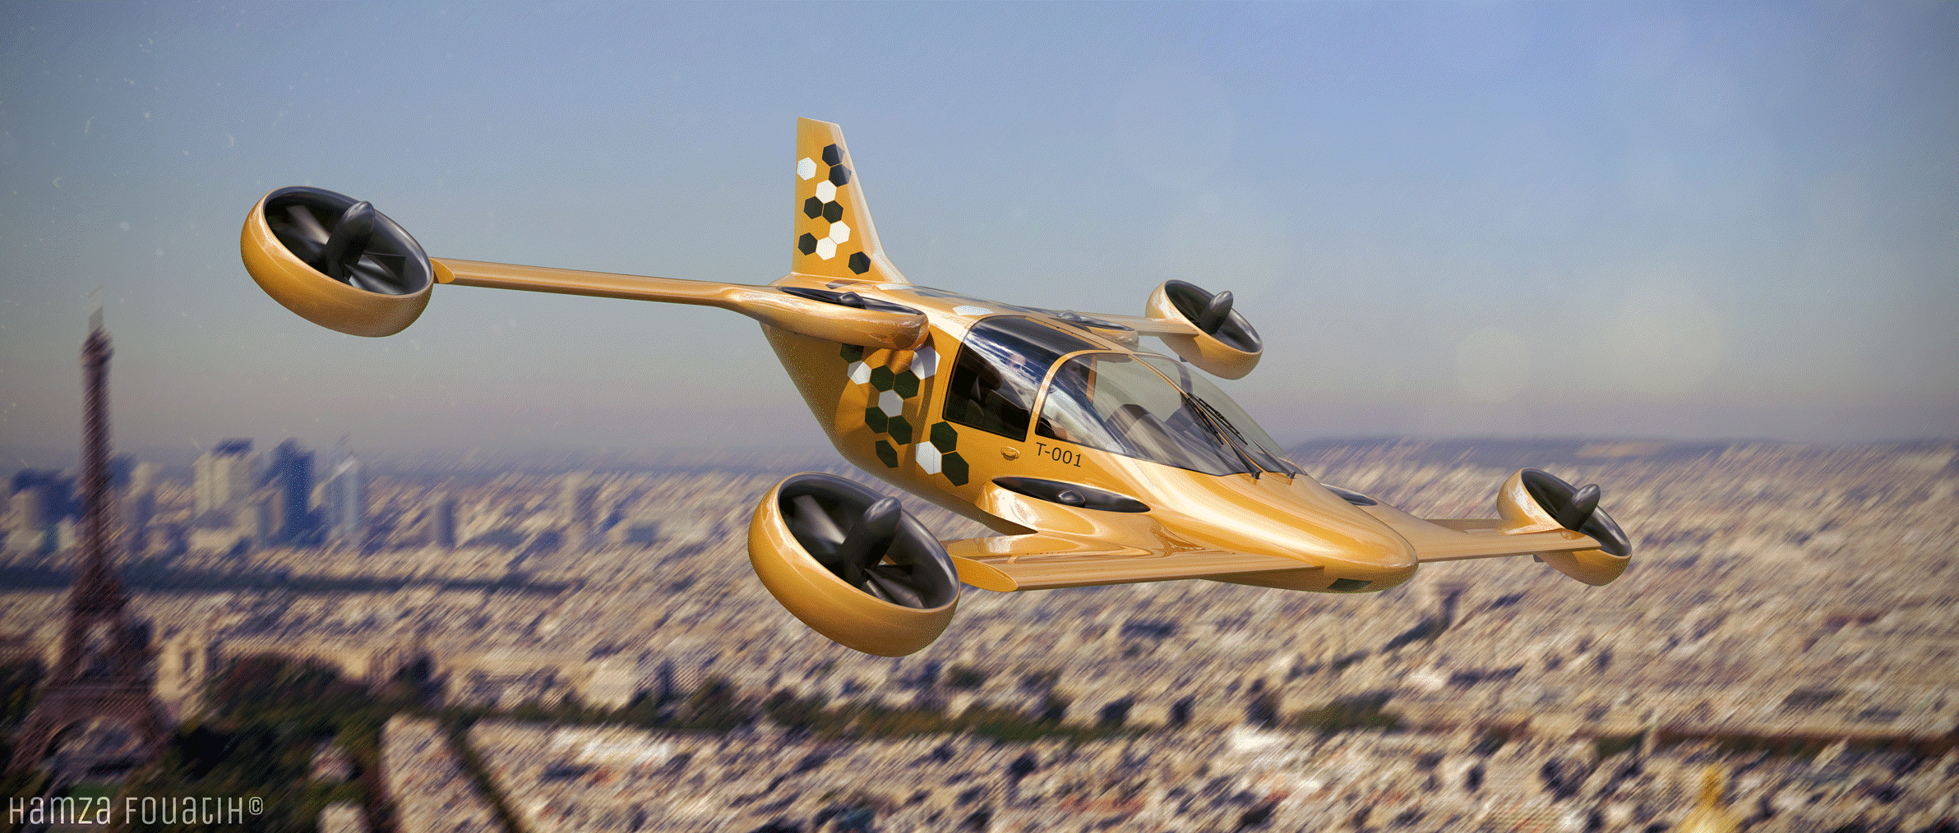
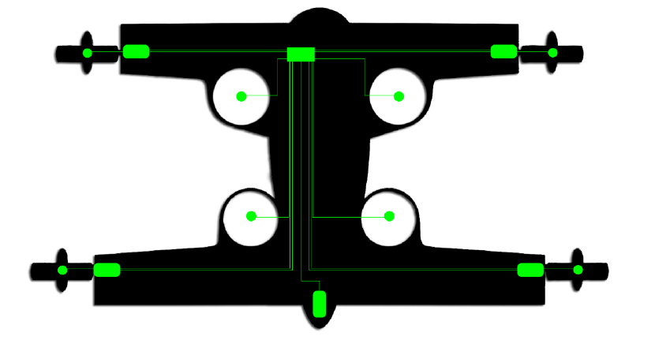
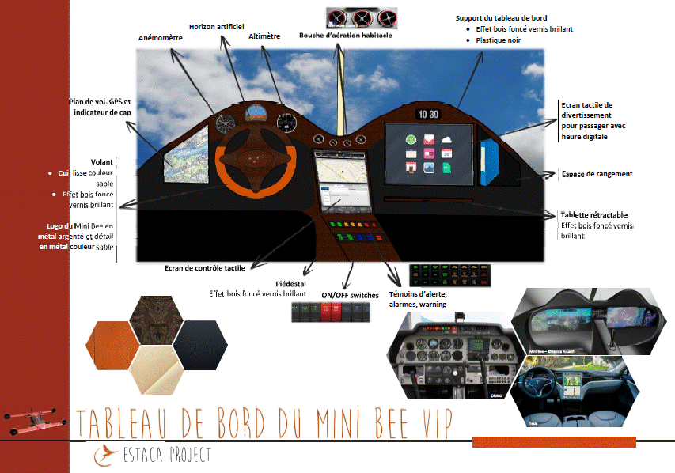
Problem of air transportation
Problems
Length of runways
High cost per hour (>300$/h)
Lack of autonomy
Complex interface
Existing vehicules
Cessna
R44
eHang
Needs
Speed over 200km/h
Vertical Take-Off and Landing (VTOL)
Low cost of
operation
Easy to drive as a car
Solutions
VTOL aircraft
Hybrid propulsion
« Car-Like » interface

Slide 4
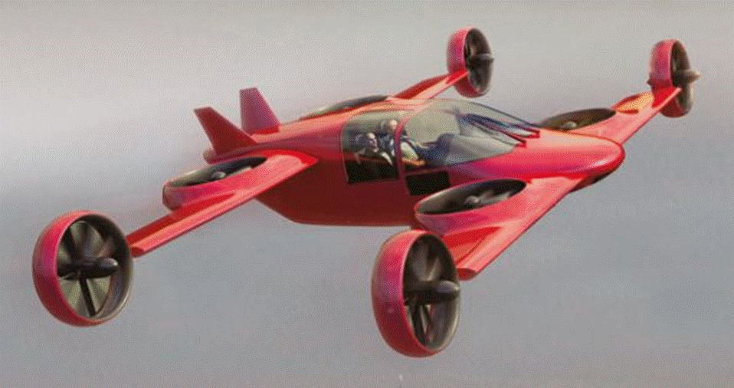
Mini-Bee Plane – Hybrid VTOL

Slide 5
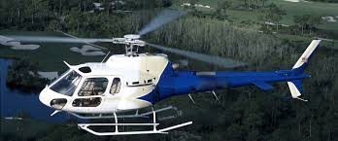

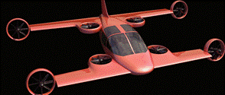
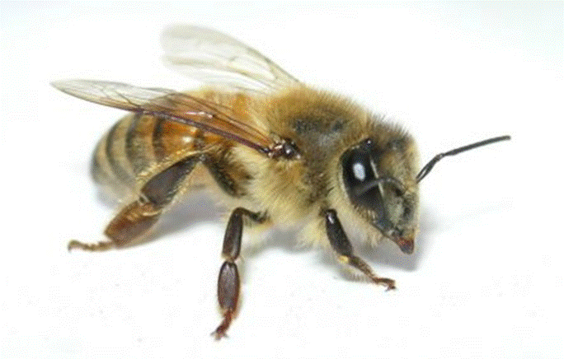
Mini-Bee Plane – At a glance
Range
Low costs
Security & Noise
Flight path management
Collaborative project
Easy maintenance
Autonomy
Driving experience

Slide 6
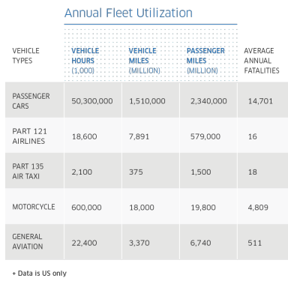
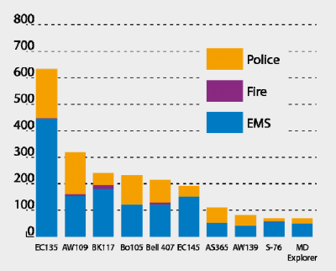
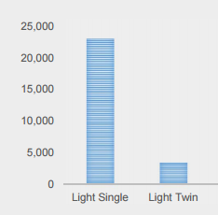
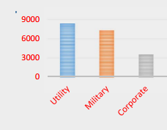
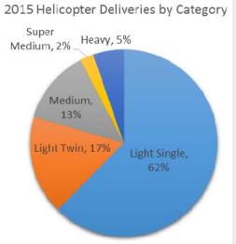
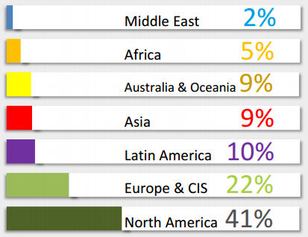
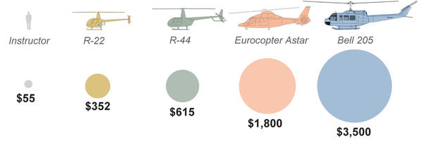
Helicopter Market
Helicopter deliveries : ~500 / year
Emergency Medical Services
Deliveries per categories
Fleet per continent
Training cost per hour
<R66
First market target : EMS in Asia

Slide 7
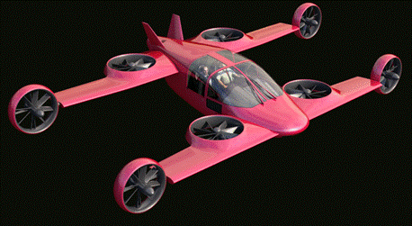
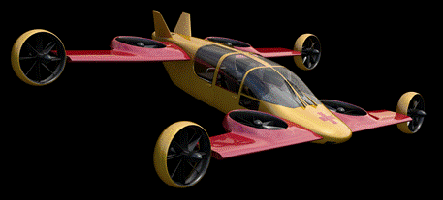
Mini Bee Plane - Description
Project state : TRL3
  Electric octocopter : 4 vertical + 4 tilt
  Hybrid energy : fuel + batteries
  2 to 4 seats (driver included)
  CS 27 multi-rotors certification
Characteristics :
  VTOL, short wings, 1.2 ton
  Range 500km, cruise speed 250 km/h
  Electric controls and engines
  « Car like » interface
Goals and market
  Air Ambulance ; then VIP, Taxi, Sport
  Estimated price 1m€ (0,7 to 2m€)

Slide 8






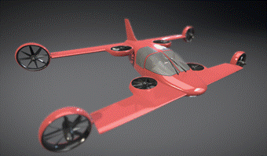




































Mini Bee Plane - Team / Partners
Lesser Open Bee License 1-3
Academic partners :
Coordinator :
Project started in 2015 with 4 universities
Institution & financial partners :
Industrials :
LOI Industrial :
Design:

Slide 9

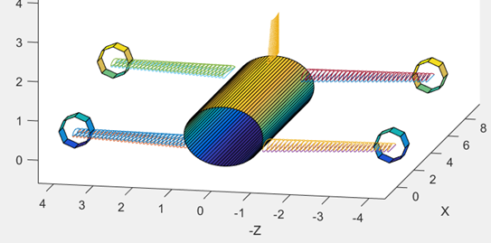
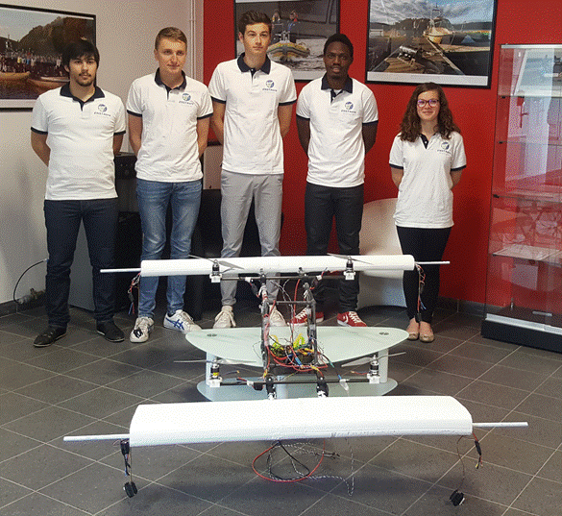
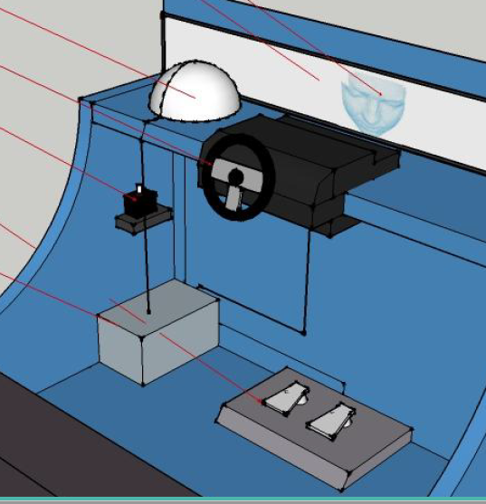
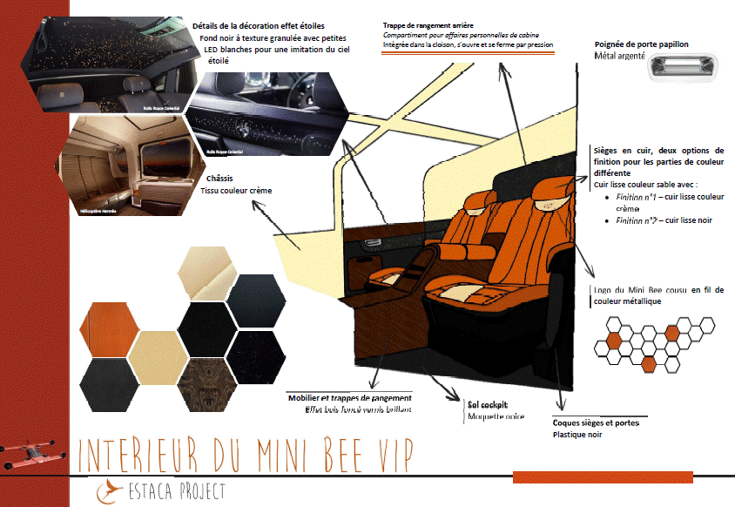
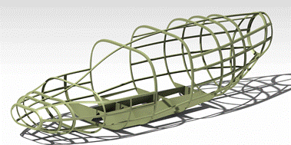
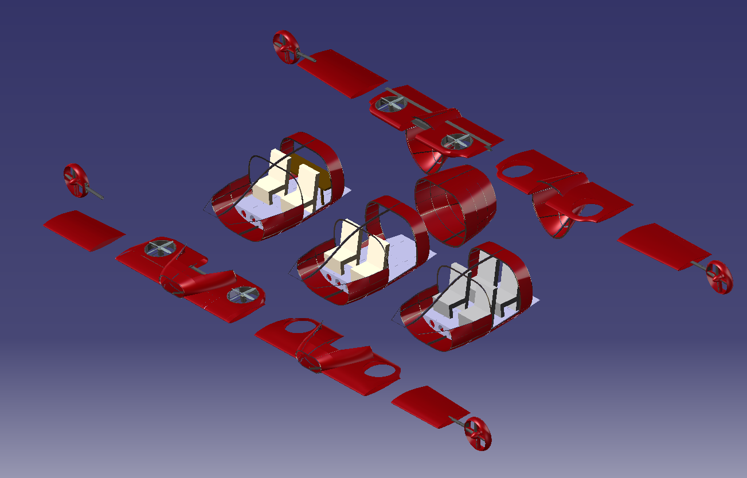

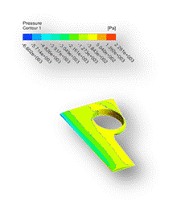
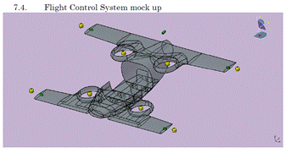
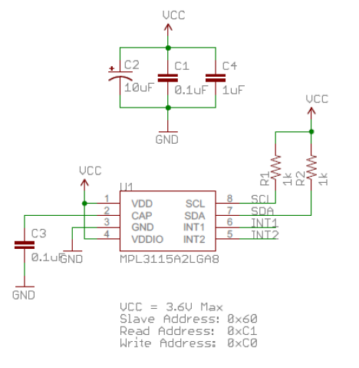
Mini-Bee Plane - Project Tasks
Lesser Open Bee License 1-3
Aircraft Design
Aeronautical simulation
Scale Mock-up
Marketing
HM Interface
Usages
Structure
Modular conception
Landing gear
Rotors
Tilt
Seats
Simulation
Equipements
Sensor Integration
Harness
3D Metal printing
Electronics

Slide 10
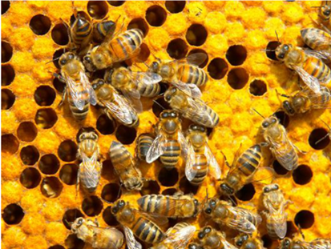
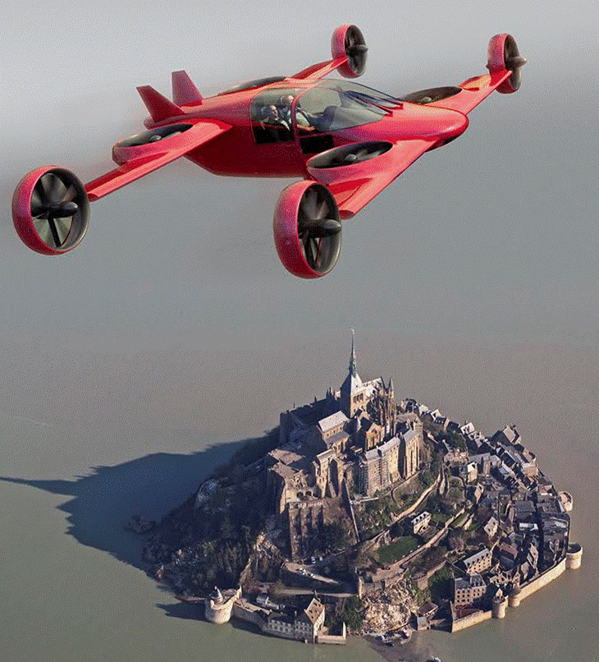
Mini-Bee Plane – Key success drivers
Lesser open source license is key to :
  A low cost structure that will drive project and product cost down
  An agile project methodology that will achieve disruptive innovation and quick project implementation
Highly collaborative project allows :
  Long term relationship between SME, academics and large industrial groups that is necessary for a new air transportation design and network
  Disruption of air transportation with existing players
  To build the first hybrid VTOL multicopter project in France
Project based in Normandy will benefit from :
  A large industrial aeronautical network with all core competences for the project
  The developpement of regional air traffic (professionnal and tourist) with a high number of private landing fields
  Airports close to an international maritime port with a low cost and worldwide efficient supply chain

Slide 11

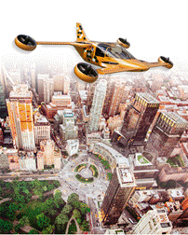
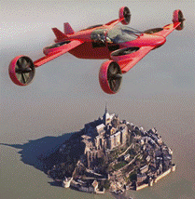
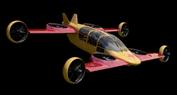

Mini-Bee Plane - Configurations
Sport
VIP
Ambulance
Taxi
* Driver included
Utilities
1srt market
1 PAX Power
2 PAX*
Weight
3 PAX
Volum
4 PAX
Seats

Slide 12
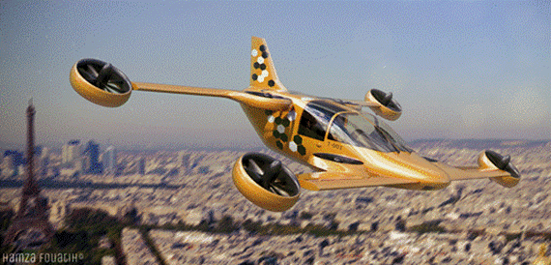

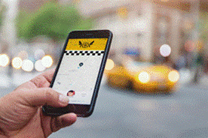

Mini Bee Plane - Taxi configuration
4 PAX (light), shorts wings, fixed landing gear

Slide 13
Mini Bee Plane - VIP Configuration
2 PAX (heavy)
Long wings
Retractable landing gear

Slide 14
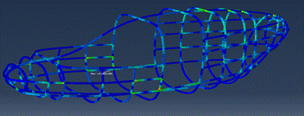
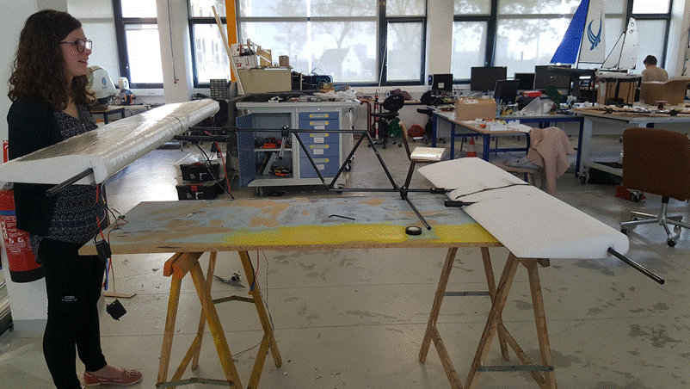
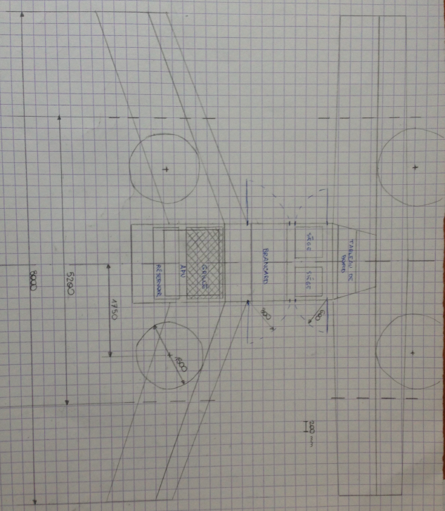
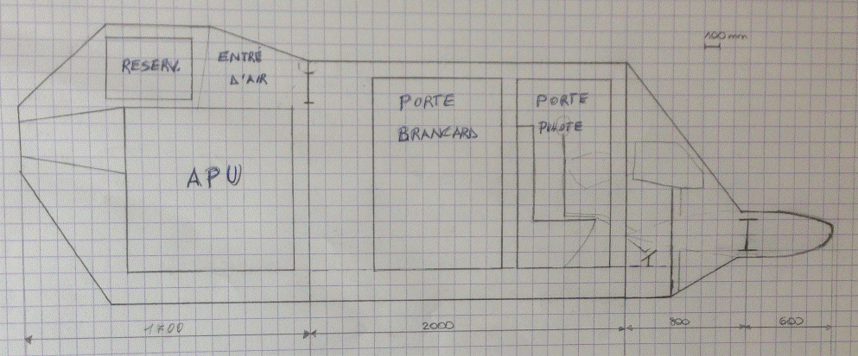
Mini Bee Plane - Structural architecture
Supmeca 2017
Ensta Bretagne 2017
Estaca 2017
Supmeca 2017
Supmeca 2017

Slide 15
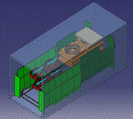
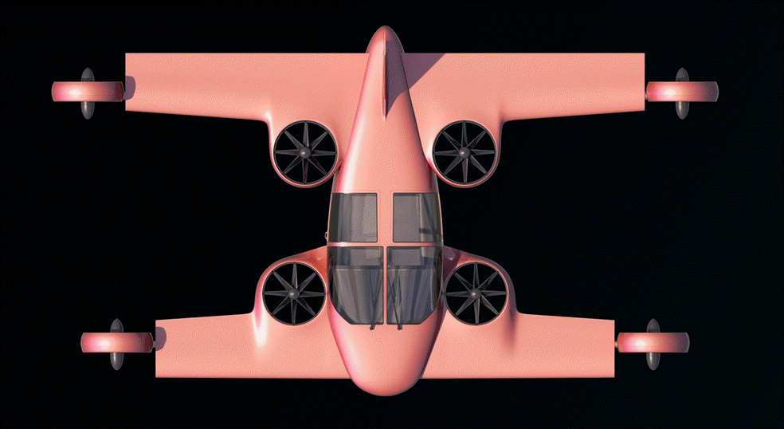
Mini Bee Plane - Modular structure
Production, delivery and MRO optimization
Delivery in 20’ Container
Estaca 2017
Taxi :
VTOL Short intra city
Short wings, high NACA
Vertical central engines
Fixed landing gear
Flight configurations
VIP :
VTOL + cruise
Longuer wings
Fuel capacities
Retractable landing gear

Slide 16
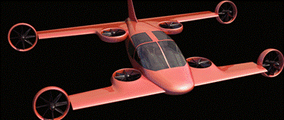
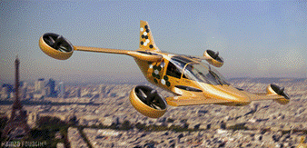
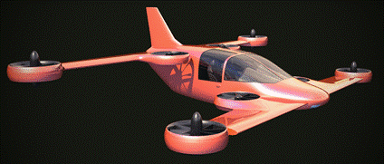
Take-off and flight transition
Cruise flight
Tilt transition
Supméca 2016
Vertical take-off

Slide 17
Actions for Mini-Bee TRL3 Project
Mini Bee Plane TRL3
  Fly a scale model with engine’s configuration (tilt in flight)
  Achieve a scale 1:1 prototype for Le Bourget Air Show 2019
  Refine detailled technical and equipement configuration
  Evaluate market opportunities, production and flight costs
  Define partnership for TRL4
  Draw project financial path
  Investigate for VC funding
Mini Bee Plane TRL4
  Launch at Le Bourget Air Show in june 2019

Slide 18
Financial project path
Estimated overall project 100m€
Actual funding step : Seed Capital 2m€ to 4 m€

Slide 19
Annexes
Individual Air Vehicules

Slide 20
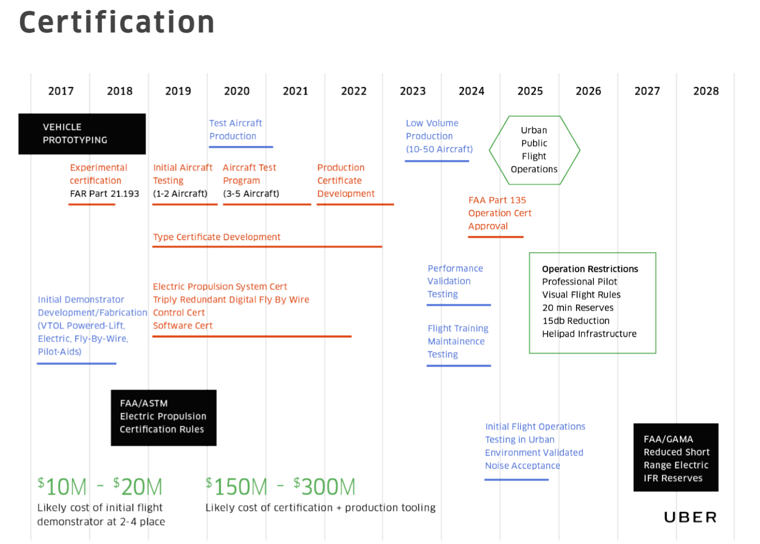
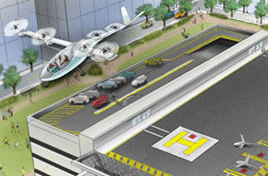


Uber Elevate planning
Uber 2016
Uber 2017

Slide 21













State of the art
Ecureuil
Airbus H160
Advanced Tactics (2016)
Osprey V22
X3 airbus
X2
Pipistrel
Mooney
Elytron

Slide 22
























Other innovative projects
Agusta Westland
Zero (2015)
Terrafugia (<2015)
Pal-V (2015)
Airbus E-fan (2015)
Trifan 600 XTI (2015)
Helium (2016)
Airbus (2017)
E-volo (<2014)
eHang (fin 2015)
Kitty Hawk (2016)
zee.aero (2016)
Joby (2016) ~ 100m€
Moler skycar (<2016)
Urban aeronautics
(<2016)
Xplorair (2016)
Lilium (2016) ~100m€
Airbus (2016)
Boeing (2016)
SoloTrek Springtail
Macro industrie (2016)
Airbus Vahana (2016)
Olympus (2016)
Mini-Bee (2016)
Trekaero.com

Slide 23

Mini-Bee
Hybrid Octocopter
Drive your Aircraft !

