Slide 2
Agenda : Mini-Bee TRL2 description
  TRL2 Partners
  Concept and technical description
  Cabine configurations
  Vehicule and system description
  SWOT analysis
  Project history
  Annexes :
  State of the art
  Other innovative projects

Slide 3
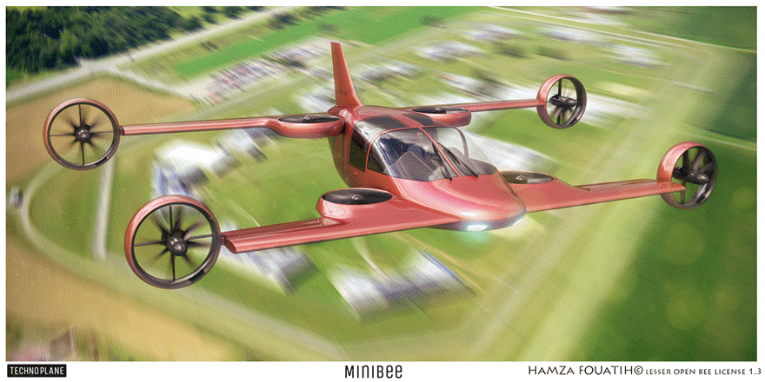
Mini-Bee : 2PAX VTOL Hybrid

Slide 4
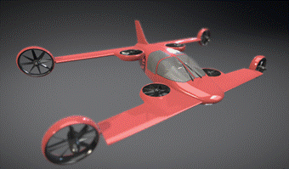




























Mini-Bee Project partners
Lesser Open Bee License 1-3
Coordinator :
Universities :
Institution & financial partners :
Design:

Slide 5
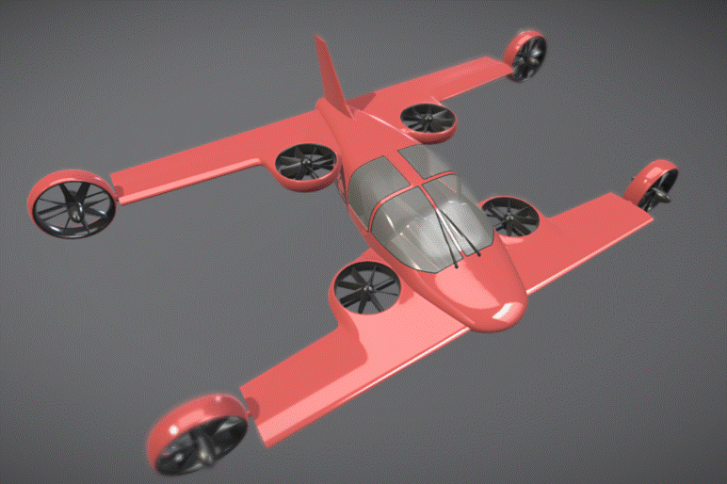
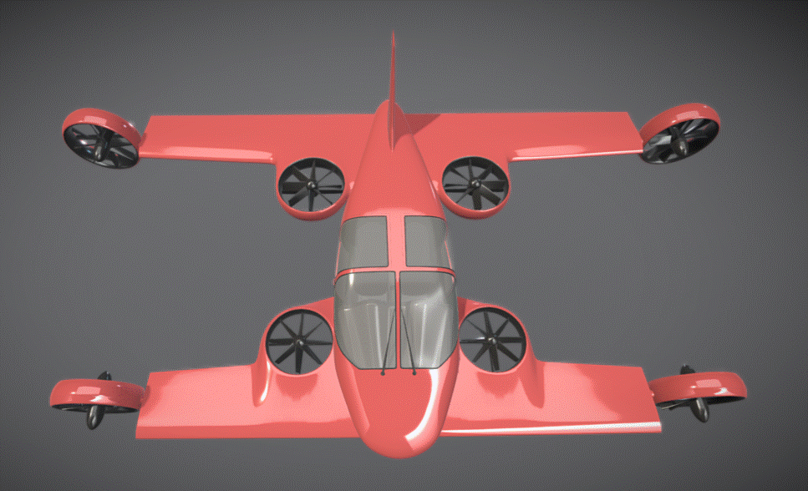
Mini-Bee description
Project state : TRL2
  Electric octocopter : 4 vertical + 4 tilt
  Hybrid energy : fuel + batteries
  2-3 seats
Characteristics :
  VTOL capacity, short wings, 1.2 ton
  Range 600km, max speed 300km/h
  Electric controls and engines
  « Car like » interface
Goals and market
  VIP, Taxi, Air Ambulance
  Estimated price 1m€ (0,7 to 2m€)

Slide 6
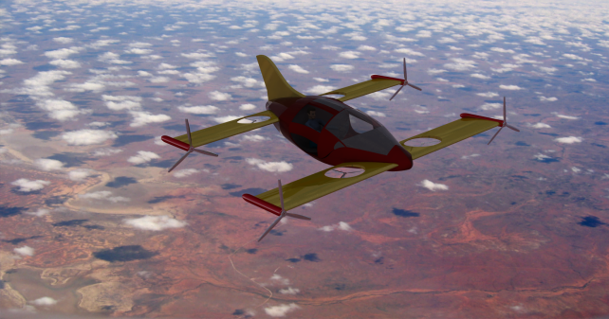
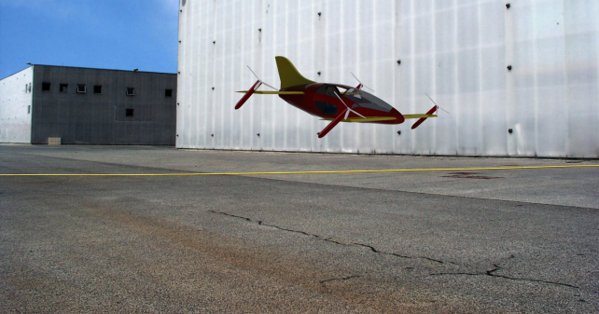
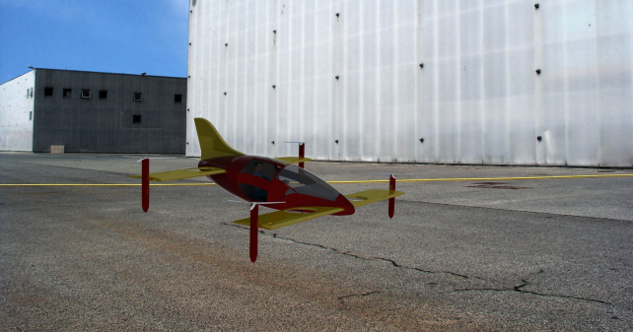
Take-off and flight transition
Cruise flight
Tilt transition
Estaca 2016
Supméca 2016
Vertical take-off

Slide 7
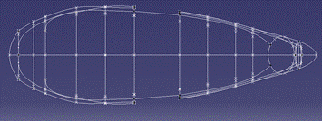

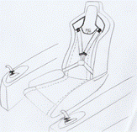
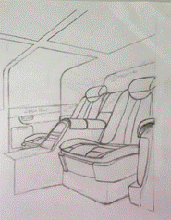
Cabine configurations
Sport
VIP
Ambulance
Taxi
Utilities
1 PAX
2 PAX
3 PAX
4 PAX (light)

Slide 8
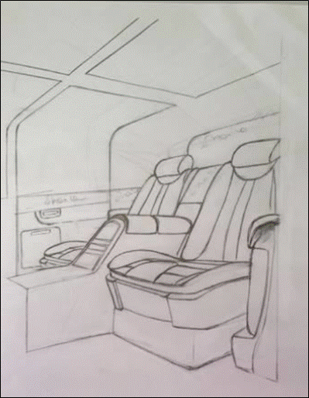
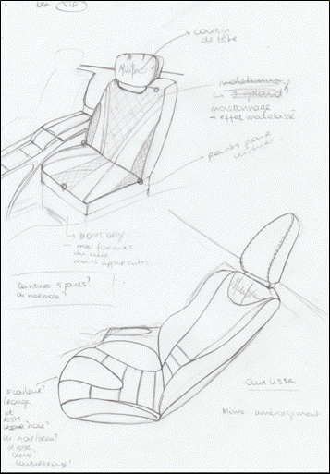
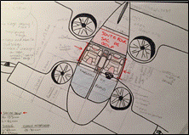
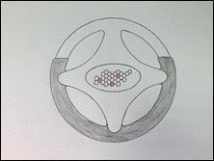
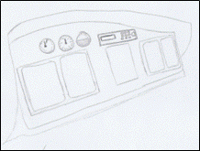
VIP Configuration

Slide 9
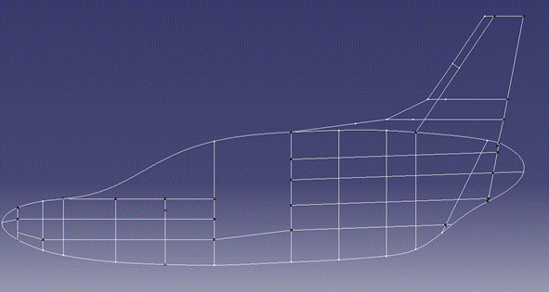
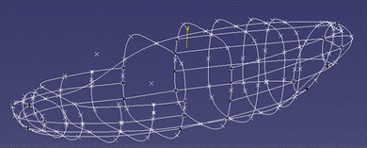
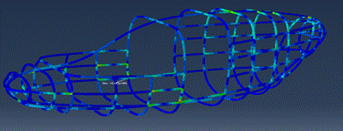
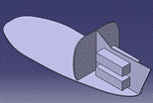
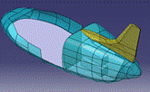
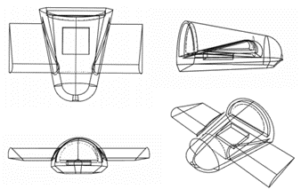
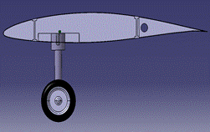
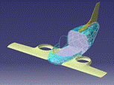
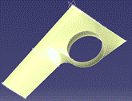
Architecture
Generators
Batteries
Cockpit
Generators
Batteries

Slide 10
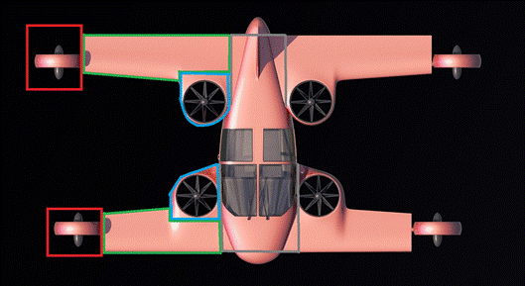
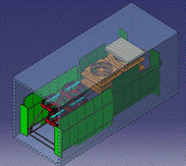
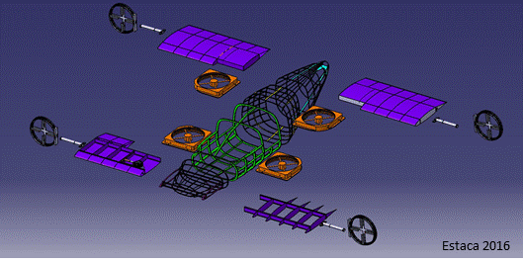
Modular structure
Production, delivery and MRO optimization
Delivery in 20’ Container
Taxi :
VTOL Short intra city
Short wings, high NACA
Vertical central engines
Fixed landing gear
2 main flight configurations
VIP :
VTOL + cruise
Longuer wings
Fuel capacities
Retractable landing gear

Slide 11
Actions for Mini-Bee TRL2 Project
Mini-Bee TRL2 tasks :
  Refine detailled technical and equipement configuration
  Evaluate market opportunities, production and flight costs
  Define partnership for TRL2 and TRL3
  Draw project financial path
  Investigate for lovemoney phase

Slide 12
Financial project path
Detailled numerical mock-up
First flight
Test flights
Final developments
Qualification
Commercialisation / Operations
Estimated overall project 100m€
Actual step : Lovemoney for 500k€ to 2m€

Slide 13
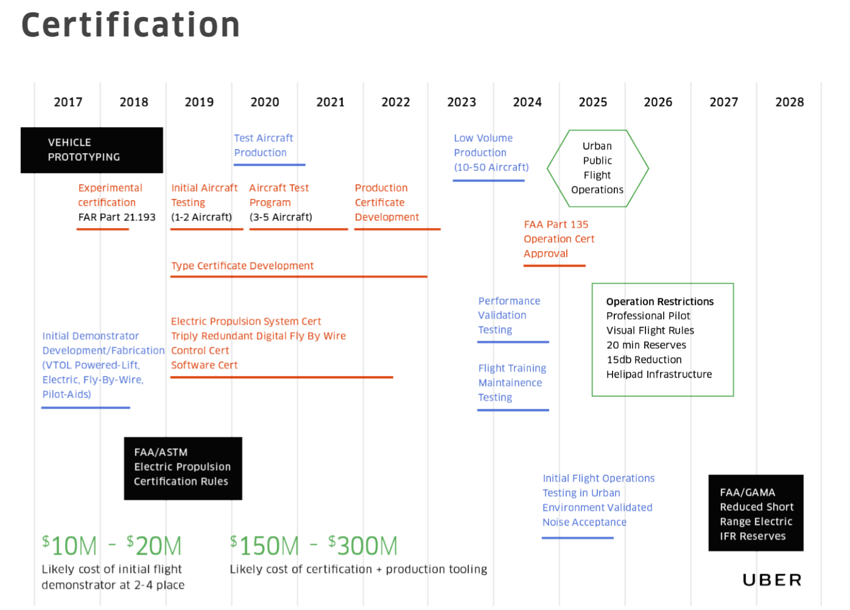
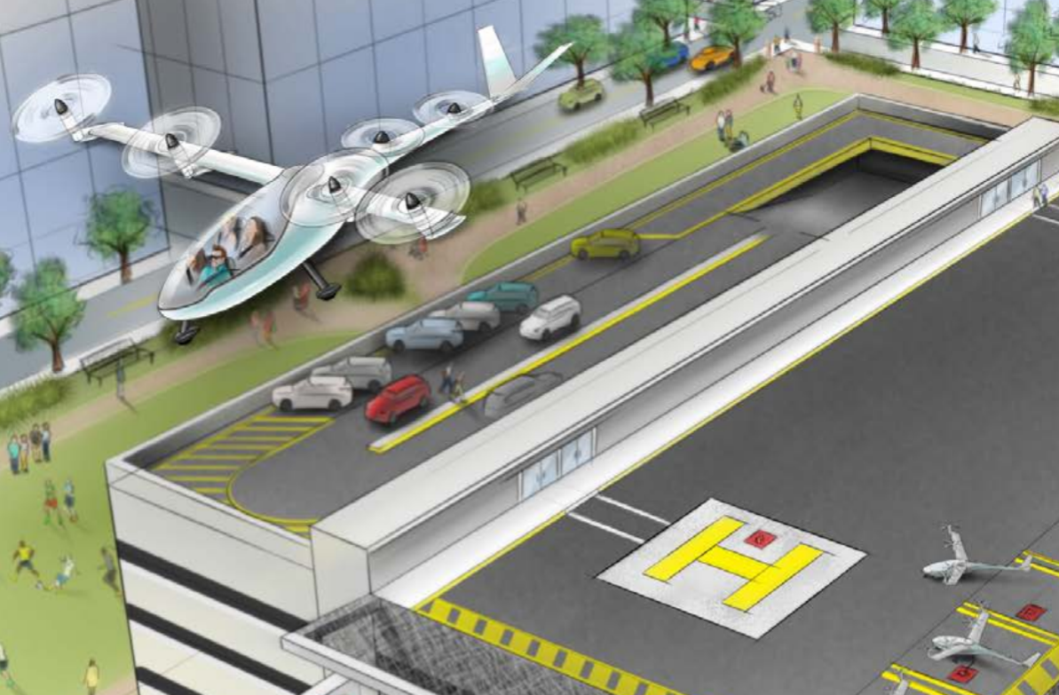
Uber Elevate planning

Slide 14
Annexes
Individual Air Vehicules

Slide 15
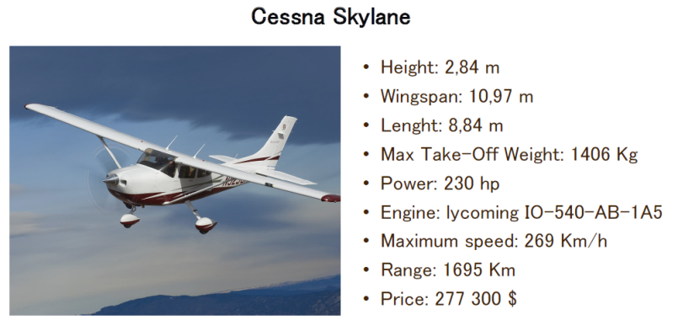
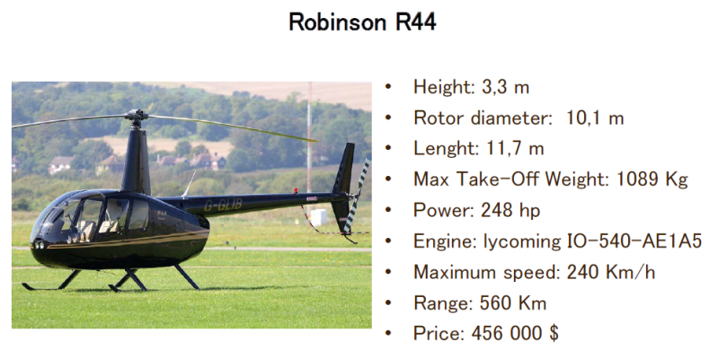
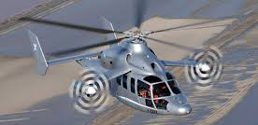
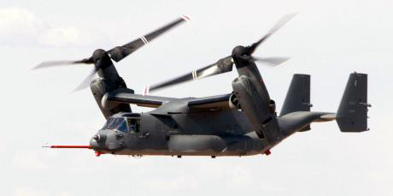
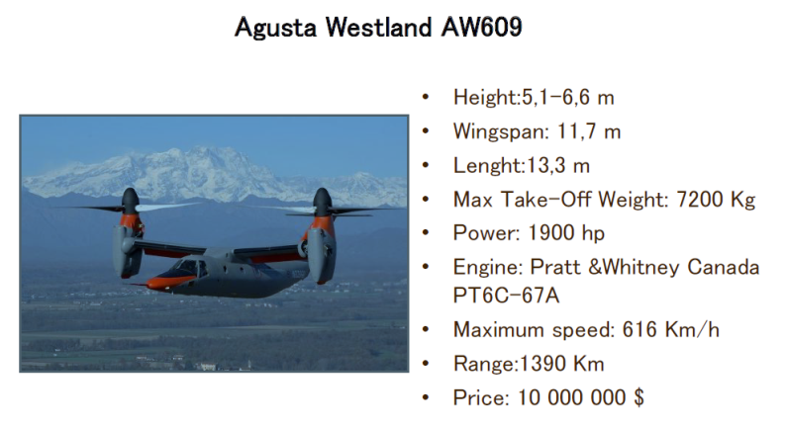
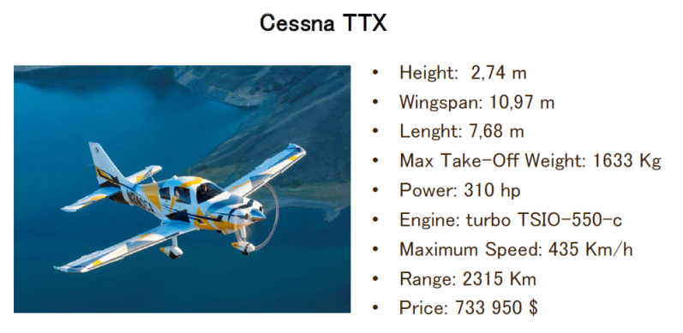
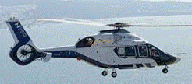
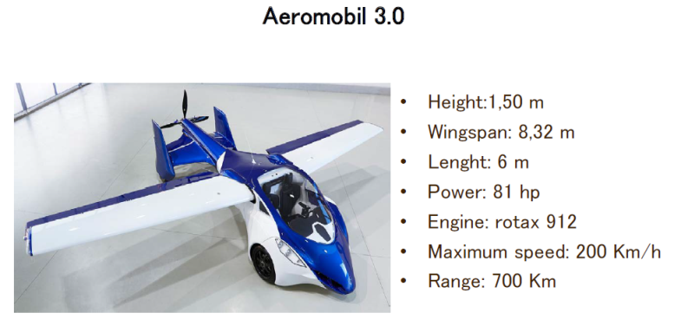
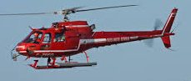
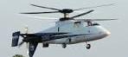
State of the art
X3 airbus
Osprey V22
Airbus H160
Ecureuil
X2

Slide 16
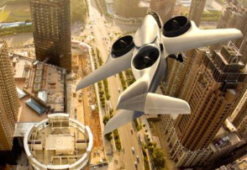
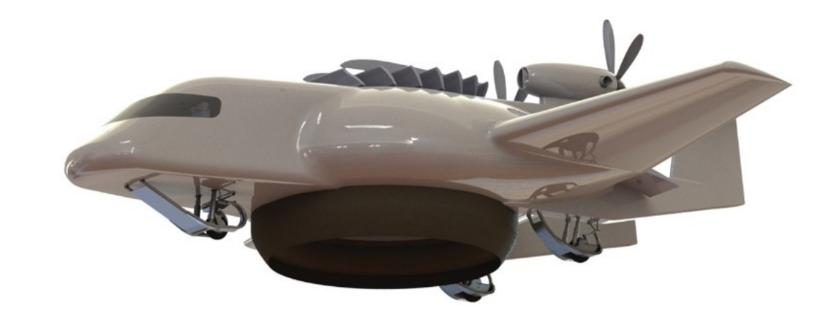
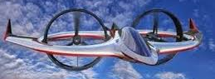
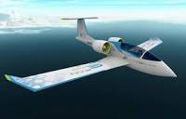
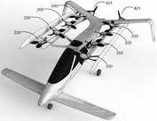
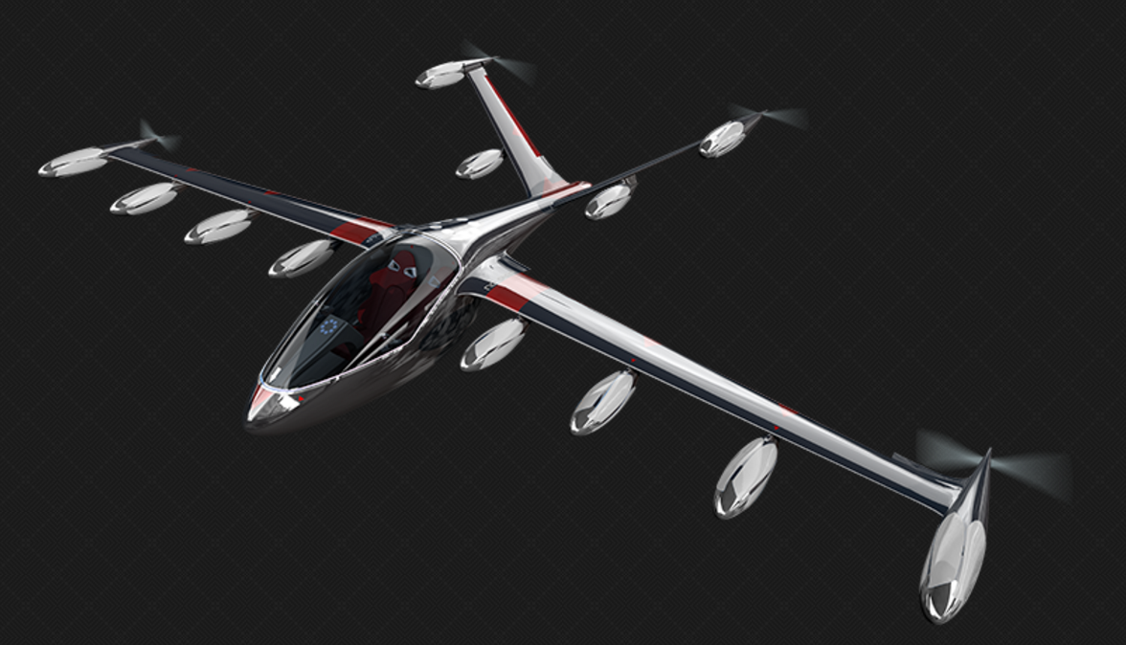
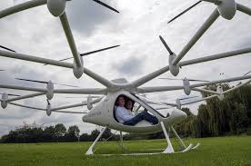
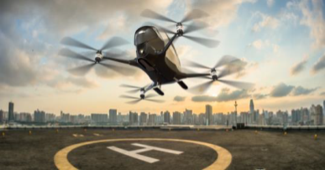
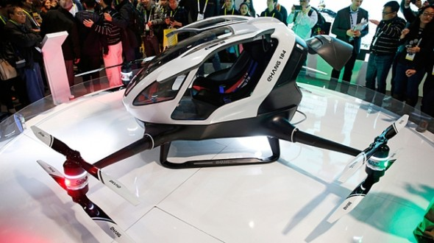
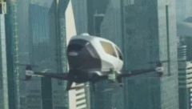
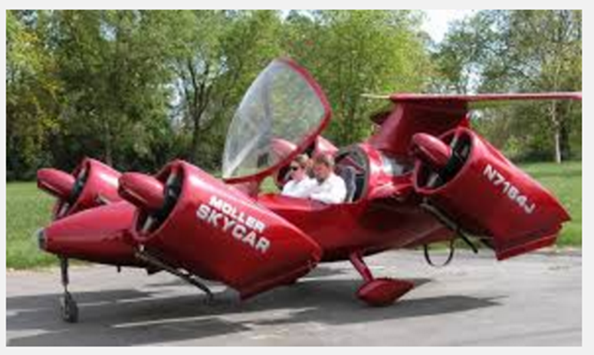











Other innovative projects
Agusta Westland
Zero (2015)
Airbus E-fan (2015)
Trifan 600 XTI (2015)
Helium (2016)
E-volo (<2014)
eHang (fin 2015)
Kitty Hawk (2016)
zee.aero (2016)
Joby (2016) ~ 100m€
Moler skycar (<2016)
Urban aeronautics
(<2016)
Xplorair (2016)
Lilium (2016) ~10m€
Airbus (2016)
Boeing (2016)
SoloTrek Springtail
Macro industrie (2016)
Airbus Vahana (2016)
Olympus (2016)
Mini-Bee (2016)
Trekaero.com

Slide 17


Mini-Bee
2 PAX VIP Hybrid Octocopter
Lesser Open Bee License 1-3

